Slide 1
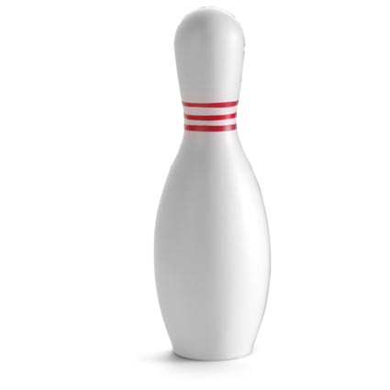
RTI Triangle
Grade/Course/Subject (place)
_____________________________
Curricular Lens:
_____________________________
Competency Lens:
_____________________________
Students who need the most support
Tier 3
Tier 2
Students who need the most challenge
Tier 1
Curricular
Competency

Slide 2
Course/Subject/Grade(s): |  |  |  | Planning Team:
Unit Big Idea: |  |  |  | Unit Guiding Question:
Goals |  | This is what I need to know and do | This is what I must know & do | This is what I can know & do | This is what I could know & do | This is what I can try to know & do
Content:
Curricular Competencies:

Slide 3
Unit Mini Lesson Planner
Course/Subject/Grade(s):
Unit Question:
Mini lessons
Q1 | Competency question:
 | Mini lesson: | Mini lesson: | Mini lesson: | Mini lesson:
 | Content:
Q2 | Competency question:
 | Mini lesson: | Mini lesson: | Mini lesson: | Mini lesson:
 | Content:
Q3 | Competency question:
 | Mini lesson: | Mini lesson: | Mini lesson: | Mini lesson:
 | Content:
Q4 | Competency question:
 | Mini lesson: | Mini lesson: | Mini lesson: | Mini lesson:
 | Content:

Slide 4
Course/Subject/Grade(s): |  |  |  |  | Planning Team:
Unit Guiding Question:
Competency Guiding Question: Mini lesson: |  |  |  |  |  | Supports
Content: | Connect:
 | Process:
 | Transform:
Task(s)
NEED to do… |  | MUST do… | CAN do… | COULD do… |  |  | TRY to do…

