Slide 1
RTI Triangle
Lens:
Tier 3
Tier 2
Tier 1

Slide 2
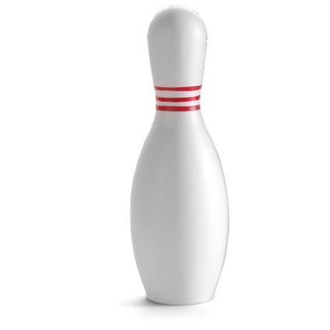
RTI Triangle
Grade/Course/Subject (place)
_____________________________
Lens 1:
_____________________________
Lens 2:
_____________________________
Students who need the most support
Tier 3
Tier 2
Students who need the most challenge
Tier 1
Curricular
Competency

