Slide 1


Slide 2
Thinking back! Looking forward!
What are some big ideas that you remember from our last session?
What have you tried since out last session?
What did you notice?
What questions are coming up?

Slide 3
Today
Review
Building Classroom Support Plans
Curriculum Design

Slide 4
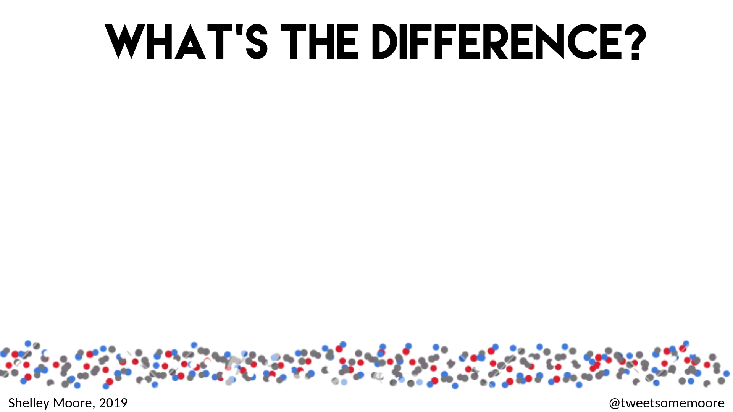
Curriculum
Students

Slide 5
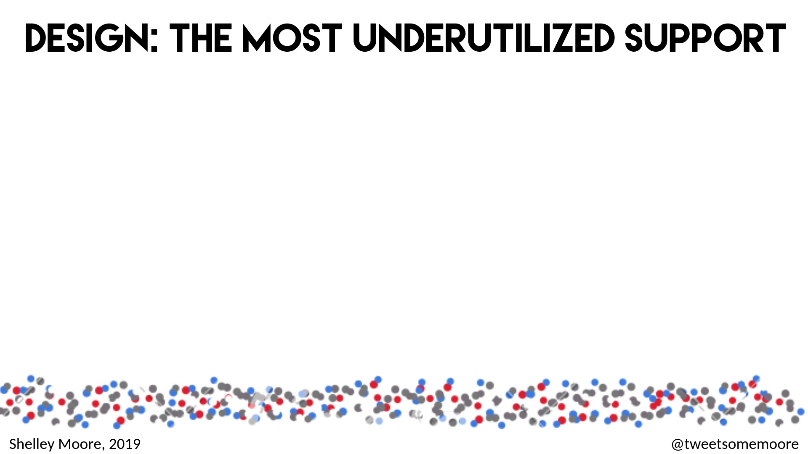
Design
Curriculum
Students
Curriculum

Slide 6
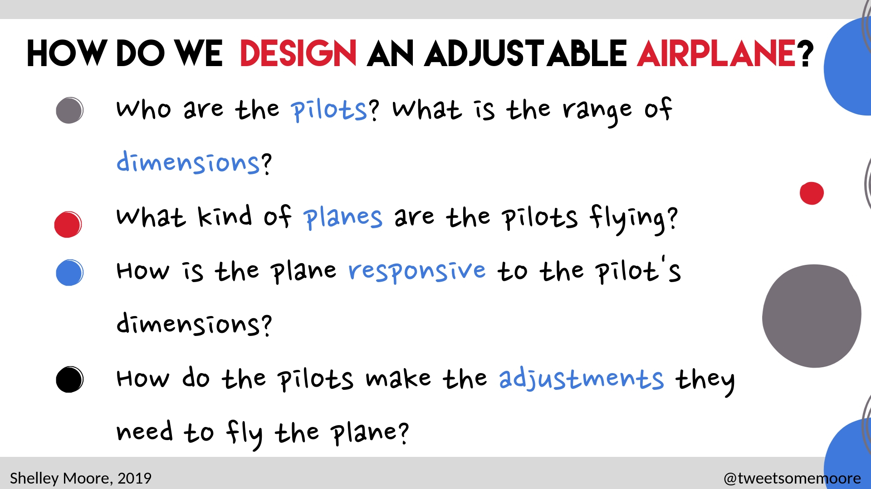

Slide 7
How can we design an adjustable curriculum?
Who are our Learners?
Getting to know who are learners are and their their range of diversity
What is the curriculum we are using?
Designing curriculum with goals in mind (e.g. math, reading, behaviour, home Ec, etc.)
How is the curriculum responsive to the learners?
Designing curriculum with both access and challenge as well as considering specific supports needed for this group of learners
How are we teaching students to make the adjustments they need to use the curriculum?
Students knowing what they need to fit into and use the curriculum
2018 Summer Institute for Inclusive Learning
Shelley Moore, 2018

Slide 8
Educational Architects:
Designing with Equity in Mind
What are we teaching?
Curriculum Design
Instructional Design
Universal Design for Learning
Adjustable
Curriculum
Adjustable
Assessment
Students
Who are we Teaching?
Adjustable
Supports
How will we support them?
How will we teach them?

Slide 9
Educational Architects:
Designing with Equity in Mind
What are we teaching?
Curriculum Design
Instructional Design
Universal Design for Learning
Adjustable
Curriculum
Adjustable
Assessment
Students
Who are we Teaching?
Adjustable
Supports
How will we support them?
How will we teach them?

Slide 10

Class Review for: ___________________
Teacher(s): _________________________
(adapted from Brownlie & King, 2000)
Interests
Classroom Strengths
Classroom Stretches
Class Wide Structures
Class Wide Goals/ Competencies
Individual Considerations
Medical
Language
Learning
Socio-Emotional
Other
www.fivemooreminutes.com
Episode 4 Strategy
Shelley Moore, 2018

Slide 11
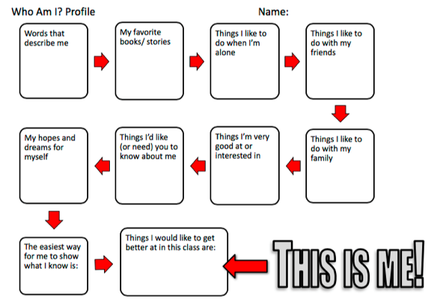

Slide 12
Who are our pilots? What do they bring?
WHO
are we?
instruction
Response to Intervention

Slide 13

RTI Triangle
Lens:
Who needs
the most
support?
Tier 3
Intensity of support
Number of people
Tier 2
Who need the most challenge?
Tier 1
Inclusion Planning Workshop Shelley Moore 2017

Slide 14
RTI Triangle
Lens: Science 10
Rocky
Keelor
Tier 3
Keisha
Jordyn
Jamie
Johnny
Sarah
Michael
Raven
Colten
Tier 2
Reece
Joel
Rae Josh H. Adam K.
Kyle
Isaiah
Tier 1
Kaitlyn Blake Jared Josh N. Nick C.
Co-planning for All Shelley Moore 2013

Slide 15
RTI Triangle: Kindergarten
Lens: Math/Creative thinking
Jade
Breanna
Kim
Tier 3
Content: Number Sense
Competency: Creative thinking
Jade
Sara Jennilyn
Aiden Breanna
Kim Kayl Kelly Nadia Aida Sam Maria Megan Jackson
Site Caden Breann Rache Annabel Johnathan Ethan
Kendra Alyssa
Eric
Tier 2
Site Caden Breann Rache Annabel Johnathan Ethan
Kendra Alyssa
Eric Z
Joanna Monica
Alexandria
Sara Jennilyn
Aiden Breanna
Kim Kayl Kelly Nadia Aida Sam Maria Megan Jackson
Monica
Alexandria
Tier 1
Co-planning for All Shelley Moore 2016

Slide 16
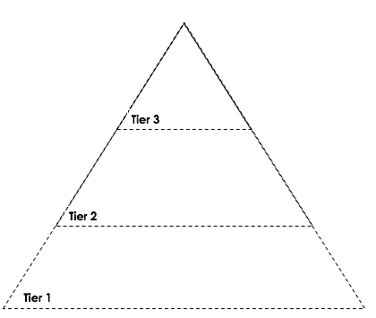
Literacy
Numeracy
Behaviour
Social Emotional

Slide 17


Slide 18
Educational Architects:
Designing with Equity in Mind
What are we teaching?
Curriculum Design
Instructional Design
Universal Design for Learning
Adjustable
Curriculum
Adjustable
Assessment
Students
Who are we Teaching?
Adjustable
Supports
How will we support them?
How will we teach them?

Slide 19
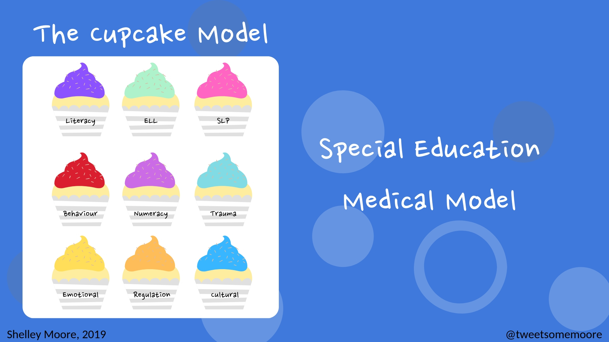

Slide 20
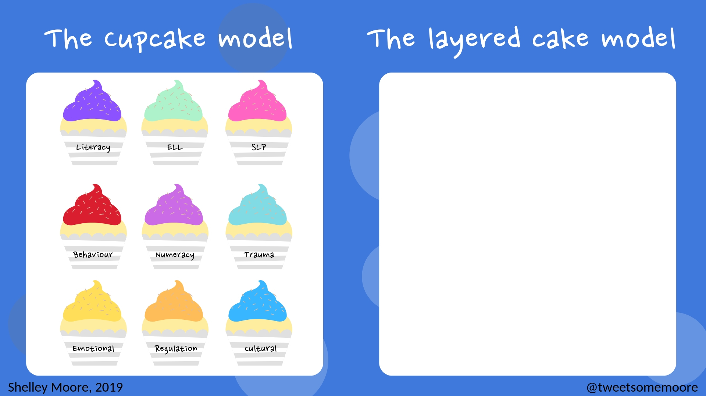

literacy
numeracy
trauma
behaviour
SLP
cultural

Slide 21
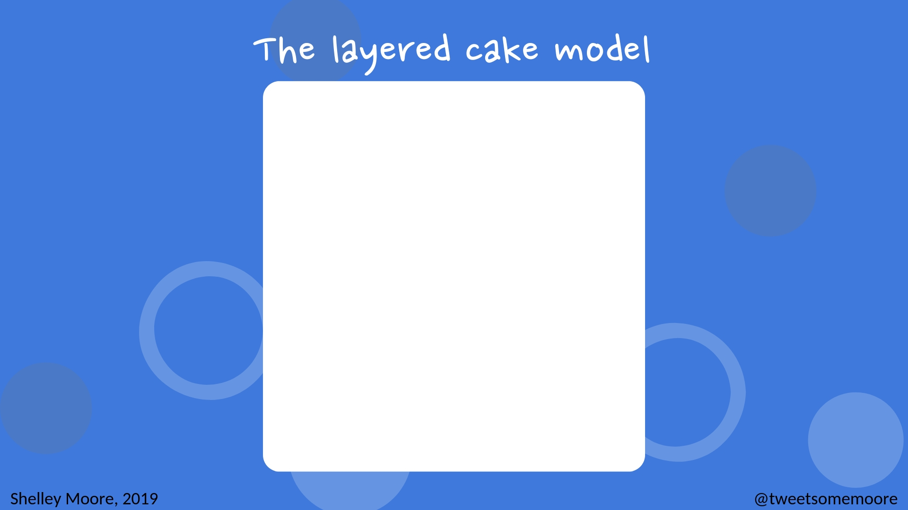
literacy
numeracy
trauma
behaviour
SLP
cultural

Slide 22
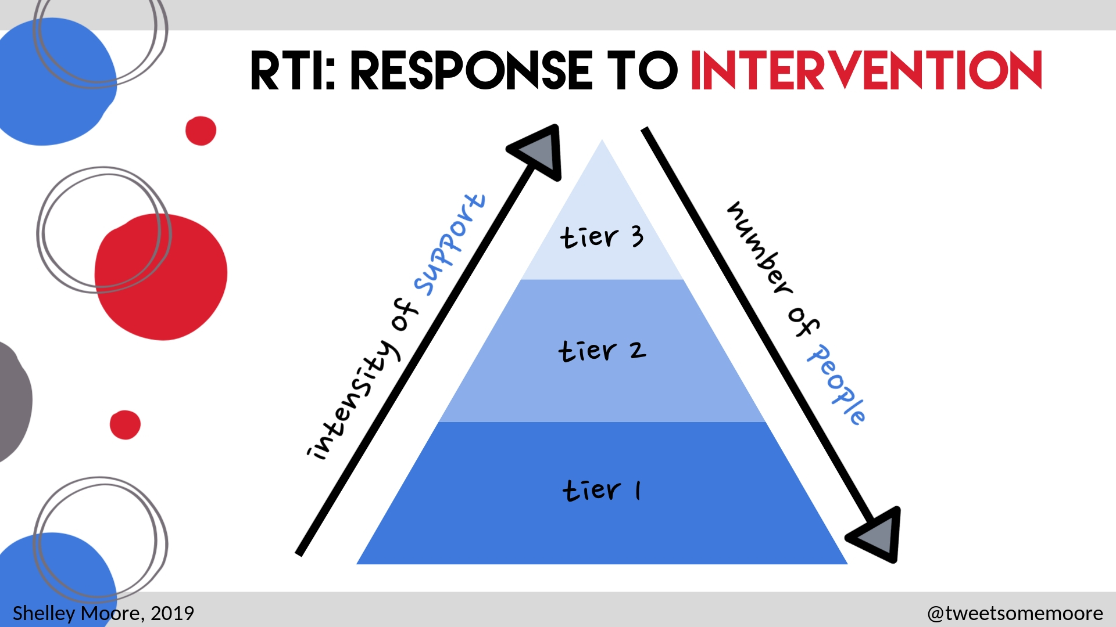

Slide 23
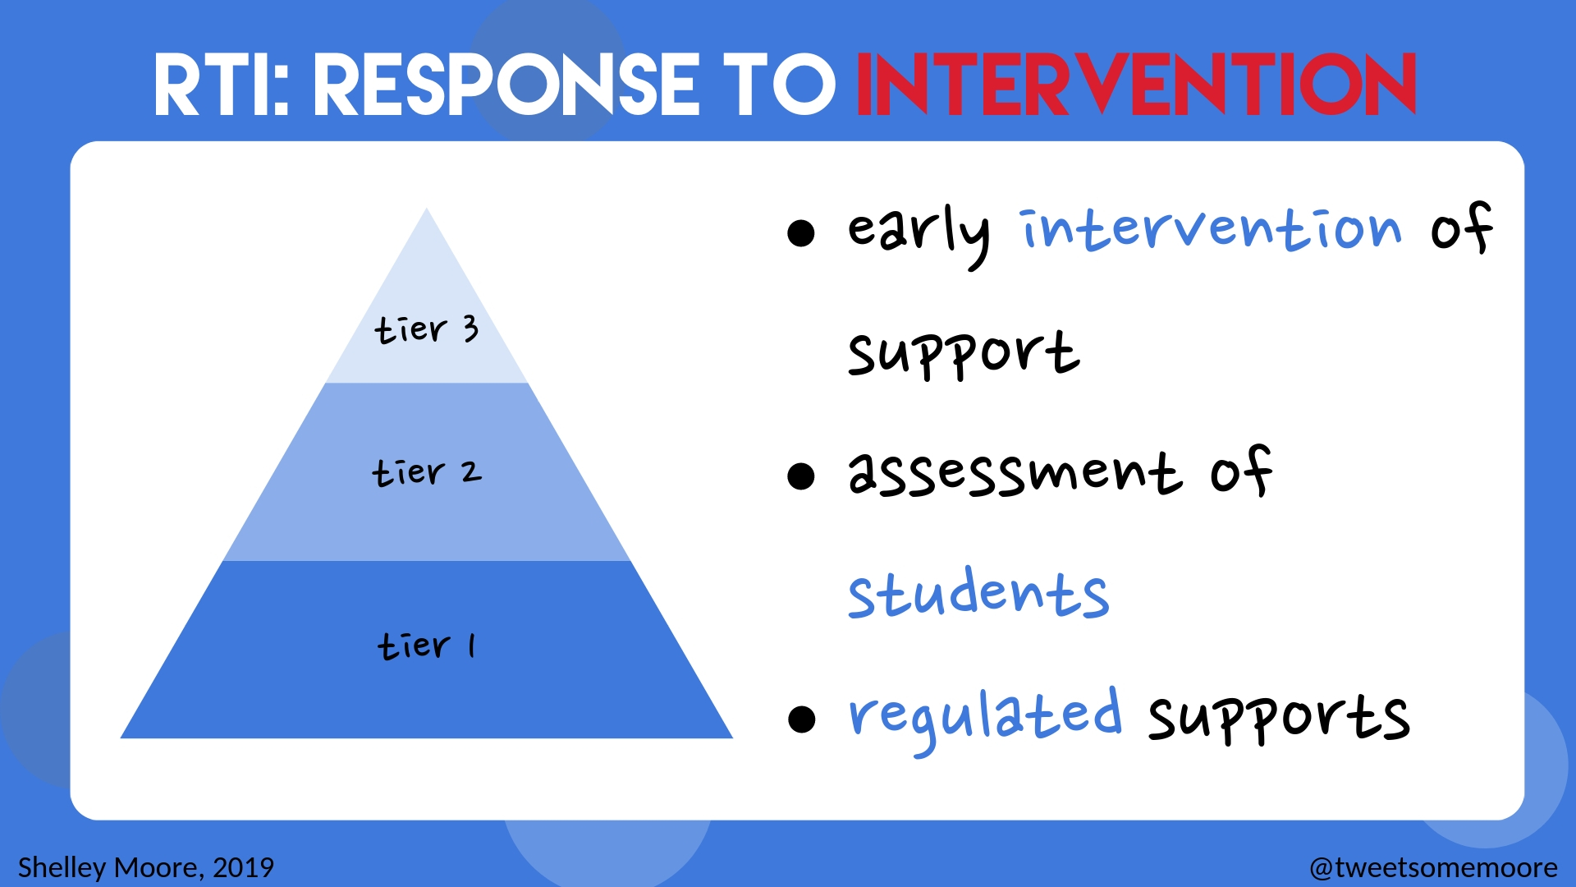

Slide 24
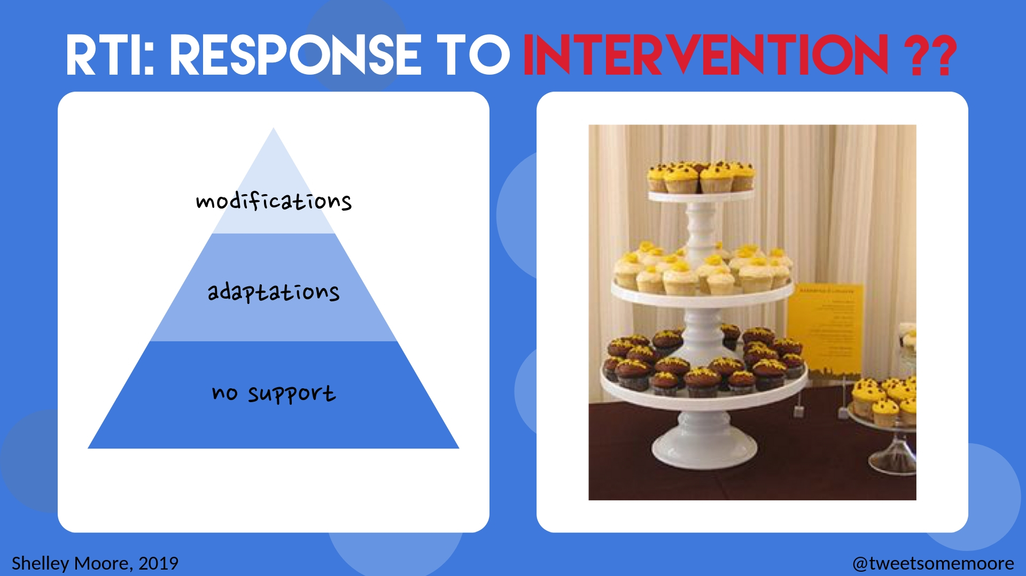

Slide 25
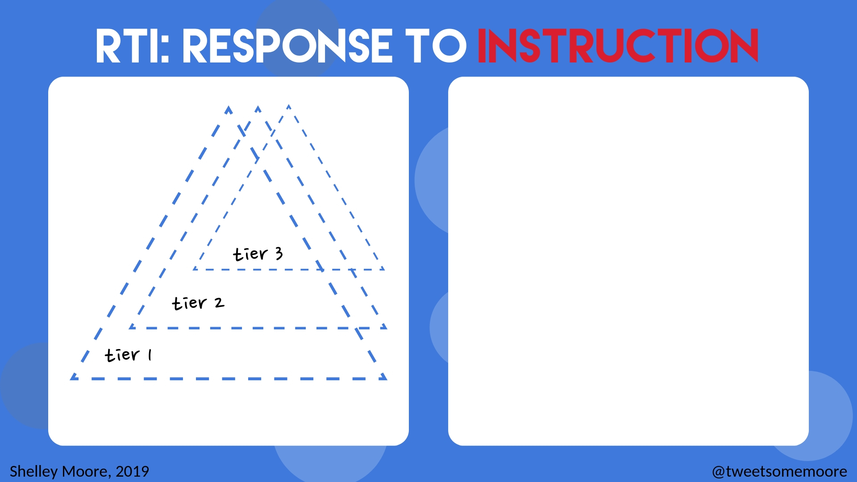
literacy
numeracy
trauma
behaviour
SLP
cultural

Slide 26
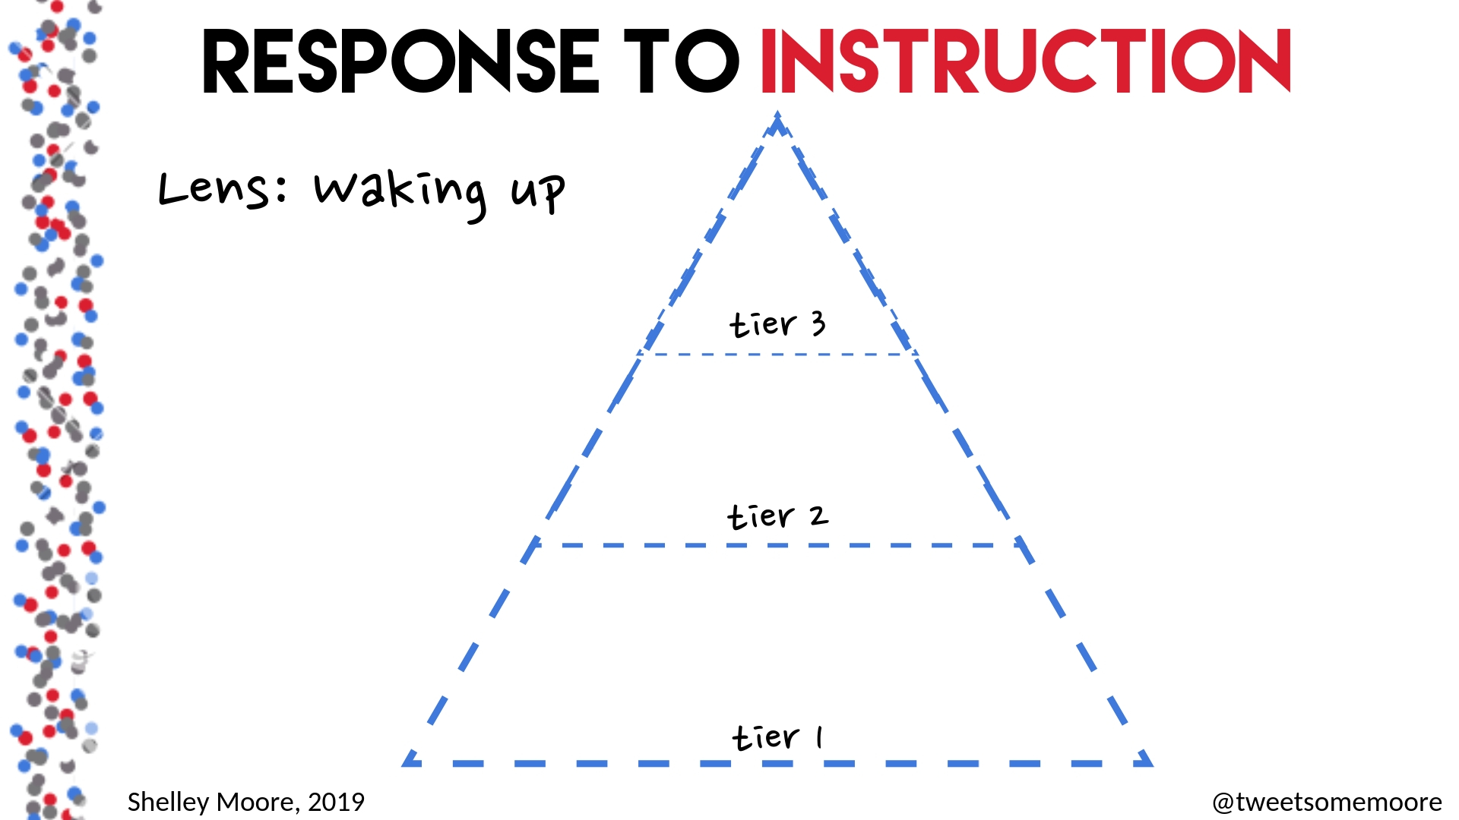

Slide 27
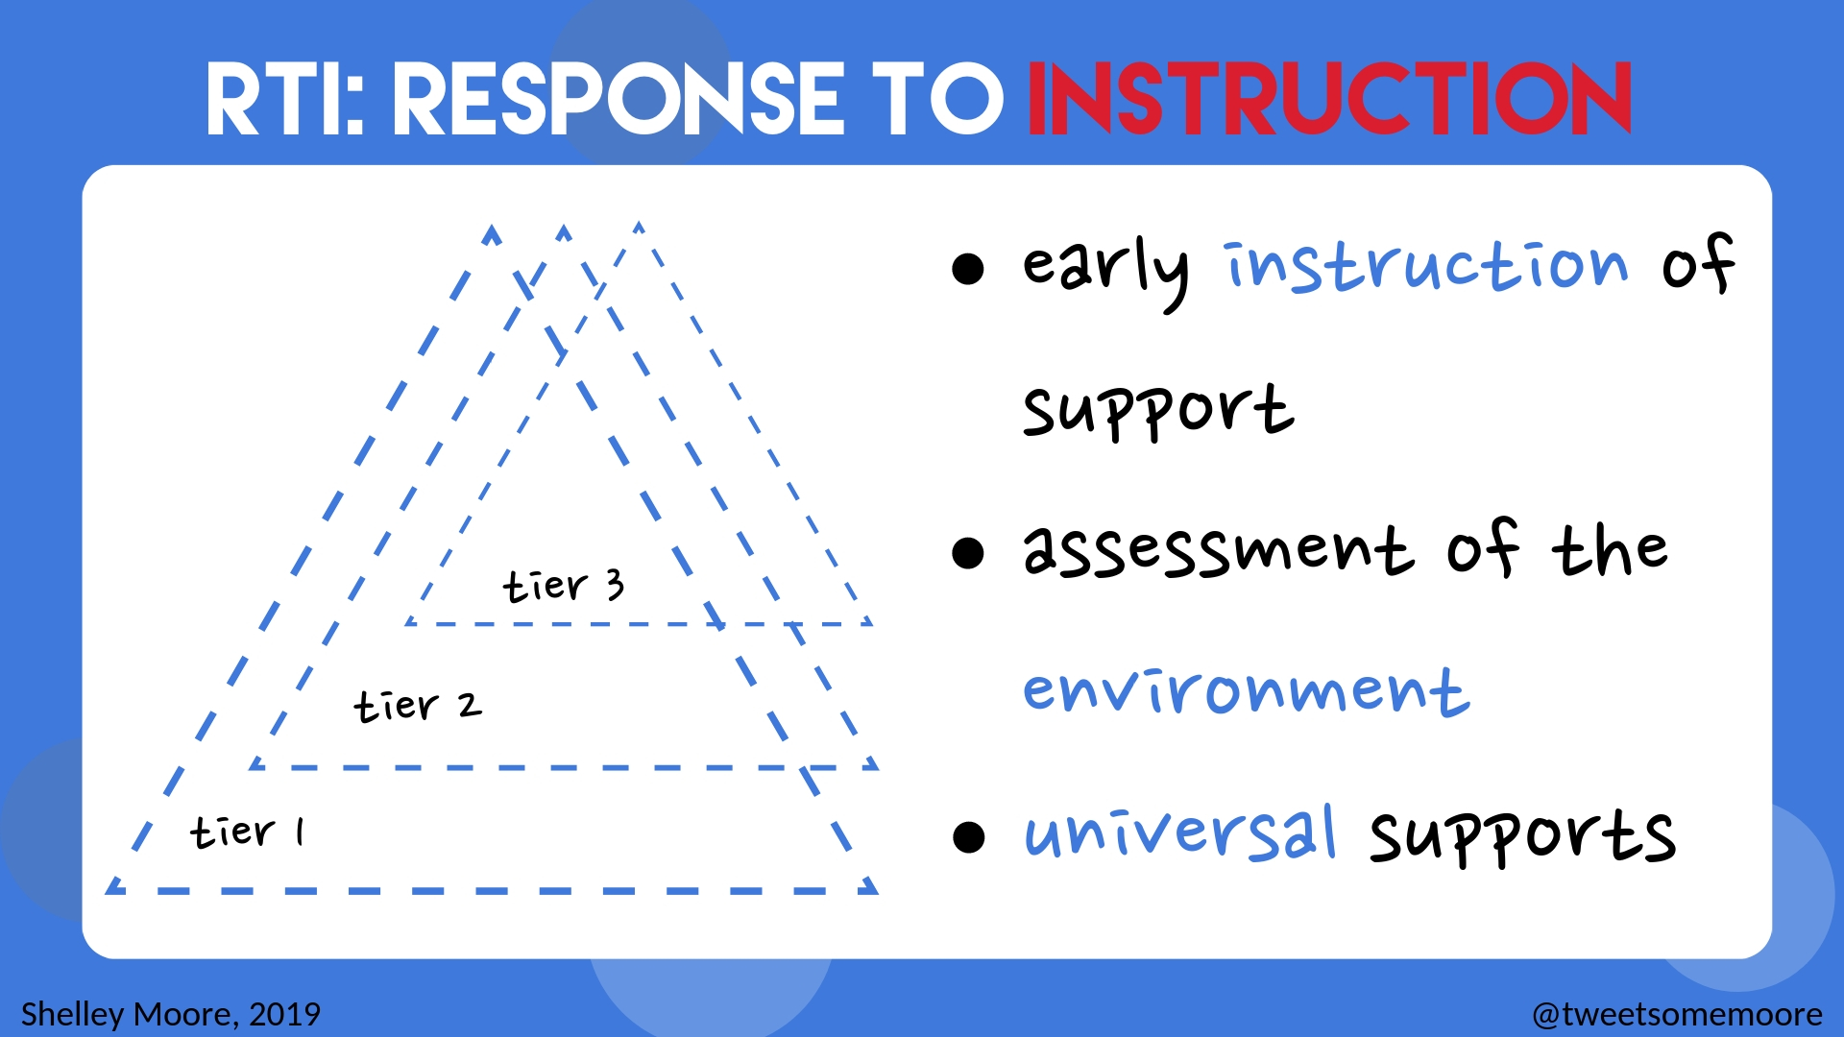

Slide 28
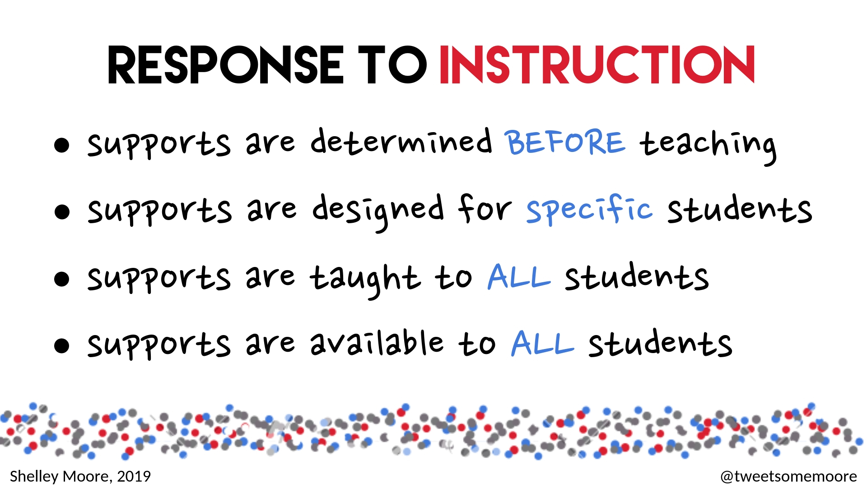

Slide 29
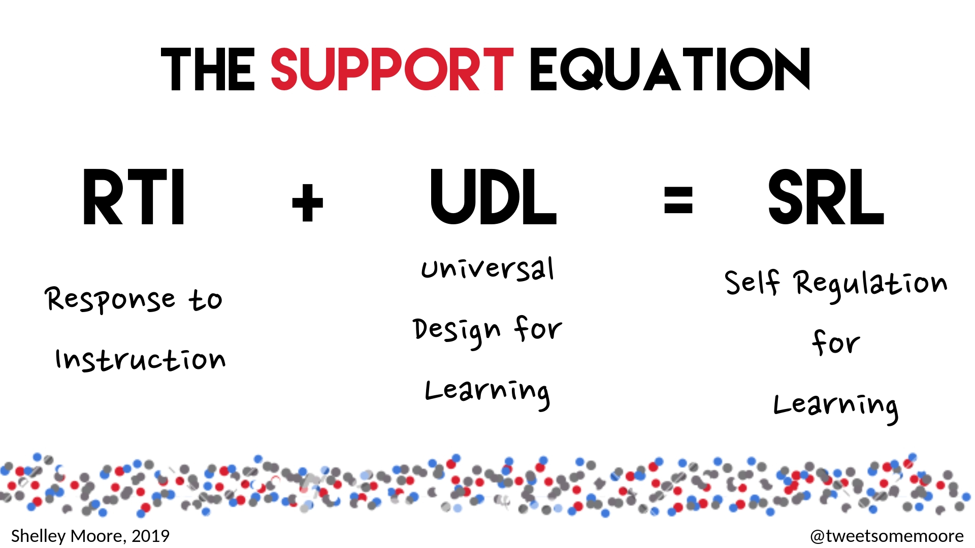

Slide 30
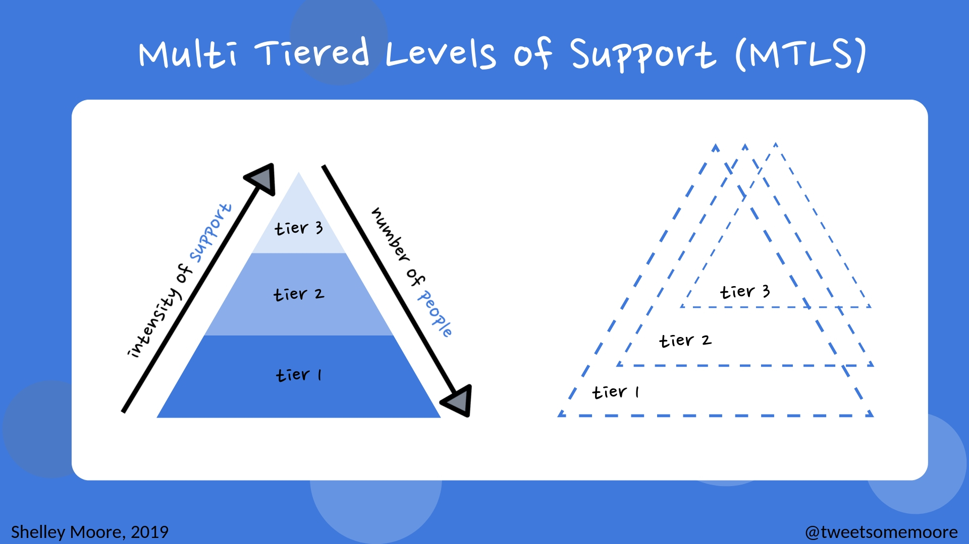

Slide 31


Slide 32
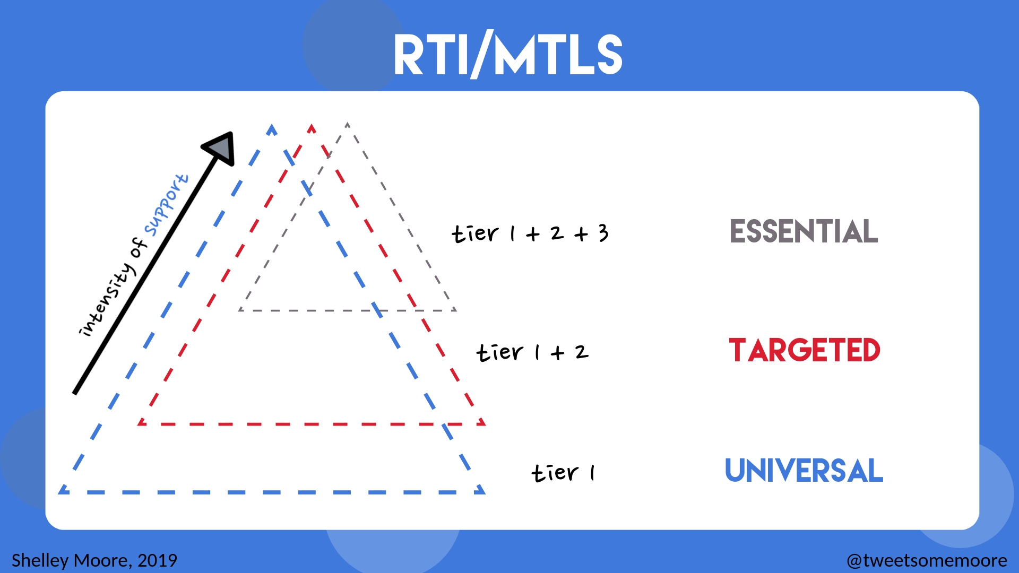

Slide 33
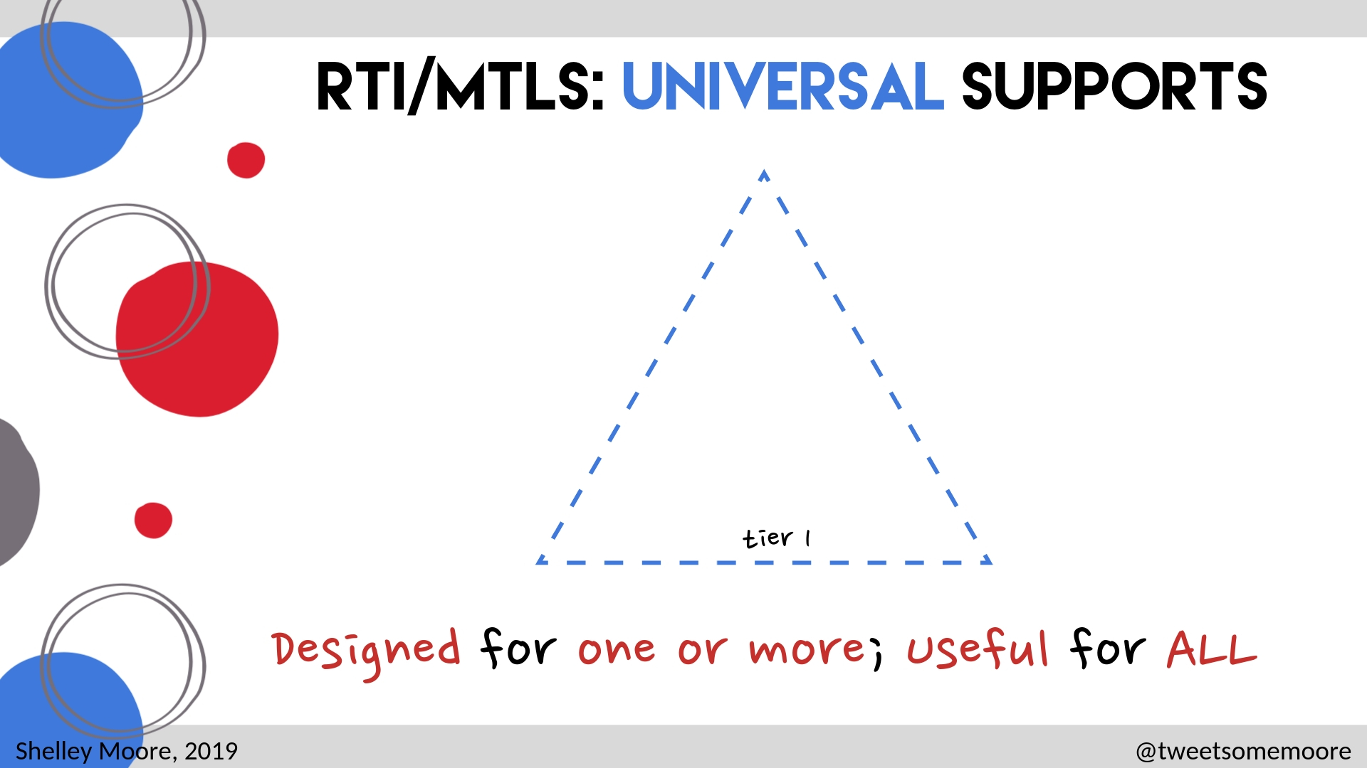

Slide 34
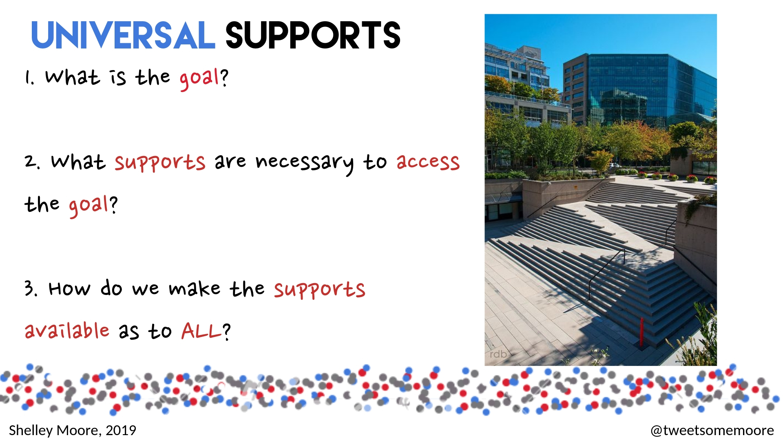

Slide 35
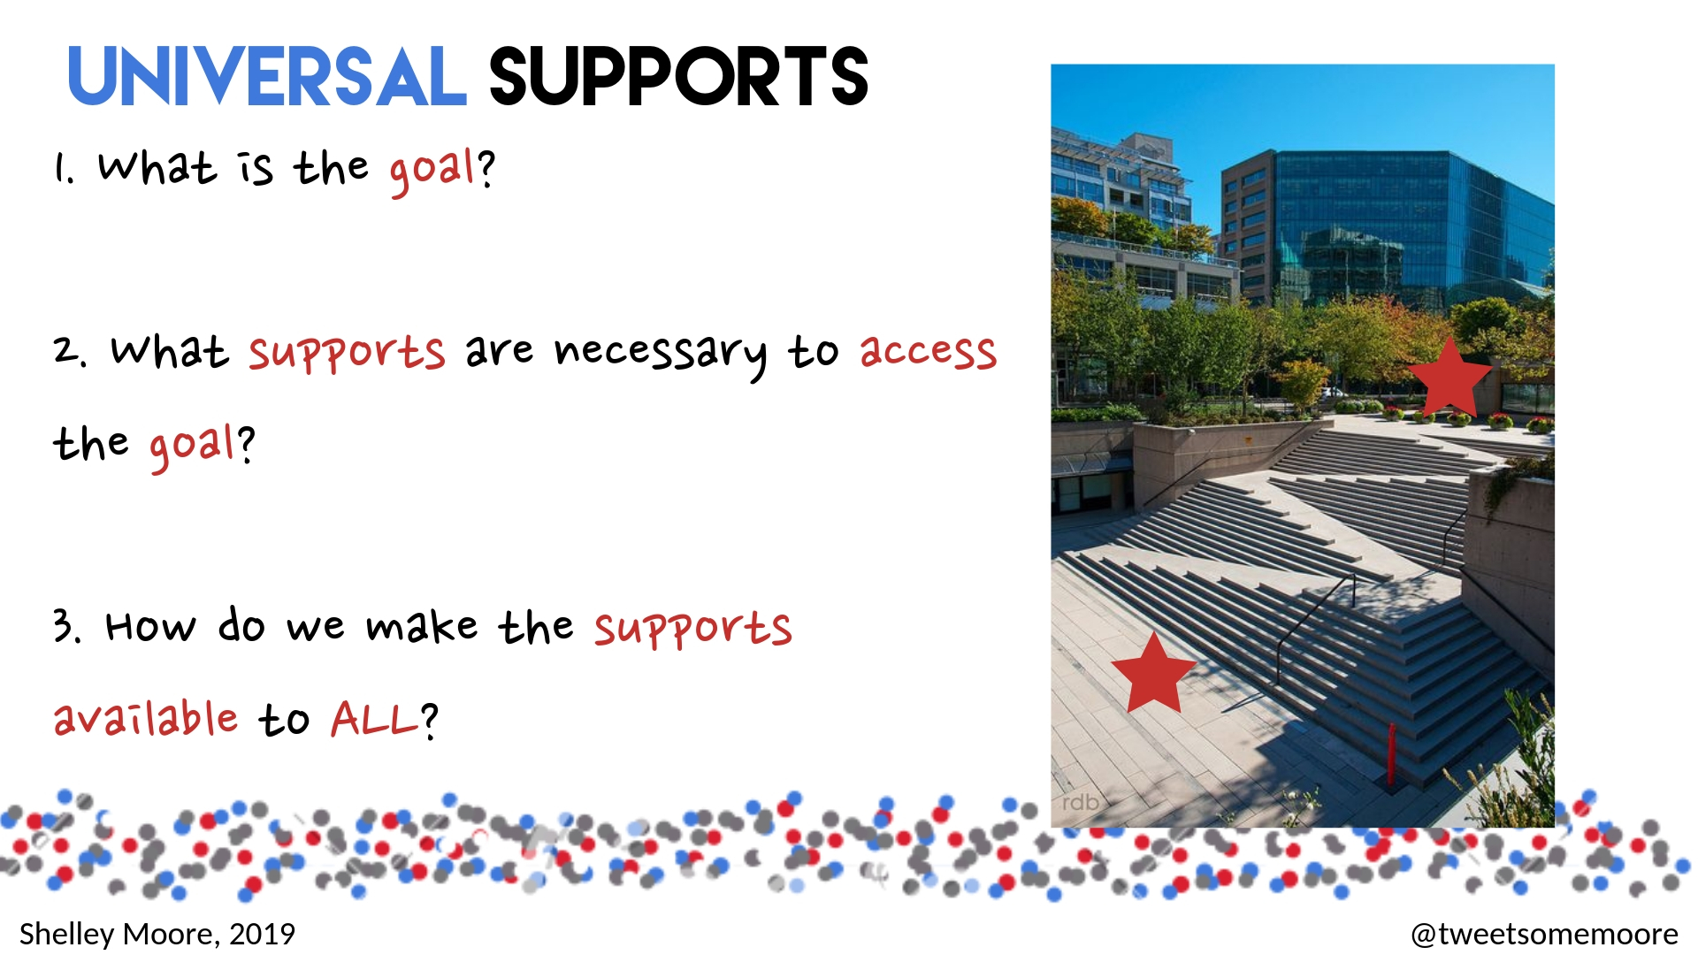

Slide 36


Slide 37
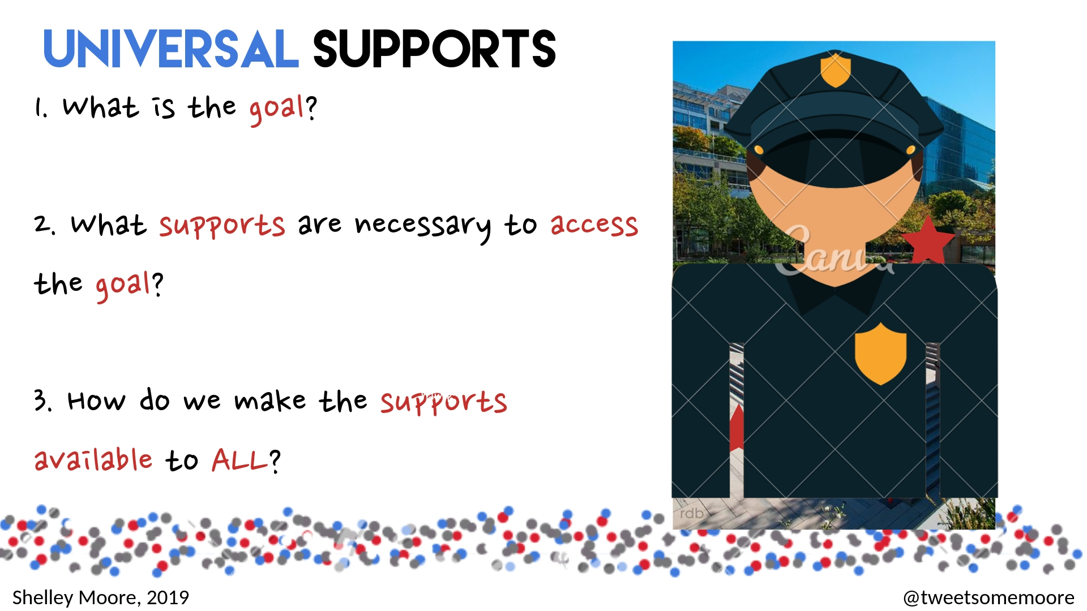

Slide 38
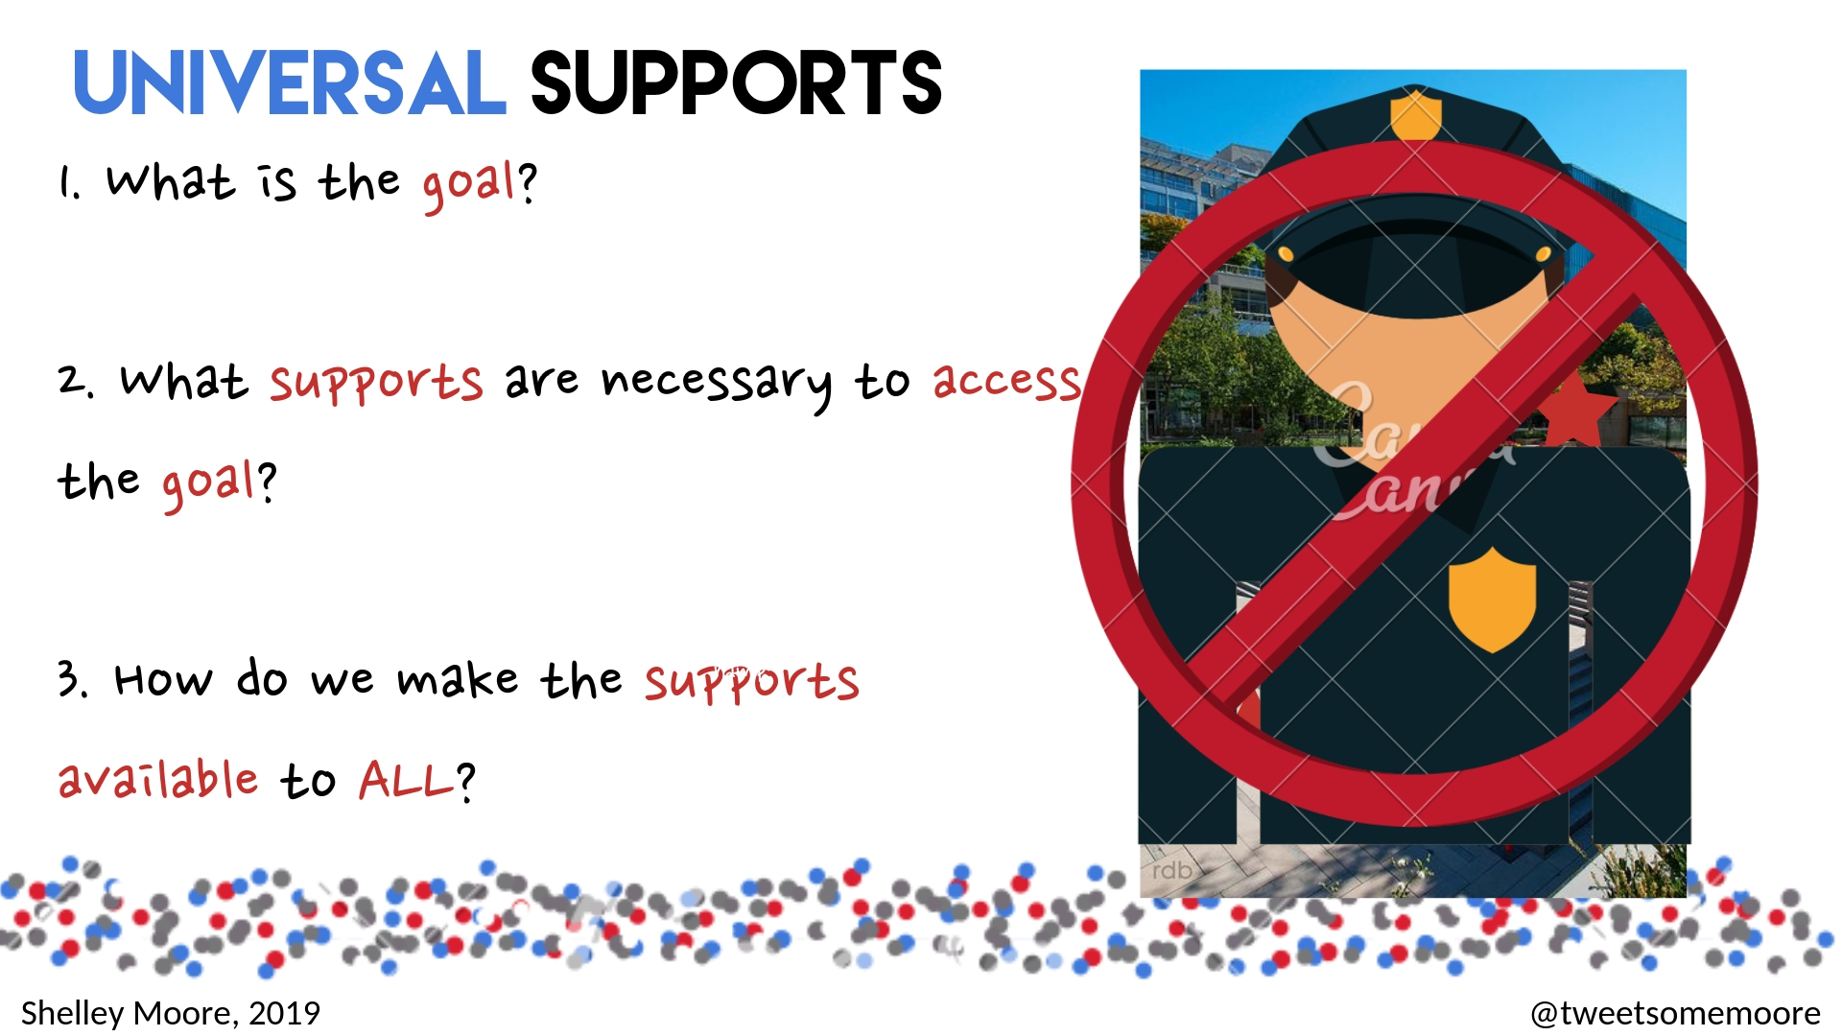

Slide 39
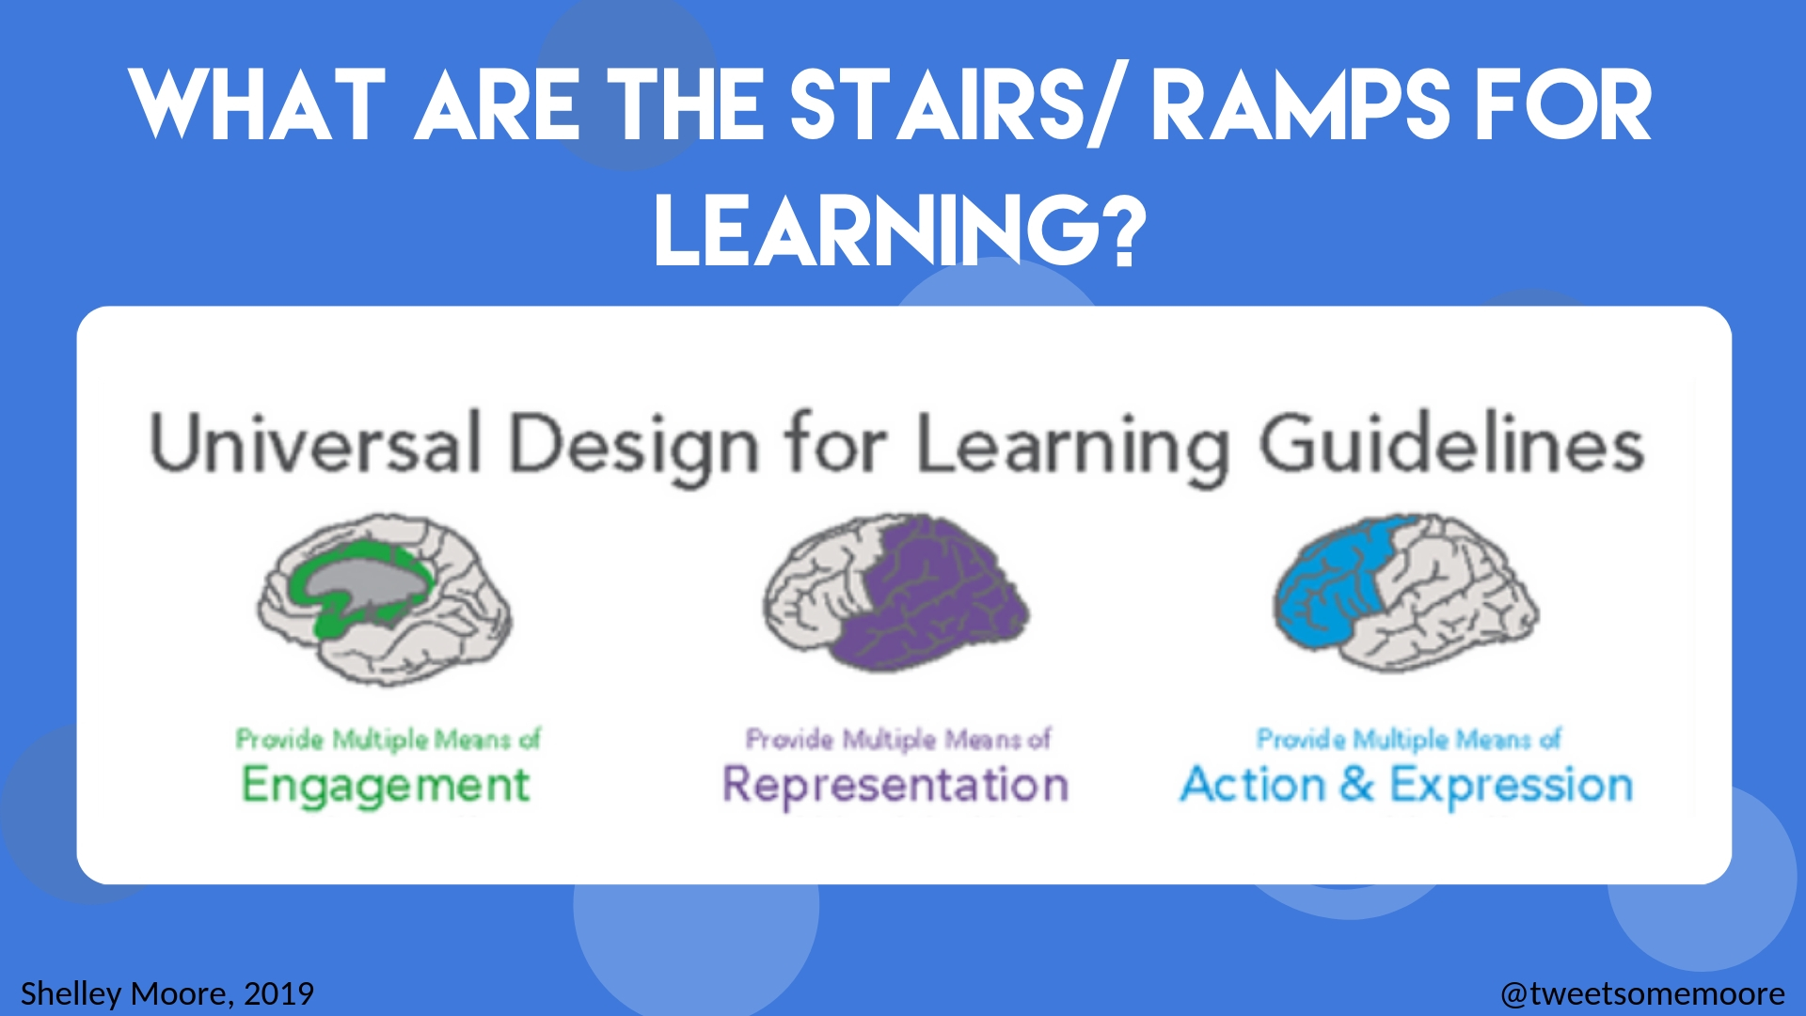

Slide 40


Slide 41
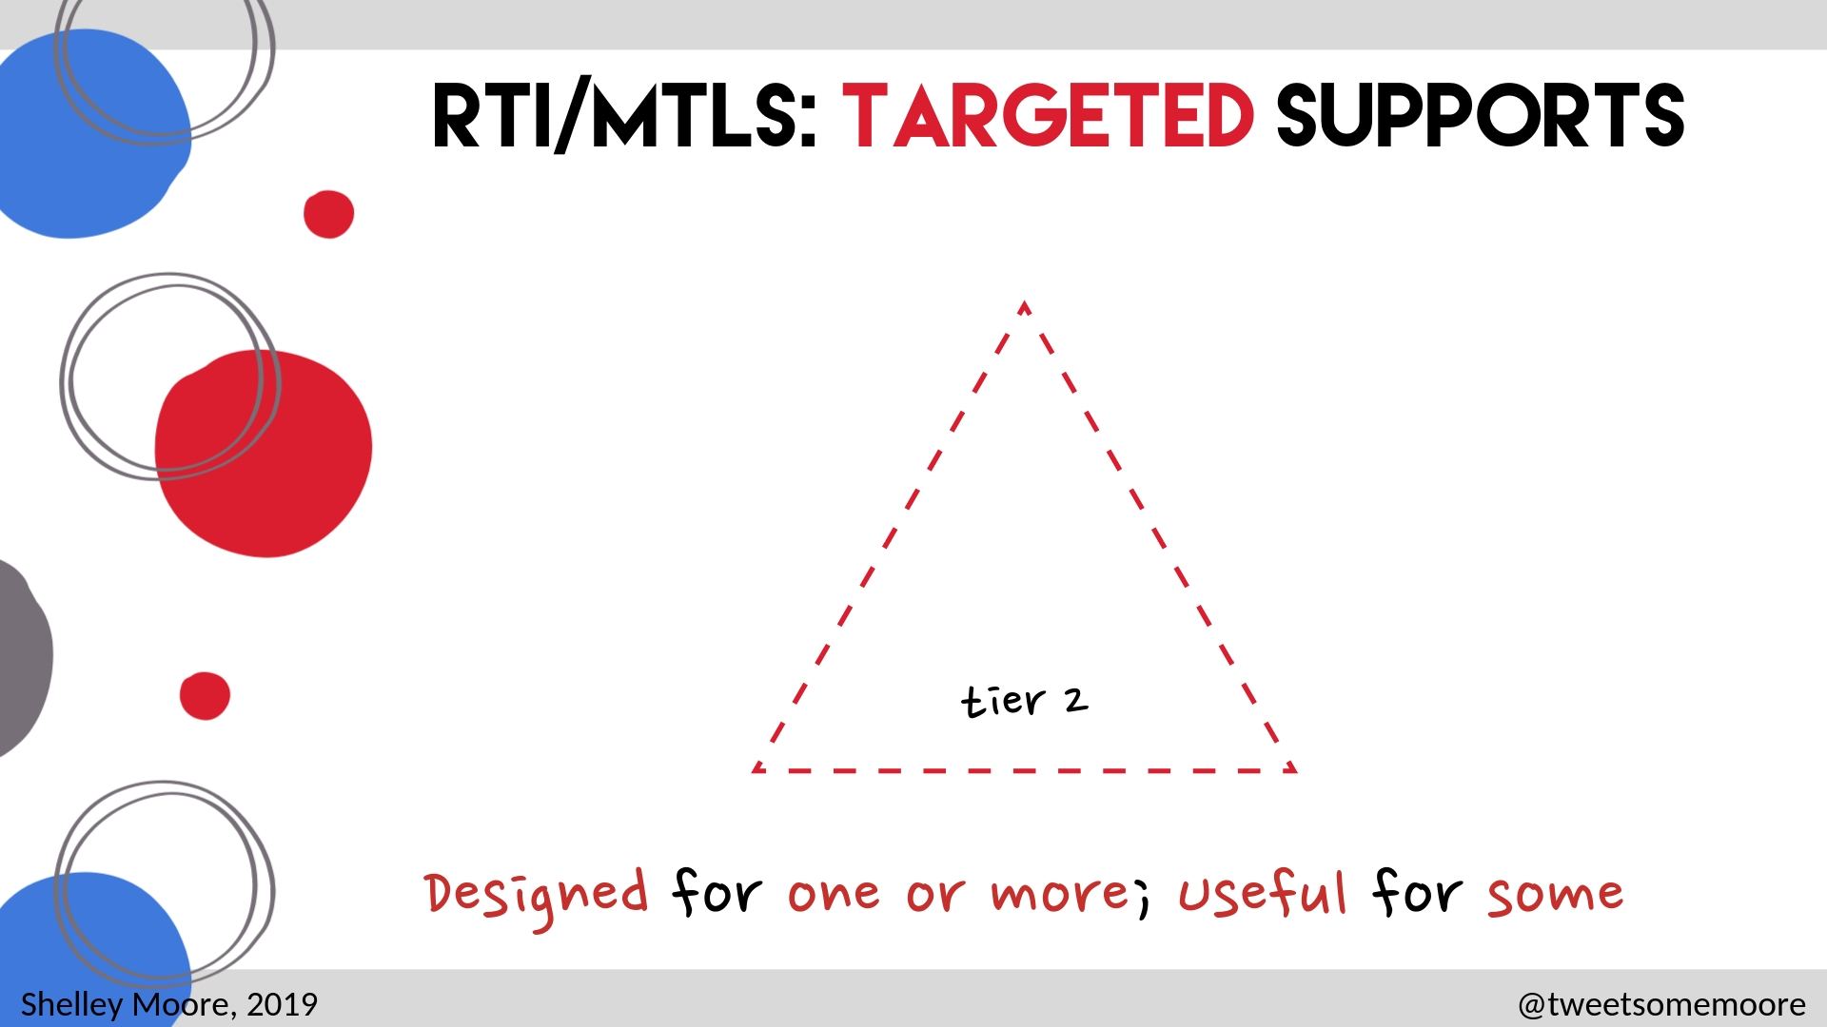

Slide 42
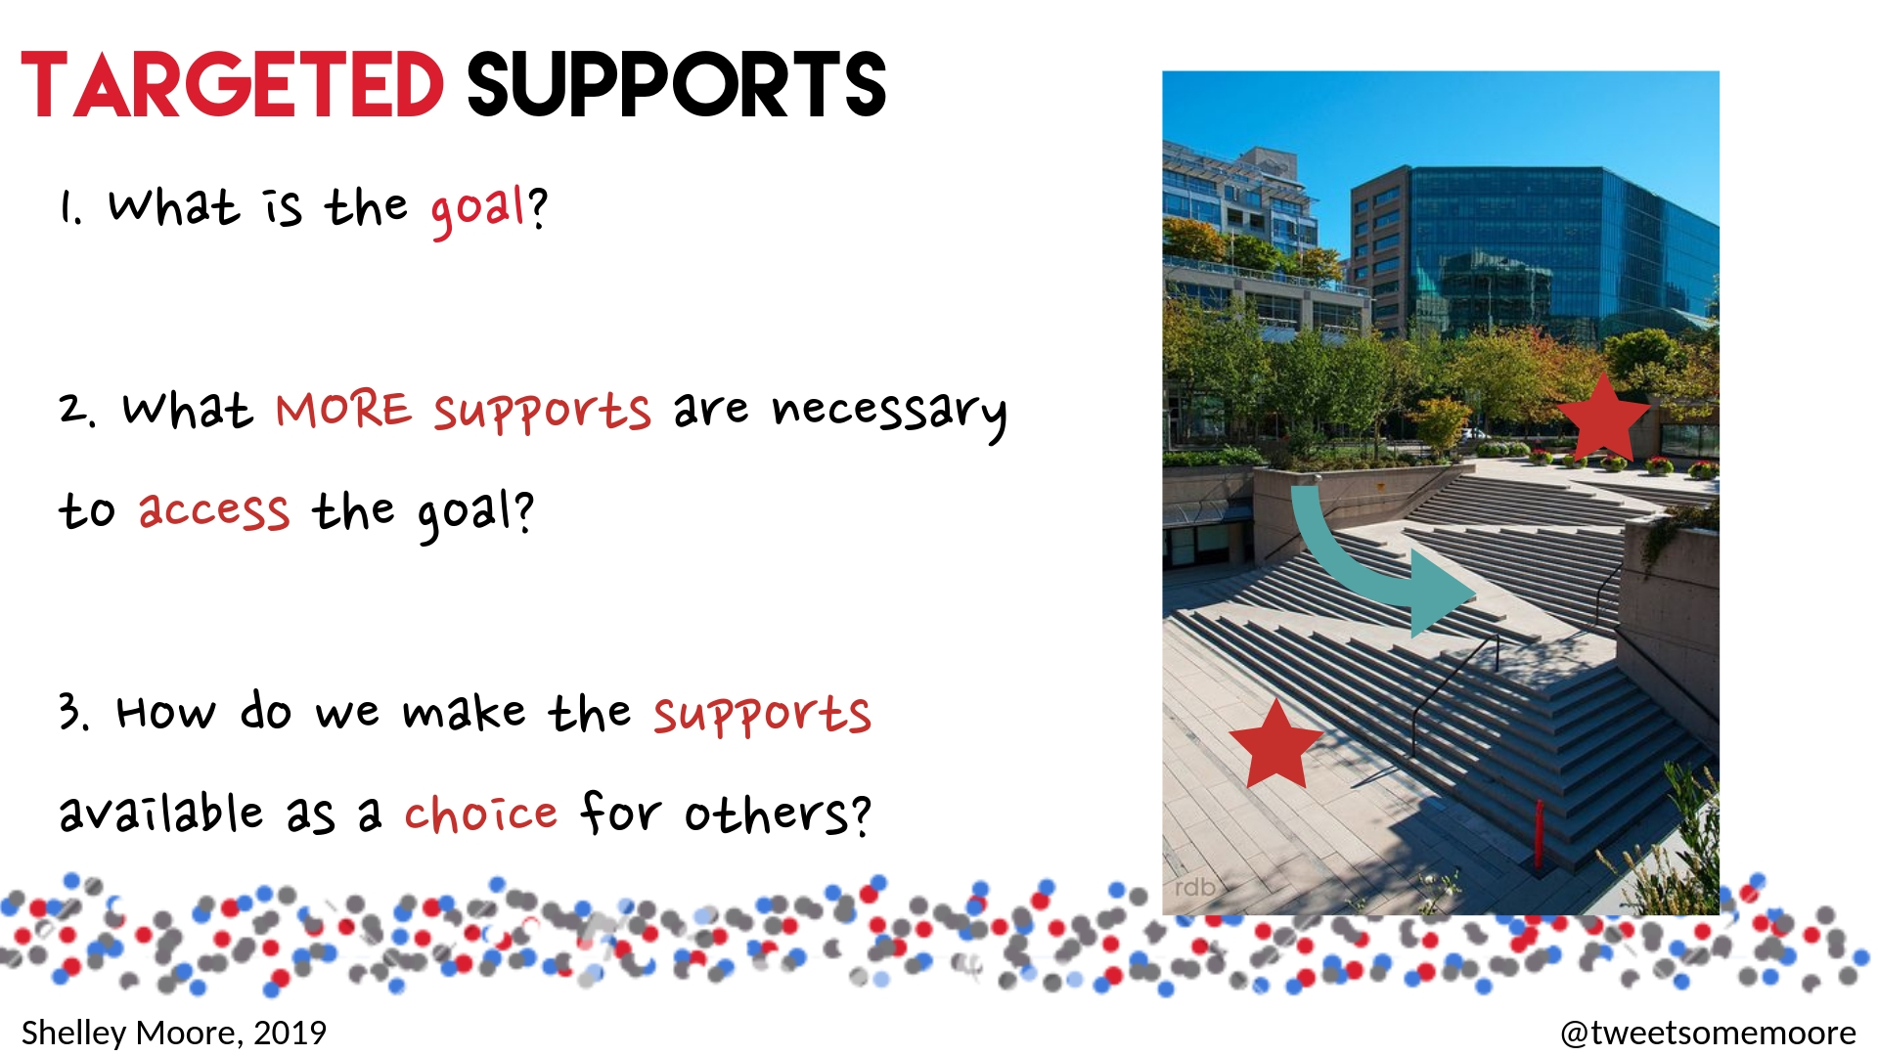

Slide 43


Slide 44
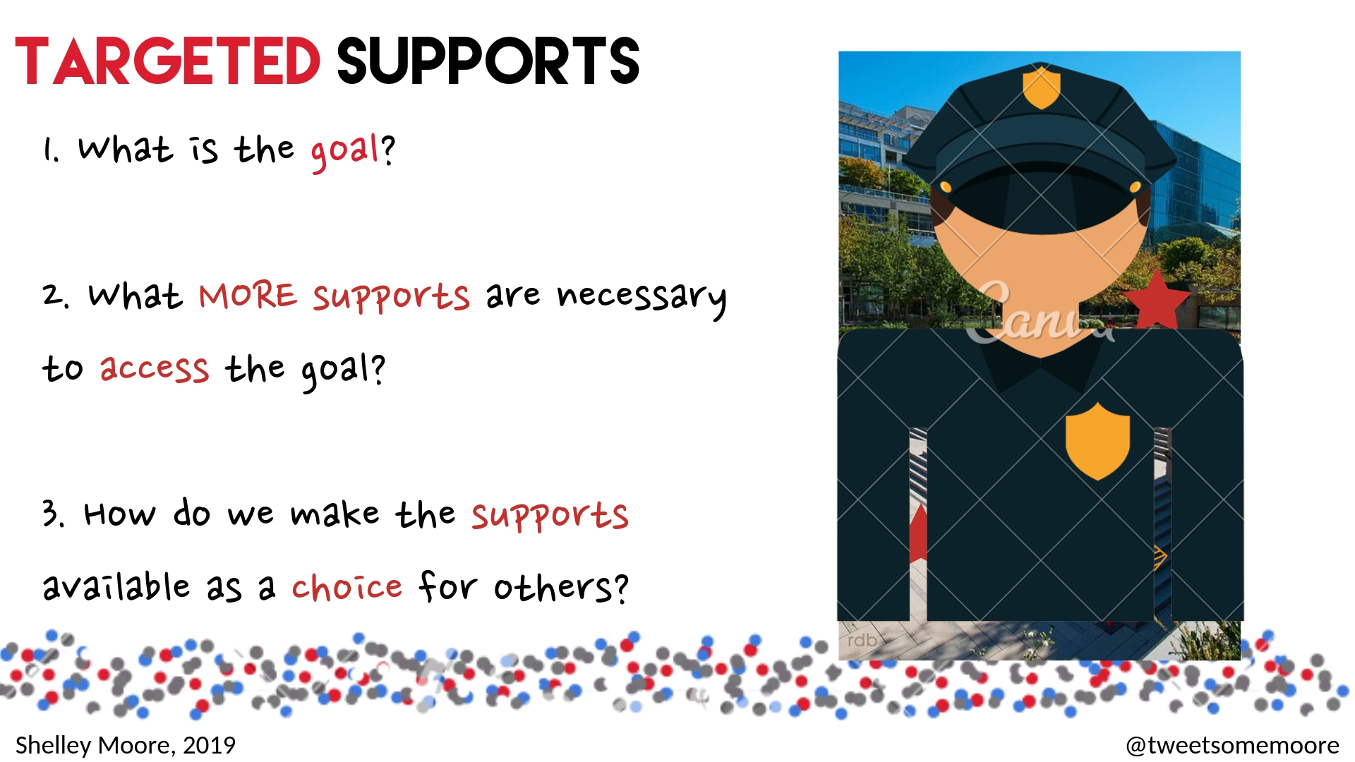

Slide 45
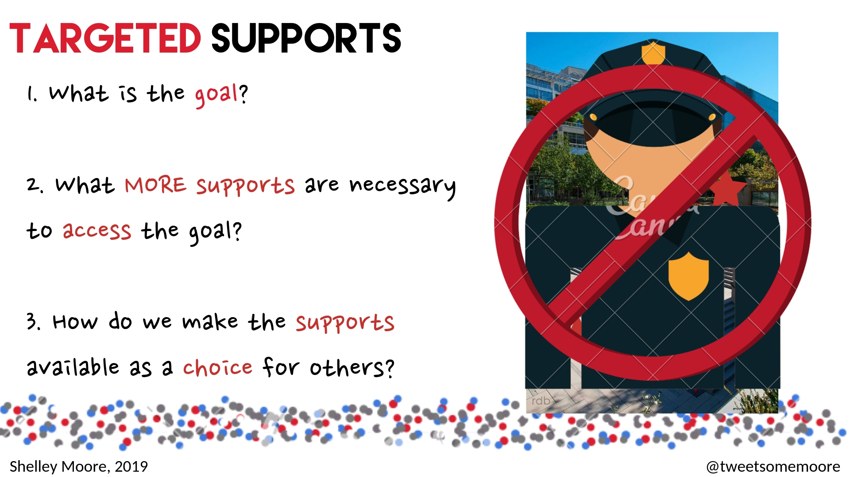

Slide 46
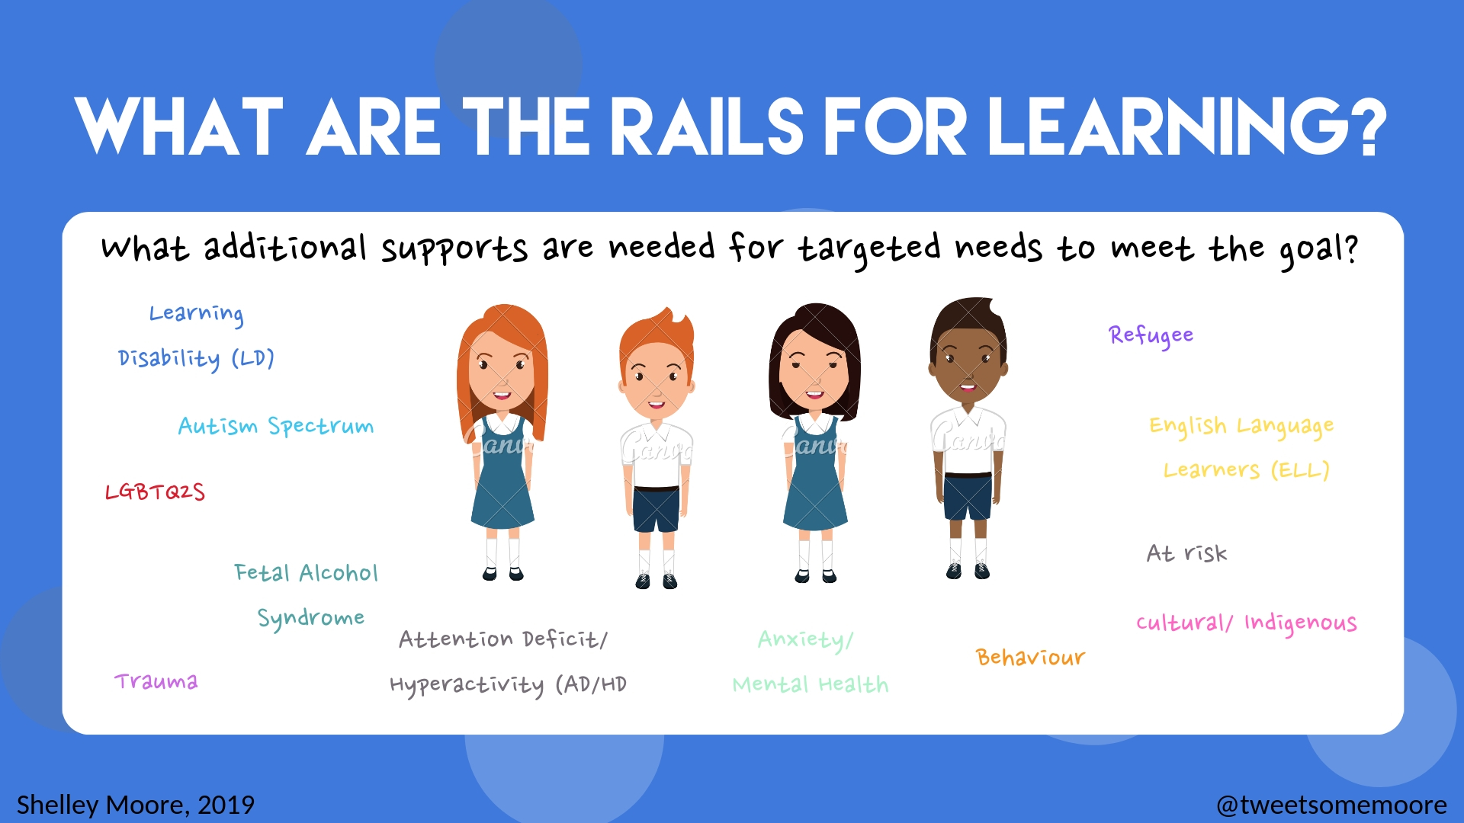

Slide 48
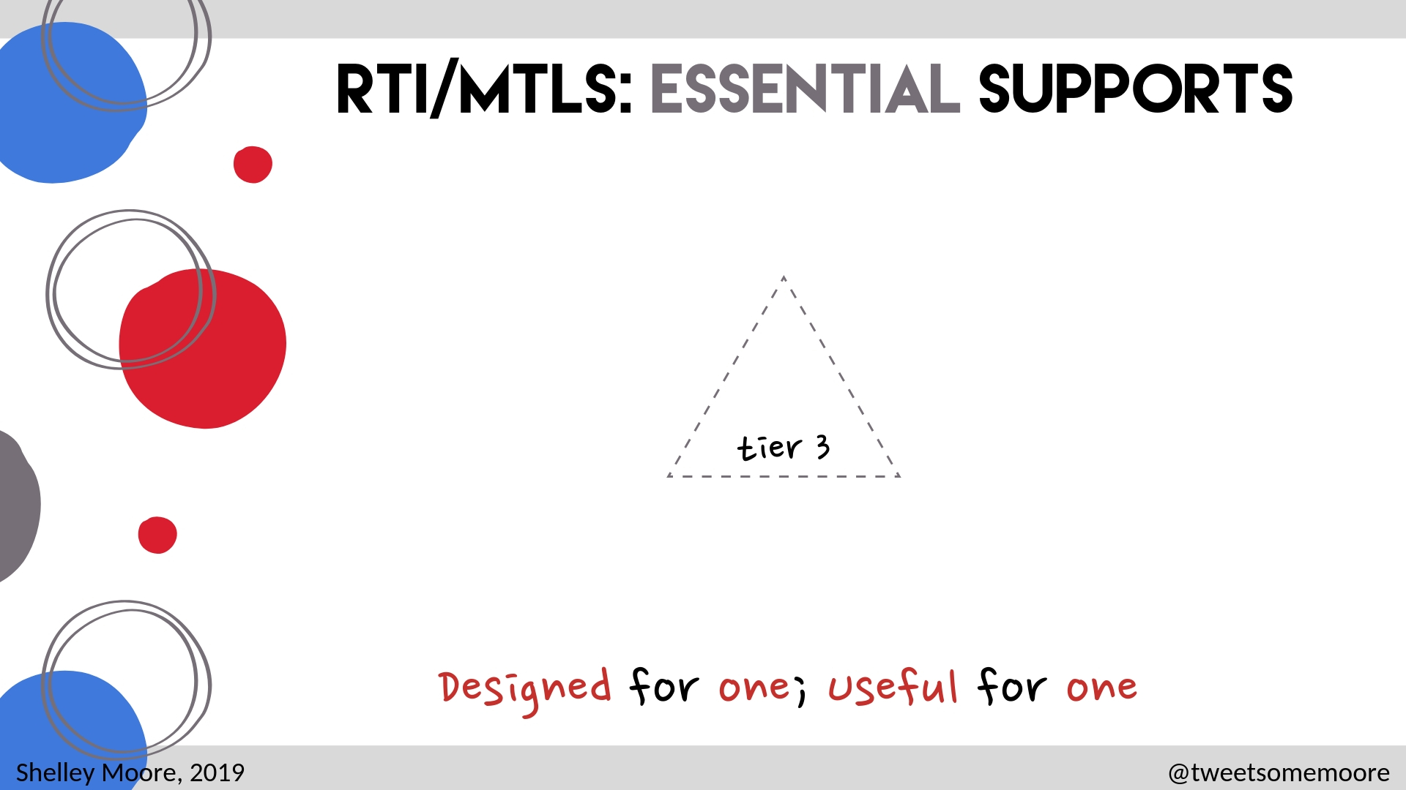

Slide 49
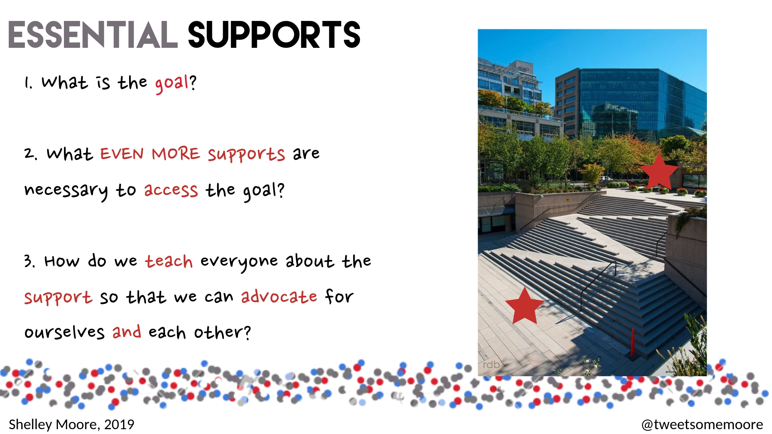

Slide 50
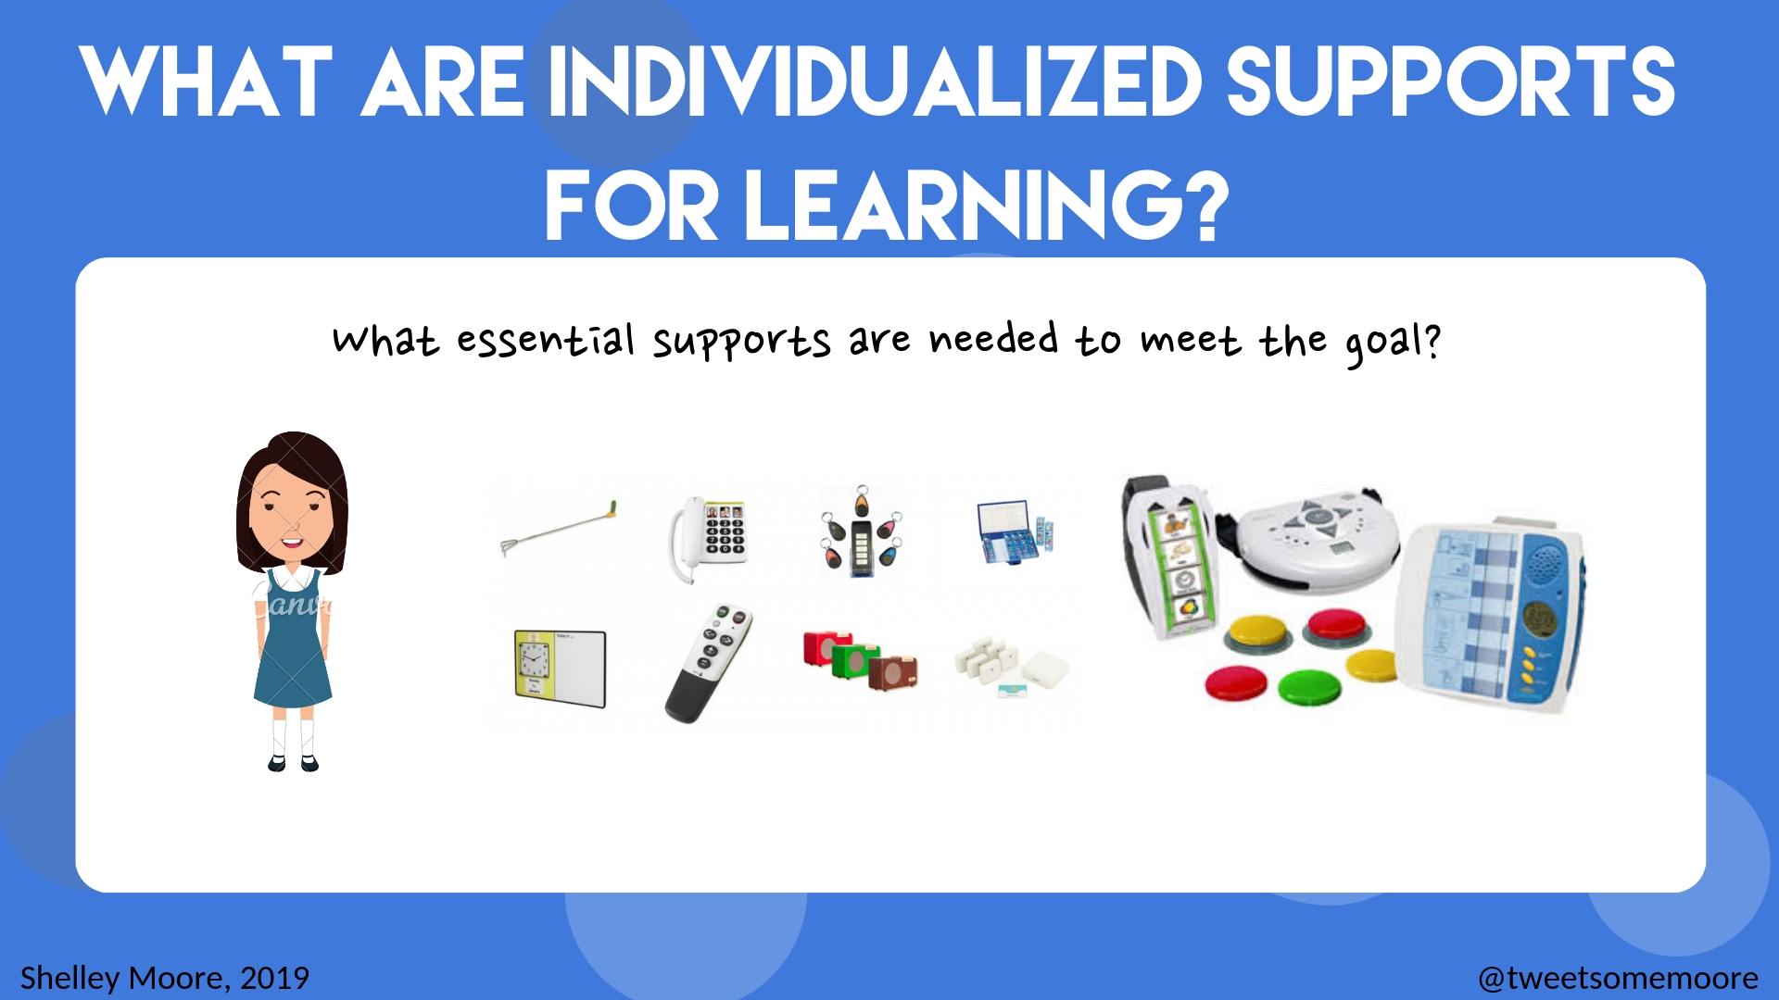

Slide 51


Slide 52
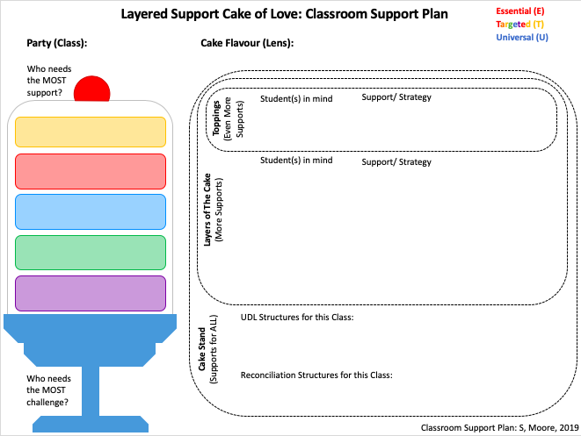
Who needs the TARGETED support?

Slide 53




Classroom Support Plan
Teacher(s): ____________________ Support Staff: ________________ Lens: _____________
Range of Support (MTLS)
Students… |  | Strategies & Supports
who needs the most support |  | Universal Support (Good for ALL) | Targeted Support (CHOICE for ALL) | Essential Support (Good for ONE)
Need
Need
Need
Need
Need
who needs the most challenge |  | Reconciliation & Equity Targets:
Range of Students (RTI)
Classroom Support Plan Shelley Moore, 2019

Slide 54
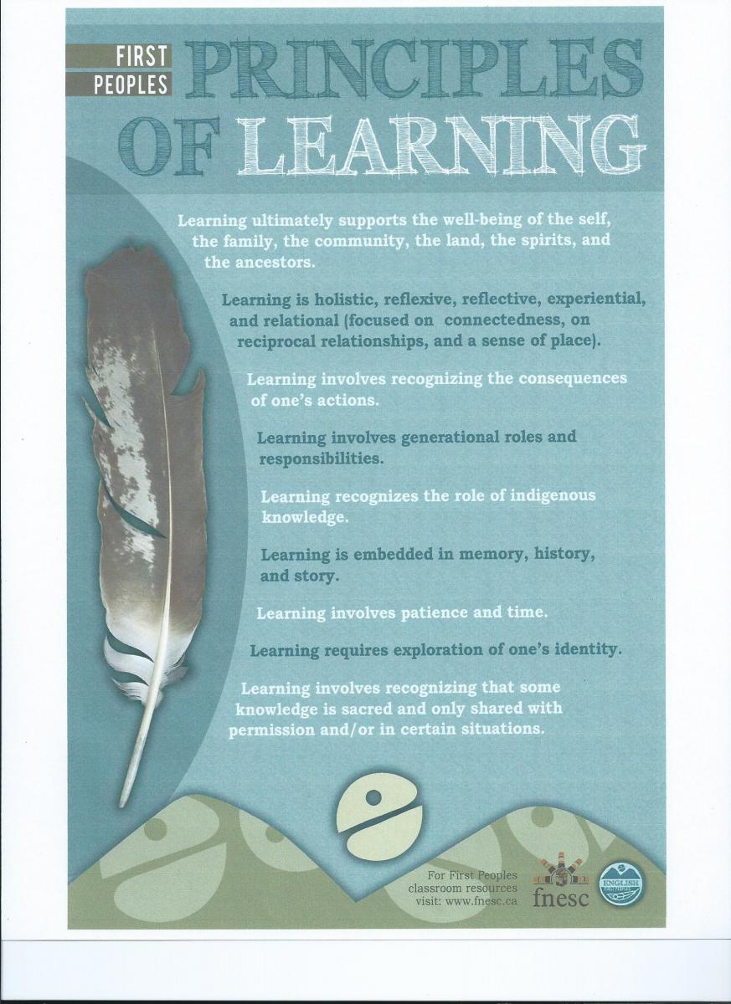
Reconciliation Targets
http://www.fnesc.ca/irsr/
https://www.edcan.ca/articles/truth-reconciliation-classroom/
https://www.reconciliationeducation.ca

Slide 55
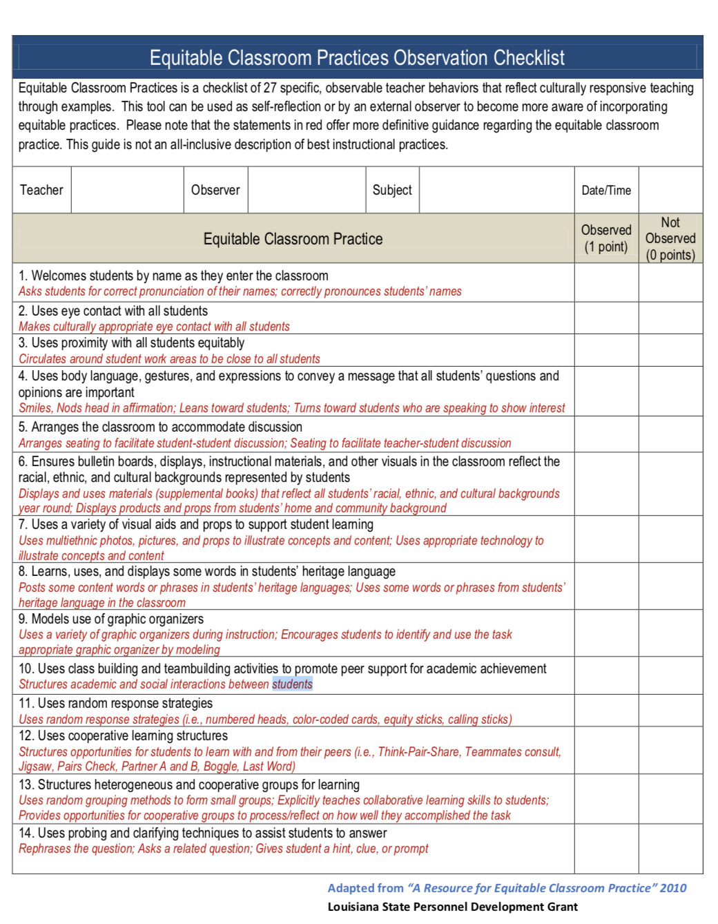
Equity Targets
http://laspdg.org/files/Equitable%20Classroom%20Practices%20Observation%20Checklist.pdf
https://ssrce.ca/wp-content/uploads/2016/01/Culturally-Responsive-Teaching-Checklist-1-page-highlighted.pdf
https://www.wgu.edu/heyteach/article/5-things-you-can-do-support-your-lgbtq-students1809.html

Slide 56
Layered Support Cake of Love: Classroom Support Plan
Essential (E)
Party (Class): Grade 2 Cake Flavour (Lens): Literacy
Targeted (T)
Universal (U)
Who needs the MOST support?
WT, AZ
Toppings
(Even More
Supports)
Student(s) in mind
Support/ Strategies
W.T (Cognitive/SLP) - AAC device, Accessible text/ goal, objects
A.Z. (Behaviour) - Quiet zone, 2 min breaks, check ins, incentive system, multiple levels of text, high interest
RC, OQ
DC, ZC
Student(s) in mind
Support/ Strategy
R.C./ P.K/ I.H. (ELL) - Visuals, vocabulary connections, word walls, strategic partnering
U.V. / D.C./ Z.C. (Learning) - choice of challenge, clear learning intentions/ goals, video, outside learning, strategic groupings
P.S./ U.W./ O.Q. (Behaviour) - structure, routine, transition countdown, first/then, personal check ins, regulation breaks
Y.Q. (LGBTQ2S+ family) - text with diverse families, adjust binary family activities, demystification
PK, LH
Layers of The Cake
(More Supports)
Who needs the TARGETED support?
UW
YQ
ED, PM, EJ, KS, SS, DB
RG, NM, IK, FD
WE, SW
UDL Structures for this Class:
Engagement (hook): “I can statements…,” visual task reference, prior knowledge activity, incorporating objects/play,
Representation (input): Centers, teach vocabulary, modelling, conferencing
Expression (output): Building/showing learning, Technology (SeeSaw), flexible seating, activity breaks, chunking tasks, choice of challenge
Reconciliation Structures for this Class: We can learn by exploring our identities
Cake Stand
(Supports for ALL)
Who needs the MOST challenge?
JV, KG, BS
Classroom Support Plan: S, Moore, 2019

Slide 57
Layered Support Cake of Love: Classroom Support Plan
Essential (E)
Party (Class): Grade 10 Cake Flavour (Lens): Math
Targeted (T)
Universal (U)
Who needs the MOST support?
JG
Toppings
(Even More
Supports)
Student(s) in mind
Support/ Strategies
J.G. (Cognitive) - Access goal/text, object schedule, bin system, facilitate social connection, frequent breaks, seizure awareness
ED, ID
BD, UR
Student(s) in mind
Support/ Strategy
E.D. (Autism) - Structure, routine, real life examples , concrete options to show learning, works well with G.K.
U.R./W.S. (Learning) - small group conference to build base skills, accessible numbers, choice of challenge
P.F. (Gifted) - Choice of Challenge, extension options, organizational system for work
I.D./H.K./P.F./DC/NB (Anxiety) - Accessible tasks, check ins, homework optional choice of expression (abstract, pictoral, concrete) - praise, encouragement, goal setting
K.G. B.D. (cultural) - community building, strength based, indigenous text/perspectives, voices, leadership opportunities
WS, UR, HK
Layers of The Cake
(More Supports)
Who needs the TARGETED support?
PF
KG, DC, NB
AA, AB, NC, LB, DK, RO-L, JR, MP, KV, LD, YT
PO, SW, SZ
UDL Structures for this Class
Engagement: Provide options for recruiting interest by (optimizing, relevance, value and authenticity)
Representation: Provide options for languages and symbols by (supporting decoding text, mathematical notation and symbols)
Expression: Provide options for executive functions by (supporting planning and strategy development)
Equitable Structures for this Class: We can learn by seeking multiple perspectives
Cake Stand
(Supports for ALL)
Who needs the MOST challenge?
PF, DS, AA
Classroom Support Plan: S, Moore, 2019

Slide 58
Classroom Support Plan
Teacher(s):Mr. B Support Staff: Ms. L (support teacher last 20 min of block) Class: English 8
Range of Support
Students… |  | Strategies & Supports
Who needs the most support D.L, R.Y, O.M. |  | Universal Support (Good for ALL) | Targeted Support (CHOICE for ALL) | Essential Support (Good for ONE)
Need LD | D.L., J.K., S,W | Text at multiple reading levels, multiple types of text (oral, visual, written), You Tube, chunk lessons into 15-20 min chunks, activities to process new information, hands on, task clear and scaffolded, Summative tasks that build oral, visual & written skills, literature circles | Options to use technology (reader, scribe), a place to keep work in class so it doesn’t get lost, small group option with Ms. L to work with on activities after lesson
Need Behaviour | R.Y., I,D., F, C, G, J., OM, DL | Make personal connection daily, structure, agenda on board, start class with an accessible activity, movement breaks, music allowed when working, high interest texts, authentic and relevant | Taking breaks, flexible seating, parent check ins on good days, opportunities for leadership | Incentive monitoring system
Need LGBTQ2S+ | G, J. | Text that includes diverse characters, avoid binary (students, folks, everyone), ”safe place” sticker | opportunities for leadership, ask(and honour) preferred pronoun
Need ELL | P, K., I, L, E, E, OM | Text at multiple reading levels, review vocabulary, use of visuals, strategic partnering | Small group option with Ms. L to work with on activities after lesson | translator
Need Anxiety | R.R. | Clear learning tasks and goals, control of complexity and what supports to use, challenge option, choice of audience size | Taking breaks, choice of where to work, homework optional, parent check ins
Who needs the most challenge I.L.., R.R |  | Reconciliation & Equity Targets: Targeting text from Indigenous perspectives, attending to alternative points of view Appreciation circle once a week
Range of Students
Classroom Support Plan Shelley Moore, 2019

Slide 59
Classroom Support Plan
Teacher(s):Mr. B Support Staff: Ms. C (EA) Class: Math 9
Range of Support
Students… |  | Strategies & Supports
Who needs the most support J.W. |  | Universal Support (Good for ALL) | Targeted Support (CHOICE for ALL) | Essential Support (Good for ONE)
Need Cognitive | J.W. | Start lesson with accessible task how to work with J.W., building community activities, manipulatives, | Access Point to curriculum (Math IEP goal), may need breaks, visual agenda on board that matches AAC device, strategic partnering, calculator | AAC Device, social role on class, works well with Y.T., glasses,
Need Vision | R.P | Large print & high contrast outline of handouts, do not change furniture floor plan | Sitting close proximity to front of class | Magnifier,
Need Trauma | H.L., U.B | Make personal connection daily, snacks, drinks allowed, chunk task into an essential portion, | Quiet zone in class, breaks, allow time to leave if needed, follow up later if they leave | Check in before class with Ms. H, might be late
Need ELL | Y.I., O.R., B, F, N.M | Teach important vocabulary for a lesson, visuals, manipulatives & visuals, strategic partnering, math word wall |  | translator
Need Anxiety | R.M. | Choice of challenge, choice of support options, target advocacy skills and risk taking opportunities, open ended tasks (not one answer) | Taking breaks, choice of where to work, homework optional, parent check ins
Who needs the most challenge I.K., R.M. |  | Reconciliation & Equity Targets: Sharing local Indigenous content for math concepts Standards based grading and reporting
Range of Students
Classroom Support Plan Shelley Moore, 2019

Slide 60
Layered Support Cake of Love: Classroom Support Plan
How do we figure out supports or strategies students need?
Colleagues/ Mentors
The Students/
Friends
Critical GOOGLing
Outside Consultants
Research/ Evidence
Family/ Caregivers
School Support Staff
School Based Support Team
Experience

Slide 61
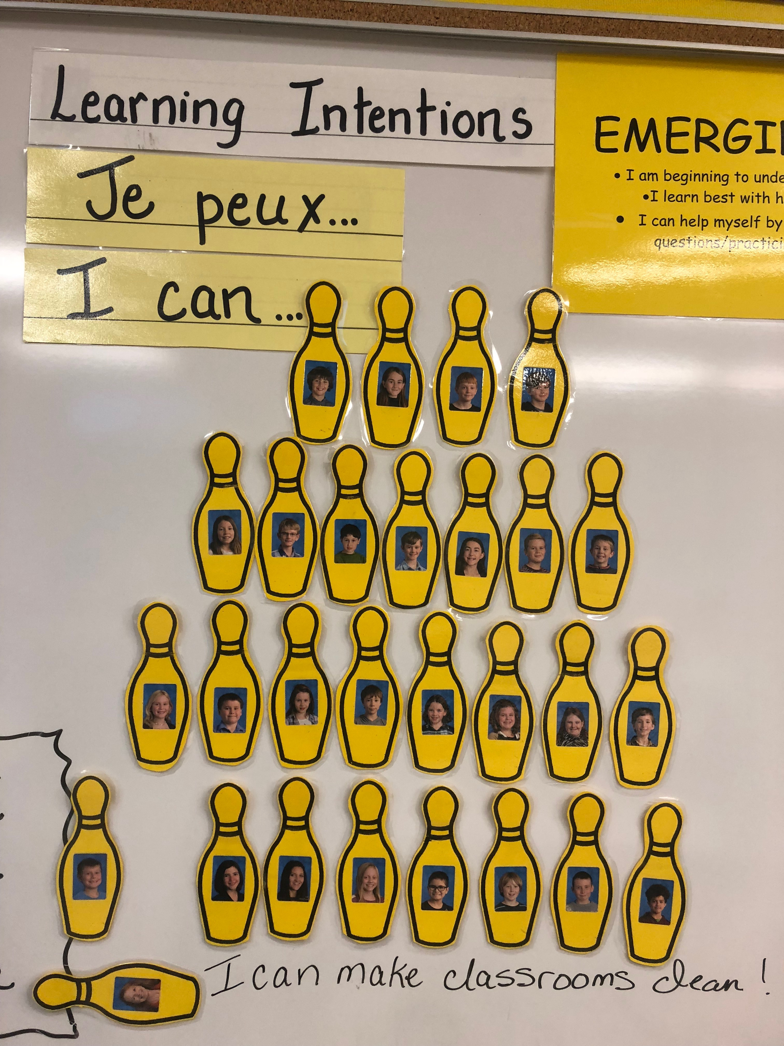
Making supports adjustable
“What ever I need I have access too!”
What is this support?
How do I use it?
How do I know when I need it?
How do I know when I don’t?

Slide 62
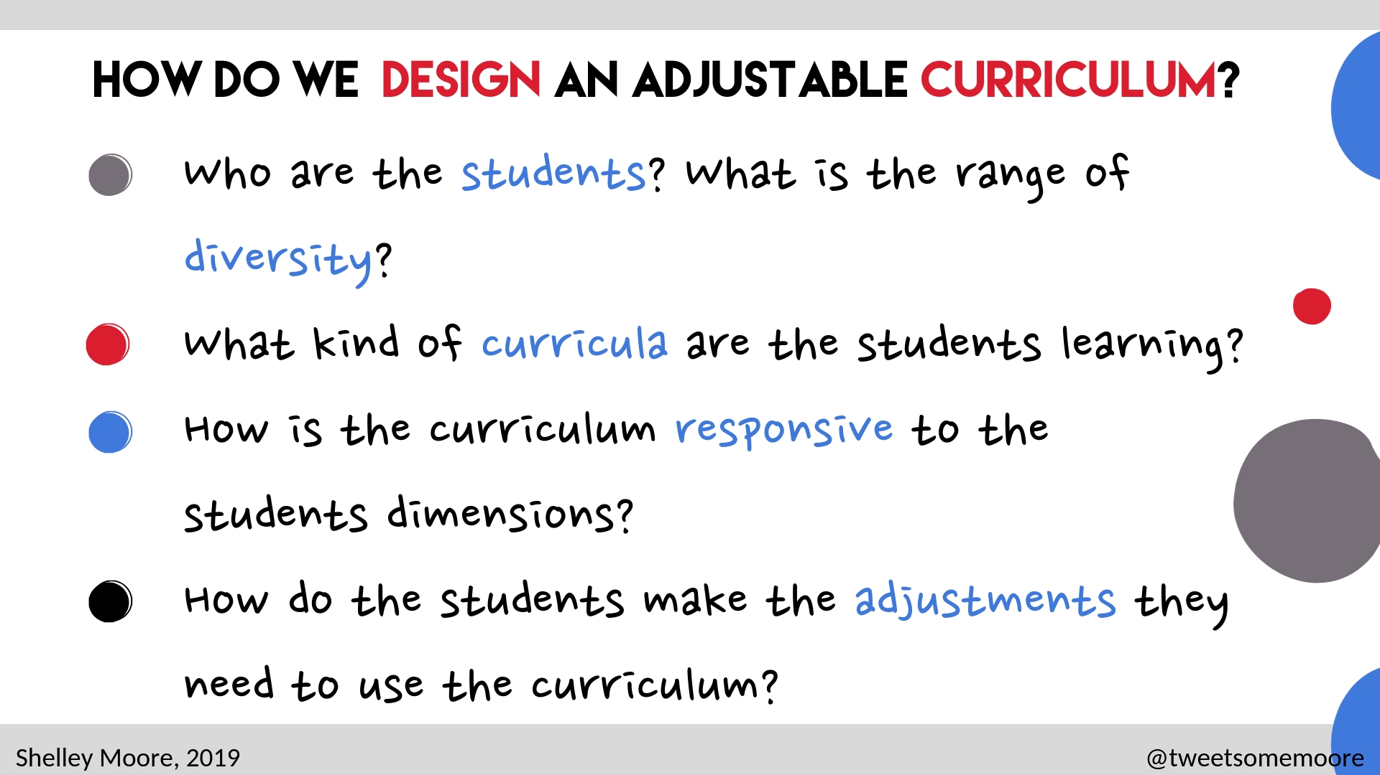

Slide 63
Educational Architects:
Designing with Equity in Mind
What are we teaching?
Curriculum Design
Instructional Design
Universal Design for Learning
Adjustable
Curriculum
Adjustable
Assessment
Students
Who are we Teaching?
Adjustable
Supports
How will we support them?
How will we teach them?

Slide 64
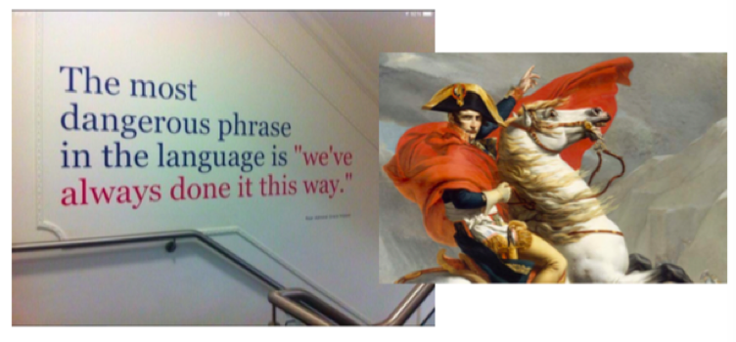
Planning & Instruction that is
goal based, not task based

Slide 65
Forward Design
Differentiated
Same for Everyone
Goals
Activity/Task
Goals
Goals
Backward Design
Diffferentiated
Same for Everyone
Activity
Goals
Activity
Activity

Slide 67
Think about curriculum like a flip book!
Shelley Moore, 2107

Slide 68
The Backwards Design
FLIPBOOK (Current 4-12)
Learning Outcomes
Topic
Context
Guiding Question
What do we need to understand?
What do we need to know?
Teacher
Reporting
Skill Outcomes
What do we need to do?
Attitude Outcomes (choice)
Who do we need to become?
Shelley Moore, 2107

Slide 69
Learning Outcomes:
Learning Outcomes:
Learning Outcomes:
Learning Outcomes:
The Backwards Design FLIPBOOK Class: ____________________
Topic:
Guiding Questions:
Skill Outcomes:
Skill Outcomes:
Attitude Outcomes:
Attitude Outcomes:
Backwards Design Learning Map Shelley Moore, 2019

Slide 71
The Backwards Design
FLIPBOOK (New DRAFT K-4)
Essential Understanding
Context
Guiding Questions (choice & coverage)
What do we need to understand?
Learning Outcome
Conceptual Knowledge
What do we need to know?
Procedural Knowledge
What do we need to do?
Teacher
Evaluation
Literacy Competencies (choice)
What do we need to do?
Numeracy Competencies (choice)
What do we need to do?
Student
Evaluation
Competencies (choice)
Who do we need to become?
Shelley Moore, 2107

Slide 72
The Backwards Design FLIPBOOK
Class: Subject(s): Grade(s):
Essential Understanding:
Guiding Questions:?
Learning Outcome
Conceptual Knowledge
Procedural Knowledge
Literacy Competencies (choice from suggestions)
Numeracy Competencies (choice from suggestions)
Backwards Design Learning Map Shelley Moore, 2019

Slide 73
The Backwards Design FLIPBOOK
Class: Subject(s): Science Grade(s): Kindergarten
Essential Understanding: Investigating change and the diversity of Earth’s systems helps us to develop understandings of the conditions necessary to sustain life
Guiding Questions: How are things in my environment alike and different?
Learning Outcome: I can investigate living and non living things in the local environment
Conceptual Knowledge
I know that plants and animals are living things
I know that the environment includes living, non-living and human – made things
I know that living, non-living, and human made things have places in the shared environment
I know that science involves asking questions about the world
I know that exploring of the environment involves wondering and observing
I know that living and non living things in the environment need to be treated with respect
I know information gained through observations and stories is important to FNMI understandings of the world
Procedural Knowledge
I can collect information about living, non-living, and human-made things respectfully, responsibility and safely
I can ask questions about what is being observed
I can practice safe and appropriate use of simple tools, including magnifying devices
I can compare observations in a variety of ways, including orally and through illustrations and graphics
I can represent a plant or animal in the space that it uses, including its activities and its interactions with other things, through actions, pictures, or models
I can integrate new vocabulary related to scientific investigations
I can explore FNMI stories about plants and animals
Literacy Competencies
I can access vocabulary
Numeracy Competencies
I can use methods and tools
I am an information manager
Backwards Design Learning Map Shelley Moore, 2019

Slide 74
The Backwards Design FLIPBOOK
Class: Subject(s): Science Grade(s): Kindergarten
Essential Understanding: Investigating change and the diversity of Earth’s systems helps us to develop understandings of the conditions necessary to sustain life
Guiding Questions: How are things in my environment alike and different?
Learning Outcome: I can investigate living and non living things in the local environment
Conceptual Knowledge
I know that plants and animals are living things
I know that the environment includes living, non-living and human – made things
I know that living, non-living, and human made things have places in the shared environment
I know that science involves asking questions about the world
I know that exploring of the environment involves wondering and observing
I know that living and non living things in the environment need to be treated with respect
I know information gained through observations and stories is important to FNMI understandings of the world
Procedural Knowledge
I can collect information about living, non-living, and human-made things respectfully, responsibility and safely
I can ask questions about what is being observed
I can practice safe and appropriate use of simple tools, including magnifying devices
I can compare observations in a variety of ways, including orally and through illustrations and graphics
I can represent a plant or animal in the space that it uses, including its activities and its interactions with other things, through actions, pictures, or models
I can integrate new vocabulary related to scientific investigations
I can explore FNMI stories about plants and animals
Literacy Competencies
I can access vocabulary
Numeracy Competencies
I can use methods and tools
I am an information manager
Backwards Design Learning Map Shelley Moore, 2019

Slide 75
Standards Based Grade Book – Subject Focused
Kindergarten
Essential Understanding: Investigating change and the diversity of Earth’s systems helps us to develop understandings of the conditions necessary to sustain life.
Subject Areas | Science |  |  |  |  | Science
Learning Outcomes | Children investigate living and non living things in the local environment |  |  |  |  | Children explore seasonal changes in the local environment
Levels of Complexity | Approaching | Minimally Meeting / Emerging | Meeting/ Developing | Fully Meeting/ Proficient | Extending | Approaching | Minimally Meeting / Emerging | Meeting/ Developing | Fully Meeting/ Proficient | Extending
Student
Student
Student
Student
Student

Slide 76
Standards Based Grade Book – Cross Curricular
Kindergarten
Essential Understanding: Exploring connections strengthens our understandings of relationships to help us make meaning of the world.
Subject Areas | ELA |  |  |  |  | Math |  |  |  |  | Science
Learning Outcomes | Children make connections between language and feelings. |  |  |  |  | Children explore and communicate the relationship between quantities. |  |  |  |  | Children explore nature and describe personal connections to it.
Levels of Complexity | Approaching | Minimally Meeting / Emerging | Meeting/ Developing | Fully Meeting/ Proficient | Extending | Approaching | Minimally Meeting / Emerging | Meeting/ Developing | Fully Meeting/ Proficient | Extending | Approaching | Minimally Meeting / Emerging | Meeting/ Developing | Fully Meeting/ Proficient | Extending
Student
Student
Student
Student
Student

Slide 77
Standards Based Grade Book – Cross Curricular
Kindergarten (Collecting Evidence of Learning)
Essential Understanding: Exploring connections strengthens our understandings of relationships to help us make meaning of the world.
Subject Areas | ELA |  |  |  |  | Math |  |  |  |  | Science
Learning Outcomes | Children make connections between language and feelings. |  |  |  |  | Children explore and communicate the relationship between quantities. |  |  |  |  | Children explore nature and describe personal connections to it.
Levels of Complexity | Approaching | Minimally Meeting / Emerging | Meeting/ Developing | Fully Meeting/ Proficient | Extending | Approaching | Minimally Meeting / Emerging | Meeting/ Developing | Fully Meeting/ Proficient | Extending | Approaching | Minimally Meeting / Emerging | Meeting/ Developing | Fully Meeting/ Proficient | Extending
Student | ✔️ | ✔️ |  |  |  | ✔️ | ✔️ |  |  |  | ✔️ | ✔️
Student | ✔️ |  |  |  |  | ✔️ |  |  |  |  | ✔️ | ✔️
Student | ✔️ | ✔️ | ✔️ | ✔️ |  | ✔️ | ✔️ |  |  |  | ✔️ | ✔️
Student | ✔️ | ✔️ | ✔️ |  |  | ✔️
Student | ✔️ |  |  |  |  | ✔️ | ✔️ |  |  |  | ✔️ | ✔️ | ✔️

Slide 78
Standards Based Grade Book – Cross Curricular
Kindergarten (Formative Assessment)
Essential Understanding: Exploring connections strengthens our understandings of relationships to help us make meaning of the world.
Subject Areas | ELA |  |  |  |  | Math |  |  |  |  | Science
Learning Outcomes | Children make connections between language and feelings. |  |  |  |  | Children explore and communicate the relationship between quantities. |  |  |  |  | Children explore nature and describe personal connections to it.
Levels of Complexity | Approaching | Minimally Meeting / Emerging | Meeting/ Developing | Fully Meeting/ Proficient | Extending | Approaching | Minimally Meeting / Emerging | Meeting/ Developing | Fully Meeting/ Proficient | Extending | Approaching | Minimally Meeting / Emerging | Meeting/ Developing | Fully Meeting/ Proficient | Extending
Student | ✔️ | ✔️ |  |  |  | ✔️ | ✔️ |  |  |  | ✔️ | ✔️
Student | ✔️ |  |  |  |  | ✔️ |  |  |  |  | ✔️ | ✔️
Student | ✔️ | ✔️ | ✔️ | ✔️ |  | ✔️ | ✔️ |  |  |  | ✔️ | ✔️
Student | ✔️ | ✔️ | ✔️ |  |  | ✔️
Student | ✔️ |  |  |  |  | ✔️ | ✔️ |  |  |  | ✔️ | ✔️ | ✔️

Slide 79
Essential Understanding: Exploring connections strengthens our understandings of relationships to help us make meaning of the world. |  |  |  |  |  |  |  |  |  |  | Reporting Period:
Subject Areas | Math |  |  |  |  | Science |  |  |  |  | Art |  |  |  |  | Reporting
Learning Outcomes | Learners create and solve equations that represent problem-solving situations |  |  |  |  | Students investigate community actions that support stewardship of the land |  |  |  |  | Students analyze relationships between communities and cultures as reflected through art experiences.
Levels of Complexity | Approaching | Minimally Meeting / Emerging | Meeting/ Developing | Fully Meeting/ Proficient | Extending | Approaching | Minimally Meeting / Emerging | Meeting/ Developing | Fully Meeting/ Proficient | Extending | Approaching | Minimally Meeting / Emerging | Meeting/ Developing | Fully Meeting/ Proficient | Extending | Total | Grade
Grading | 10 |  | 5 | 3 | 2 | 10 |  | 5 | 3 | 2 | 10 |  | 5 | 3 | 2 | 60
Student | ✔️ | ✔️ |  |  |  | ✔️ | ✔️ |  |  |  | ✔️ | ✔️ |  |  |  | 30 | C
Student | ✔️ |  |  |  |  | ✔️ | ✔️ |  |  |  | ✔️ | ✔️ | ✔️ | ✔️
Student | ✔️ | ✔️ | ✔️ | ✔️ |  | ✔️ | ✔️ |  |  |  | ✔️ | ✔️ | ✔️ | ✔️ | ✔️ | 48 | A
Student | ✔️ | ✔️ | ✔️ |  |  | ✔️ | ✔️ | ✔️ | ✔️ |  | ✔️ | ✔️ | ✔️ |  |  | 48 | A

Slide 81
Next Session: April 12
Try something!
Bring back something to share
Making curriculum Adjustable
Assessment

Slide 82
