Slide 2
Grade: | Subject Area: | Planning Team:
Big Idea: ADST, Science, Art, Language Arts (output) - play, curiosity, forces, influence movement, creative expression, risk taking, language & joy |  | Unit Guiding question: Who are our monsters? How many ways can we catch a monster?
Content Goal: Science |  | I know types of forces
Content Goal: Language arts |  | I know elements of a story
Curricular Competency Goal: ADST |  | I can make a monster trap
Curricular Competency Goal: Science |  | I can plan and test my monster trap
Curricular Competency Goal: Art |  | I can explore and create using art processes and materials
Curricular Competency Goal: LA |  | I can create a story for an audience
Cross Curricular Competency |  | I can use materials safely

Slide 3
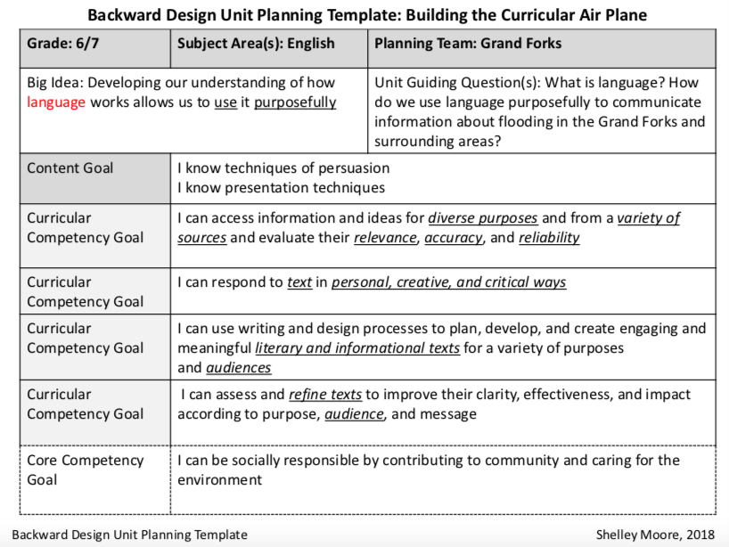

Slide 4
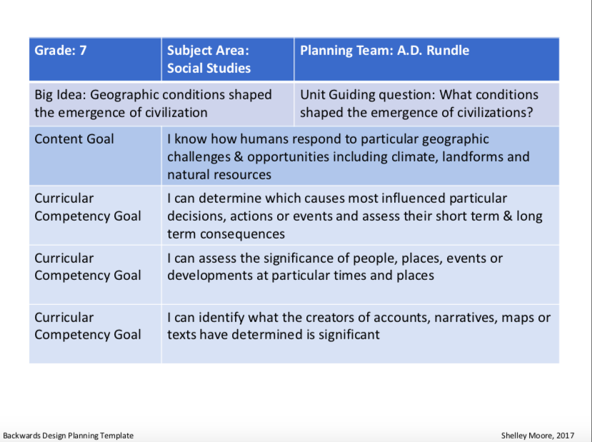

Slide 5
Backward Design Unit Planning Template: Building the Curricular Plane
Grade: 8 | Subject Area(s): English | Planning Team:
Big Idea: Questioning what we hear, read, and view contributes to our ability to be educated and engaged citizens. |  | Unit Guiding Question(s): How can I be active citizen? How can I use oral language to be an active citizen and my contribute to community?
Content Goal | I know oral language features and strategies I know elements of visual and graphic texts
Curricular Competency Goal | I can construct meaningful connections between self, text and world
Curricular Competency Goal | I can synthesize ideas from a variety of sources to build understanding
Curricular Competency Goal | I can use writing and design processes to plan, develop, and create engaging and meaningful oral texts for a variety of purposes and audiences
Curricular Competency Goal | I can assess and refine oral texts to improve their clarity, effectiveness, and impact according to purpose, audience, and message
Backward Design Unit Planning Template Shelley Moore, 2018

Slide 6
Grade: Grade 10 | Subject Area: Science | Planning Team: Carihi Secondary
Big Idea: Chemical processes require energy change as atoms rearrange |  | Unit Guiding question: What is an atom? How and why to they rearrange?
Content Goal 1: | I know that energy changes during chemical reactions
Content Goal 2: | I know the practical applications and implications of chemical processes, including First Peoples perspectives
Curricular Competency Goal: I can plan and construct by: | Assessing risk and addressing ethical, cultural, and/or environmental issues associated with their proposed methods and those of others
Curricular Competency Goal: I can process and analyze data and information by: | Applying First People’s principles perspectives and knowledge, other ways of knowing and local knowledge sources of information
Curricular Competency Goal: I can evaluate by: | Considering social, ethical, and environmental implications of the findings from their own and others’ investigations
Curricular Competency Goal: I can communicate by: | Formulating physical or mental theoretical models to describe a phenomenon
Core Competency Goal: Communication | I can become a communicator by…

Slide 7
Backwards Design: The Plane
Grade: 11 | Subject Area: Bio | Planning Team:
Big Idea: All living things have common characteristics. Living things evolve over time. |  | Unit Guiding question: Why is our forest unique in Campbell River? How and why have our forest ecosystems evolved over time?
Content Goal: | I know speciation that occurs within our forest
I can process and analyze data and information by: Curricular Competency Goal Curricular Competency Goal | I can experience and interpret the local environment
 | I can Seek and analyze patterns, trends, and connections in data, including describing relationships between variables, performing calculations, and identifying inconsistencies
 | I can Construct, analyze, and interpret graphs, models, and/or diagrams
Social Responsibility | I can become socially responsible by…

Slide 8
Course/Subject/Grade(s): English Studies 12
Unit Big Idea: The exploration of text and story deepens our understanding of diverse, complex ideas about identity, others, and the world. |  | Guiding Unit Questions: How does a moral individual exist in an immoral world? How does a good person, exist in an evil world?
Goals
Content: I know reading strategies I know elements of style
Curricular Competencies | I can construct meaningful personal connections between self, text, and world
 | I can think critically, creatively, and reflectively to analyze ideas within, between, and beyond texts
 | I can express and support an opinion with evidence
 | I can use writing and design processes to plan, develop, and create engaging and meaningful texts for a variety of purposes and audiences
 | I can assess and refine texts to improve their clarity, effectiveness, and impact

