Slide 1
The Curricular Air Plane
Course: EPSE 390K |  | Subject Area: Planning for Inclusion | Planning Team: Shelley and class
Big Idea: Getting to know our learners needs collectively allows us to design for them and allows other learners to benefit from shared supports and strategies while eliminating he needs for accommodations, adaptations and modifications and building self regulation of learning skills |  |  | Unit Guiding question: What are supports and strategies? How do we get to know the needs of our learning community? How can we effectively and efficiently design supports and strategies to meet the needs of diverse learners with retrofitting?
Content Goal | We know the interests, strengths and stretches of my group of learners | We know the interests, strengths and stretches of my group of learners
Competency Goal | We can construct classroom support plans by getting know our learners | We can construct classroom support plans by getting know our learners by
Competency Goal | We can construct classroom support plans that are responsive and living | We can construct classroom support plans that are responsive and living by:
Competency Goal | We can construct classroom support plans that identify supports and strategies | We can construct classroom support plans that identify supports and strategies by:
Competency Goal | We can construct classroom support plans that commit to reconciliation and equity targets | We can construct classroom Support plans that commit to reconciliation and equity targets by:

Slide 2
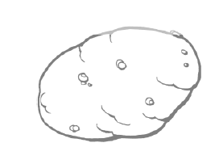
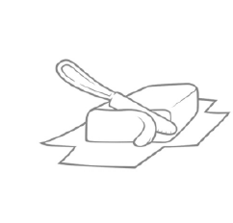
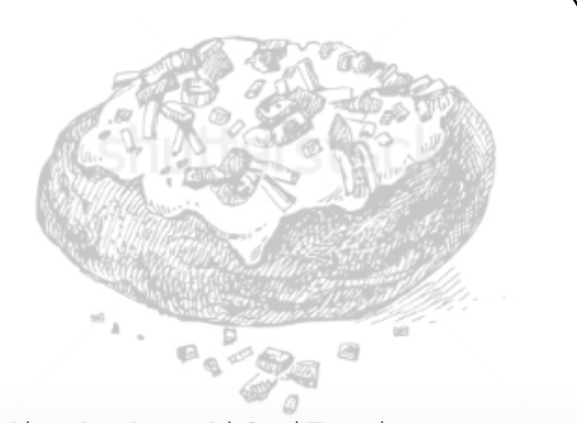

Baked Potato Planning Pyramid: Designing for a range of complexity
Criteria Element:
We can construct classroom support plans by getting know our learners by:
personally connecting with learners
finding shared needs among a group
identifying student needs in a group
understanding that student needs are connected to, but do not rely on, a diagnosis
designing with the edges in mind (who needs the most support/ challenge)
Ensuring that the plan focuses explicitly on the edges (the bowling pins)
collecting data to get to know learners strengths, stretches and interests (class profile, student inventory)
Goal for ALL
Goal for MOST
Goal for FEW
Shelley Moore, 2019

Slide 3
Baked Potato Planning Pyramid: Designing for a range of complexity
Goal for ALL
Criteria Element:
We can construct classroom support plans that are responsive and living by:
- identifying lens or areas of learning
- Determine a general or specific lens
- Organize information clearly and concisely (try to keep it on one page so it can be a snapshot/ reference
- Collaboratively create plan to reflect multiple perspectives
- Utilize plan to guide classroom infrastructure/ environment
- Reflect on plan frequently to adjust as needed
Goal for MOST
Goal for FEW
Shelley Moore, 2019

Slide 4
Criteria Element:
We can construct classroom support plans that identify supports and strategies by:
Reflect the needs of a class or group
Design supports and strategies based on needs
Organize supports or strategies based on who will benefit (universal, targeted and essential)
Understand the different between universal, targeted and essential supports
Connect supports and strategies to the lens
Choose supports and strategies that are tangible, concrete and realistic to the context
Choose supports and strategies that highlight student strengths
Evaluate supports and strategies by research and evidence
Design proactively, ensuring that most supports and strategies are universal
Acknowledge student stretches and design for them
Prioritize needs, try to not have more that 5 needs groups to work on at a time
Do not include people, time or funding as supports (because they are resources not supports)
Advocate by describing how resources could be used to support a classroom
Refer to data collected about class (student inventory, class profile etc.)
Construct supports and strategies that engages learners, representing information to learners and allow learners to express their learning
Baked Potato Planning Pyramid: Designing for a range of complexity
Goal for ALL
Goal for MOST
Goal for FEW
Shelley Moore, 2019

Slide 5
Baked Potato Planning Pyramid: Designing for a range of complexity
Criteria Element:
We can construct classroom Support plans that commit to reconciliation and equity targets by:
- Determine “we can” statements to emphasis community goal
- Reflect federal recommendations
- Build from authentic indigenous texts and resources
- Include equity targets which supports indigenous and other marginalized population (e.g. LGBTQ2S+, People of Colour, People with Disabilities etc.)
- Connect to core competencies
- Connect to identity by honouring story
- Inviting Elders in to be a part of the class commitments
- Commit to a doable number of targets
- Include the class in the process of choosing them and help them understand why it is important
- Build community and agency based on common goals
- Connect targets to community involvement
- Evaluate the role of privilege in reconciliation and equity commitments
- Evaluate how reconciliation connects to inclusion
- Construct targets that are action oriented
Goal for ALL
Goal for MOST
Goal for FEW
Shelley Moore, 2019

