Slide 1
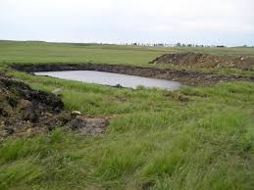
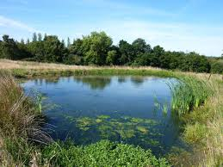
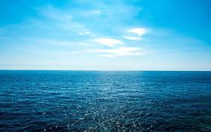
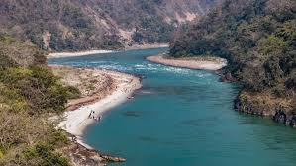
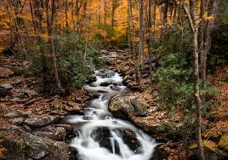
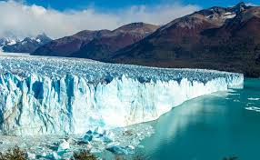
How does water impact living things?

Slide 2
Our Goal Today!
I can learn about water

Slide 3
Some New Science Words
wetlands
stream
underground water
Indian Ocean
glacier
salt water
Arctic Ocean
river
dug out/ pond
Pacific Ocean
Earth
fresh water
lake
Atlantic Ocean
Southern Ocean

Slide 4


I’m not sure about
these words.
I know these words!

Slide 5

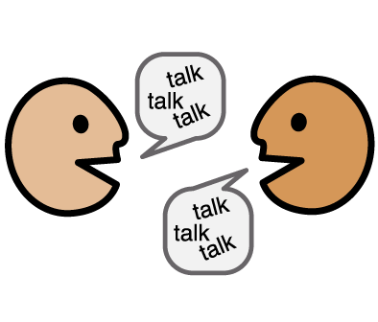
Your job…
Cut out the boxes on the black line
Talk to your partner, are these words you know or words you don’t know?
Sort the picture words into the boxes

Slide 6
What can we learn about water?
Video

Slide 7
What can we learn about water?
Names: ___________________________

Slide 8
Learning Target: I can learn about water
Start Together
NEED
Choose the picture that shows the BIG IDEA
MUST
Choose the pictures that show the different kinds of water on the Earth
Go as far as you can!
CAN
Choose the pictures that show examples of water on the Earth
COULD
Sort the pictures into fresh water and salt water examples
TRY
Find examples of things that live in fresh and salt water habitats
www.fivemooreminutes.com
Episode 6 Strategy
Shelley Moore, 2019
Notes:
709

Slide 9
What do we learn about water?
Choose a new word that you know!
Use the word to share something you learned about water
Write a sentence about what you learned about water
Write a sentence about what you learned that connects 2 new words

