Slide 1
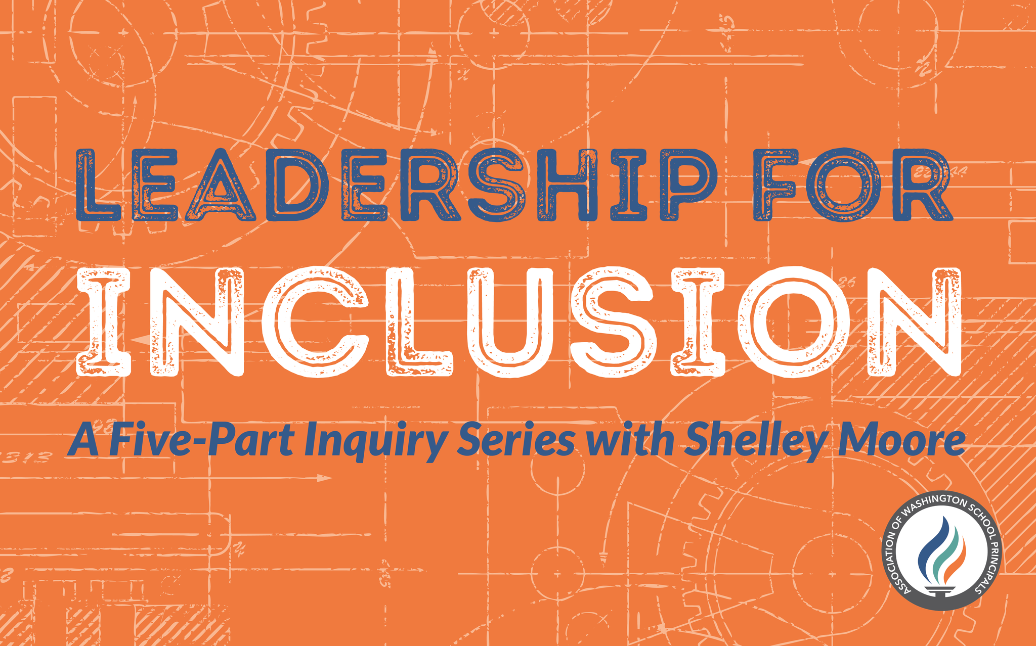

Slide 2
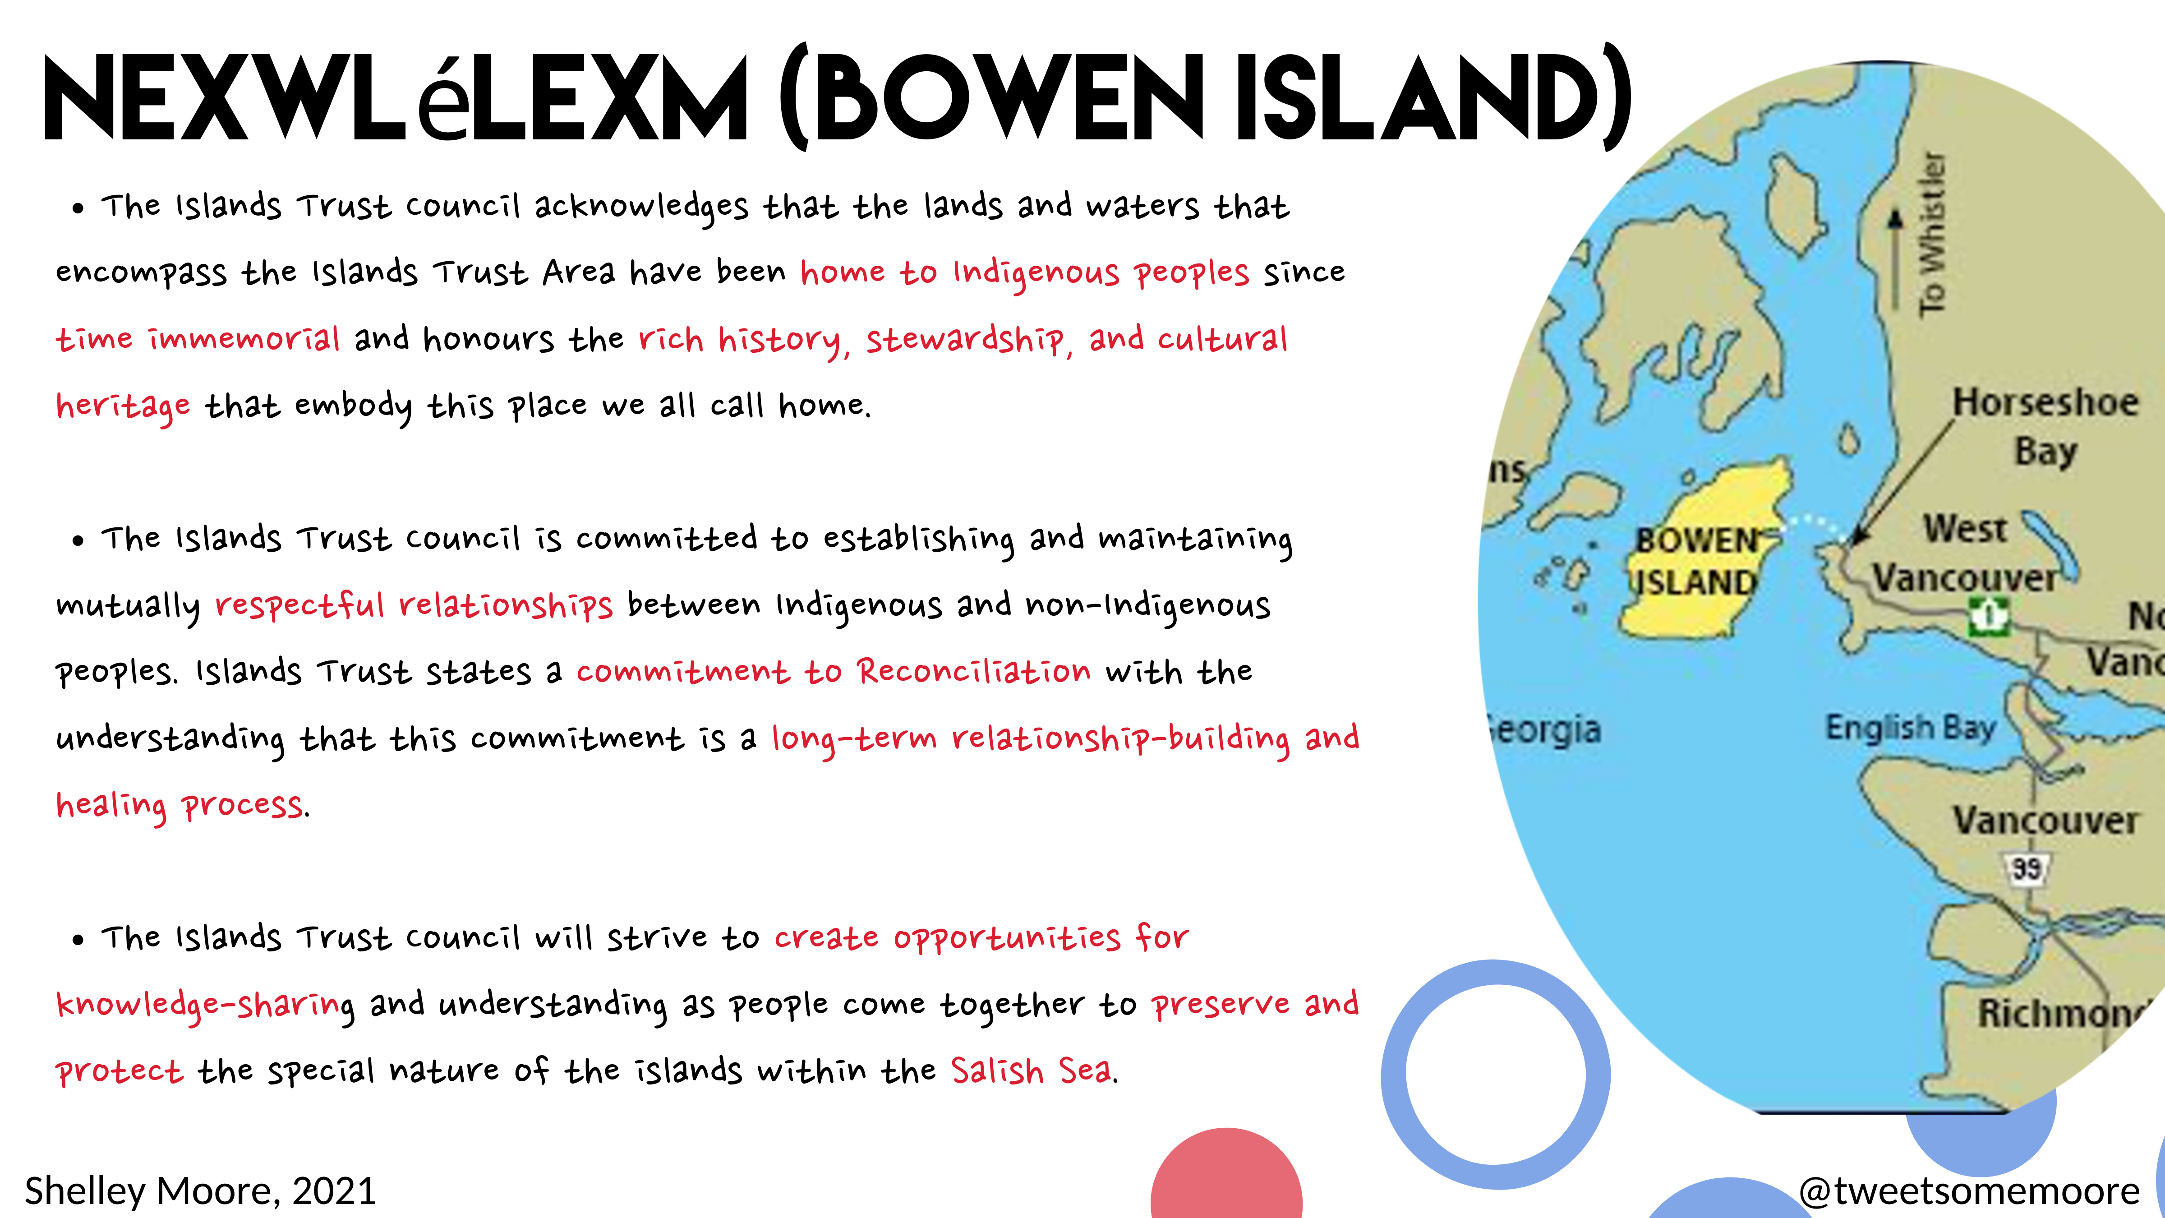

Slide 3
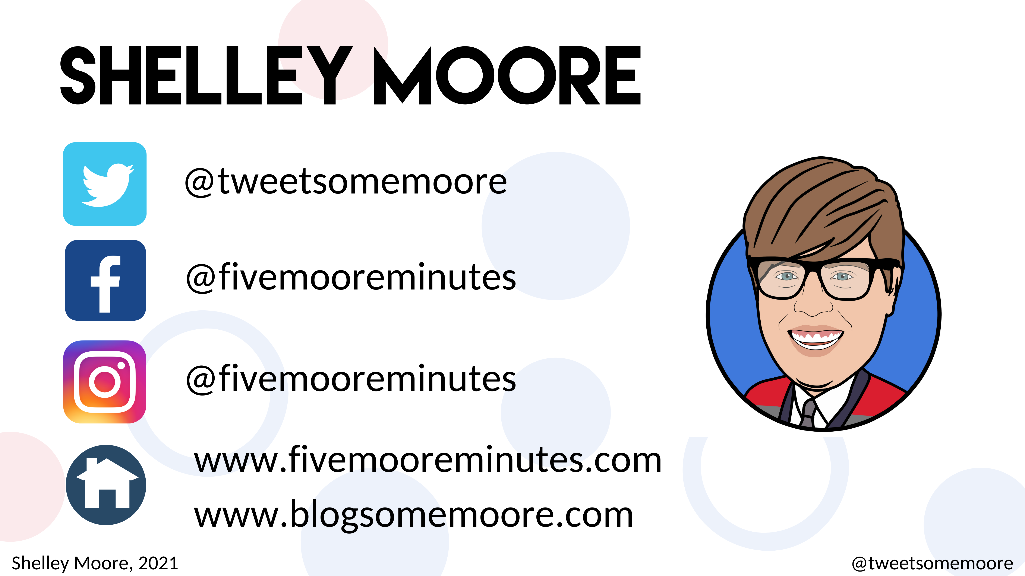

Slide 4

Our plan for today
Sharing Out
Participation Protocols
Quick Review
P #2: The Importance of Place
Next Steps & Action Plans
Resources

Slide 5
Our plan for today
Participation Protocols
Sharing Out
Quick Review
P #2: The Importance of Place
Next Steps & Action Plans
Resources

Slide 6
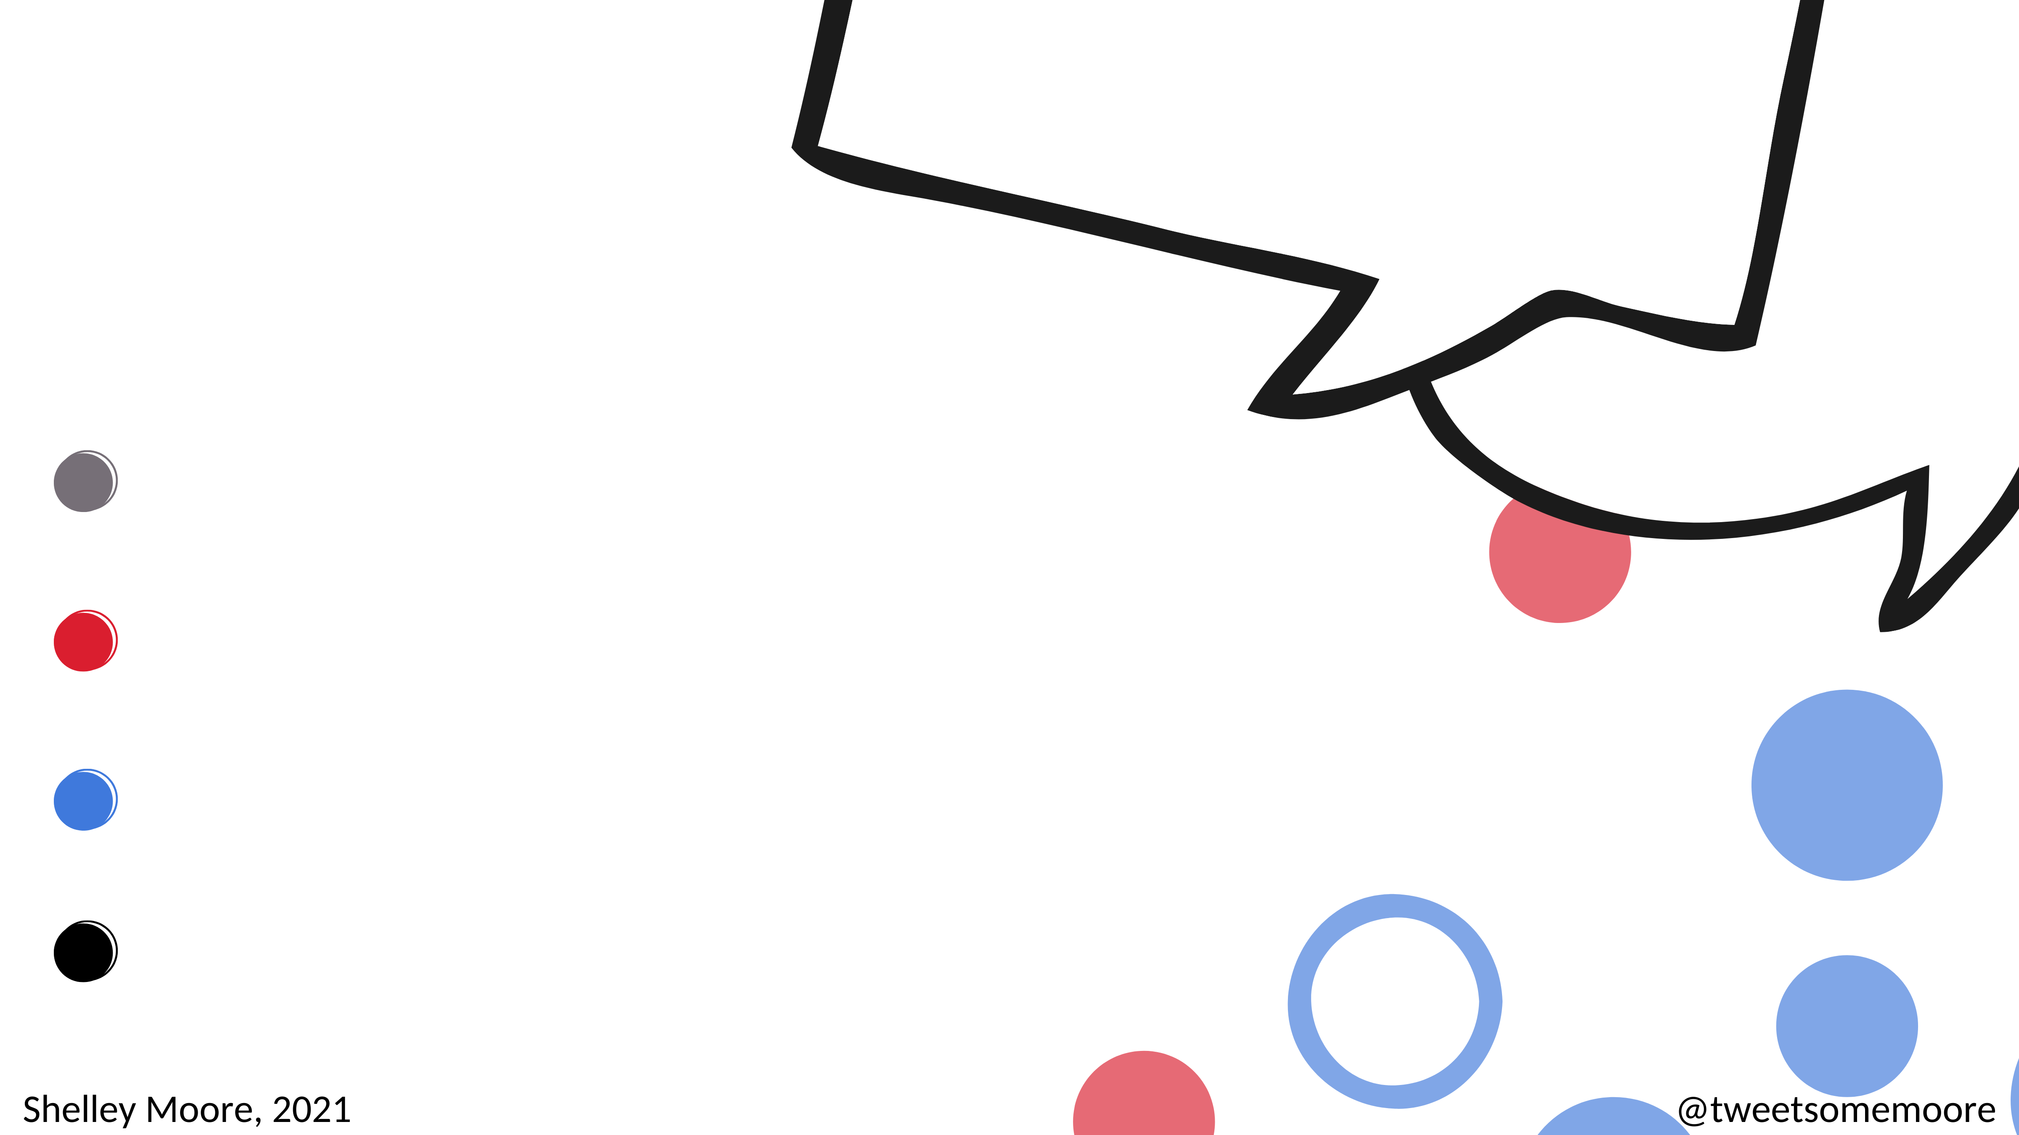
Virtual Participation Protocols
Chat Box
Anytime! All the time!
Break Out Groups
Popcorn conversations
Google Form
The Quad
Padlet
Inquiry Learning Statements

Slide 7
Break Out Groups – Popcorn
In break out groups, everyone is a kernel
You will have 3 minutes to pop – Everyone needs to pop!
You pop by sharing a thought or a response, or asking a question to the group
How can you support each other to make sure everyone pops in the time allowed?

Slide 8
QUAD questions
A link will be shared with you that will take you to a google form
Over the session you will prompted to respond to four questions with your team in a breakout group, one at a time
One Google doc/ team
You have until the end of the session to submit your responses

Slide 9
Session 2 Quad: https://forms.gle/SBrYFBMFcUHfTS4HA
Q1: What is one action that your team has taken since the series started?
Q2: What are you noticing?
Our Inquiry Team Name
__________________________
Q3: Create 1 -2 inquiry actions statements describing what your team will try between now and next session?
Shelley Moore, 2021

Slide 10
Padlet
5 Minutes
Open the link sent in the chat box
As a team, click on the pink (+) button
Add your team's name and your learning statements
Add evidence (photo, reflection, website, voice recording etc.) that supports your learning
Link is not open to public

Slide 11
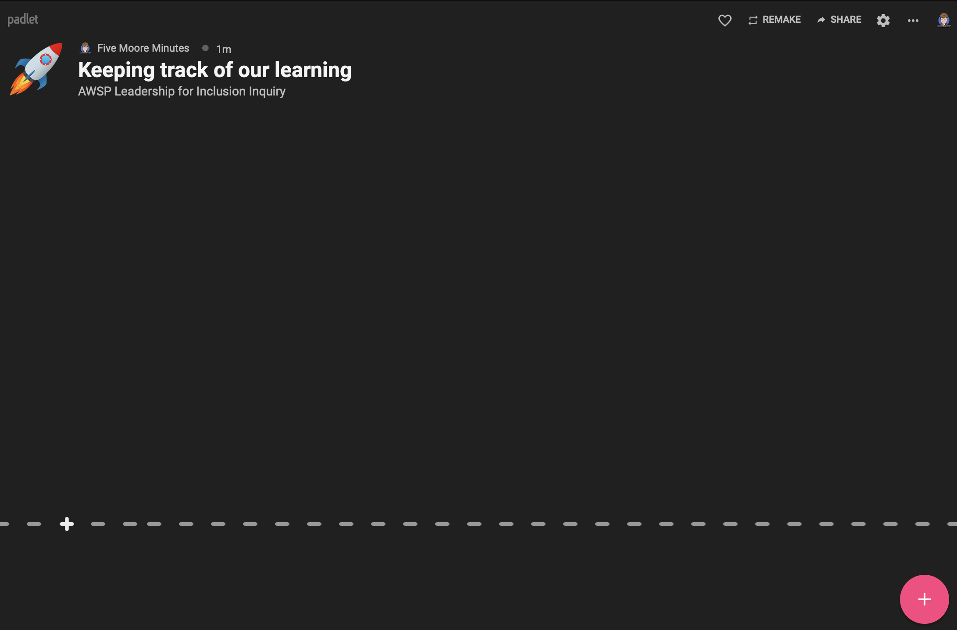
https://padlet.com/fivemooreminutes/abn6w77y0fethhqp
Shelley Moore, 2021

Slide 12
https://padlet.com/fivemooreminutes/abn6w77y0fethhqp
Shelley Moore, 2021

Slide 13
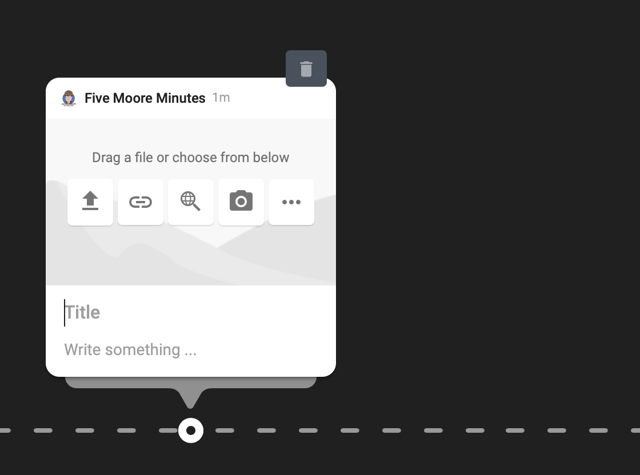
https://padlet.com/fivemooreminutes/abn6w77y0fethhqp
Shelley Moore, 2021

Slide 14
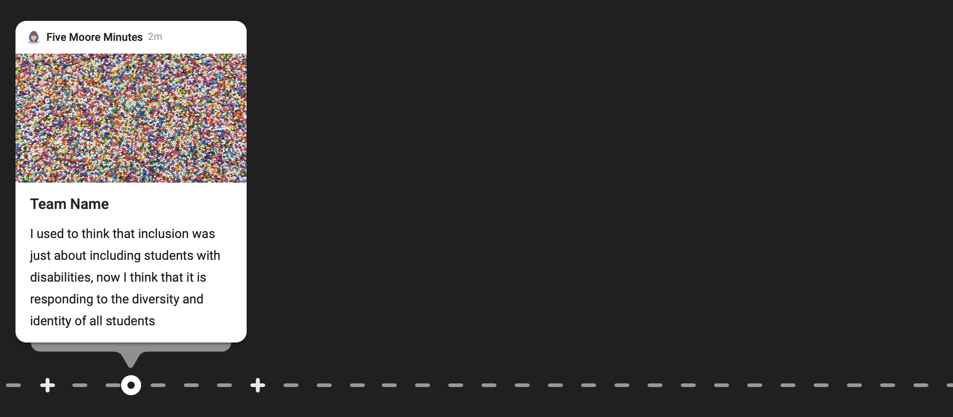
https://padlet.com/fivemooreminutes/abn6w77y0fethhqp
Shelley Moore, 2021

Slide 15
Our plan for today
Participation Protocols
Sharing Out
Quick Review
P #2: The Importance of Place
Next Steps & Action Plans
Resources

Slide 16
Taking Action: Choose your Challenge
Your team:
Needs watch the 5MM video (Feb 1.) and have a conversation with your team about your reflections
Must: choose an article or a video from the resource list. As a team eat lunch together one day and have a discussion about what you are learning
Can: choose another resource and talk to someone not on your team about what you are learning
Could: to share a summary of what your team learned with your staff at a staff meeting or a professional development session
Can try go and visit a specialized program or site and reflect on what you notice about what students can do
Have another idea? Let me know in your google form
Everyone
Choose your challenge
Shelley Moore, 2021

Slide 17
Sharing Out Step 1
5 minutes
As a team
QUAD 1 & 2
What action(s) has your team taken?
What did you try?
What are you noticing?

Slide 18
Session 2 Quad: https://forms.gle/SBrYFBMFcUHfTS4HA
Q1: What is one action that your team has taken since the series started?
Q2: What are you noticing?
Our Inquiry Team Name
__________________________
Q3: Create 1 -2 inquiry actions statements describing what your team will try between now and next session?
Shelley Moore, 2021

Slide 19
Sharing Out Step 2
5 minutes
Joining with another team and share:
- What did you and/or your team try?
What did you and/or your team notice?

Slide 20
Our plan for today
Participation Protocols
Sharing Out
Quick Review
P #2: The Importance of Place
Next Steps & Action Plans
Resources

Slide 21
What Infrastructure can be put in place that will make choosing inclusion easier?

Slide 22

What does the Research Say?
1. Guiding conditions of inclusion describe that all students...
2. Teacher professional development that...
3. Systems frameworks that ...
supports collaboration and the changing roles of educators & support staff
are presumed competent
are enrolled in and attending curricular classes
are in proximity to and participating in learning with peers
have purposeful roles and responsibilities
is situated, ongoing and inquiry based
support Universal Design for Learning
move away from a medical & deficit-based model of special education (IEPS)
are planned for
School & District Infrastructure
Teacher & Staffing Infrastructure
Student Infrastructure

Slide 23
Every Month will focus on an infrastructural
condition with supporting resources
Proximity &
Participation
with Peers
Presuming
Competence
Connecting to
Place
Purposeful
Planned For
January
February
March
April
May
June
KICK OFF
5 MM Video (1)
5 MM Podcast (15)
Newsletter Article
5 MM Video
5 MM Podcast
Newsletter Article
5 MM Video
5 MM Podcast
Newsletter Article
5 MM Video
5 MM Podcast
Newsletter Article
5 MM Video
5 MM Podcast
Newsletter Article
Celebration
of Learning
Newsletter Article

Slide 24
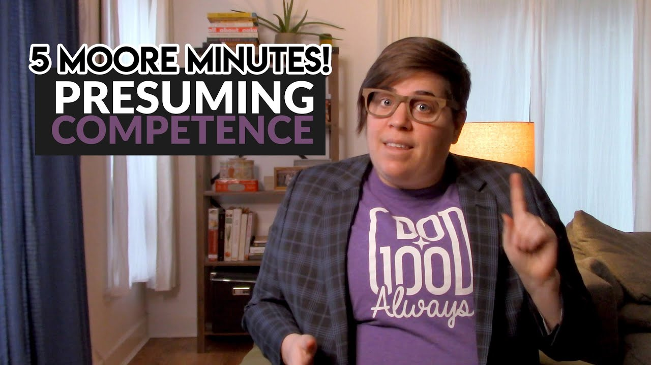


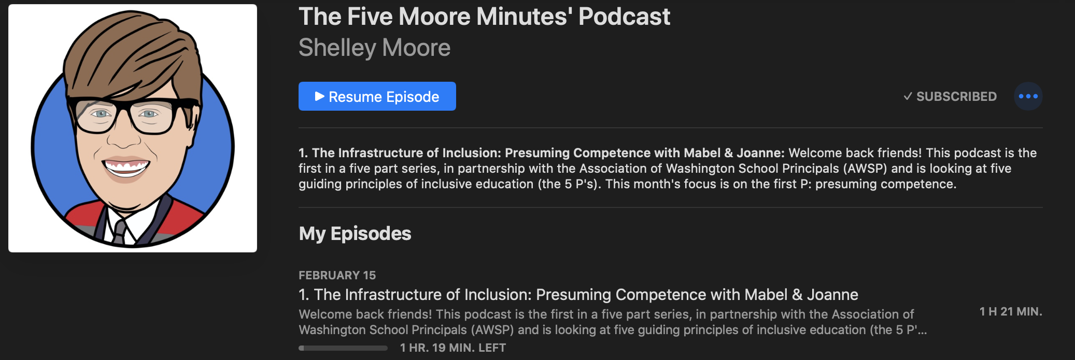
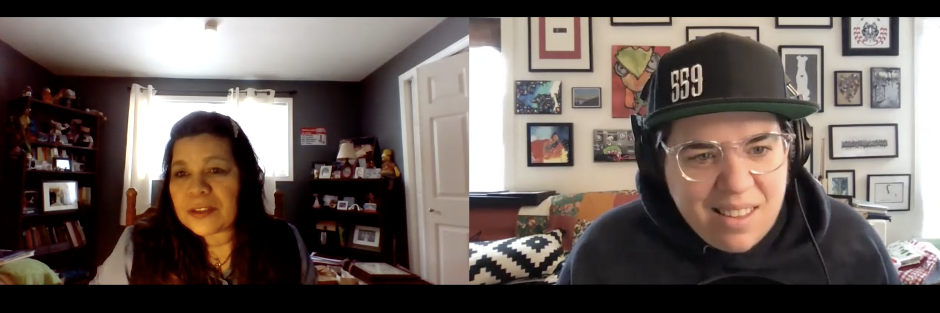
Shelley Moore, 2021

Slide 25
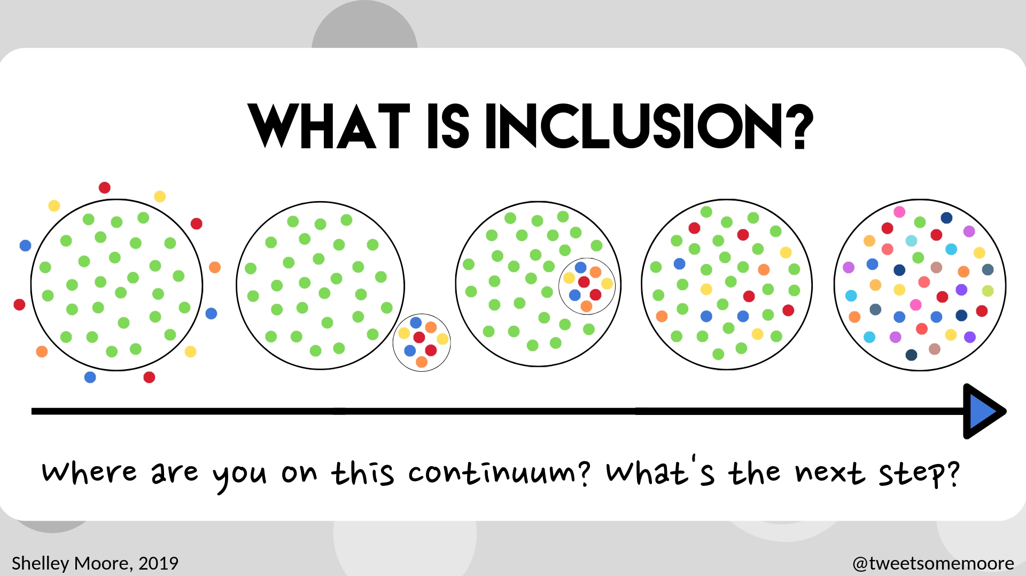

Slide 26
Now What?!
Understand WHAT Inclusion is….
Understand WHY it is important…
How to we do it?

Slide 27
What do we think when we think of someone with a disability?
Norm Referenced Criteria
Intellectual
Educational
Medical
- Measure deficits, not strengths
- Capture responses verbally/ written/ physically
- If students can’t express in the way being captured
- It leads to the perceptions that “they can’t”
Shelley Moore, 2021

Slide 28

What happens when there is a perception that students “can’t”
So we put students with disabilities into programs outside of the general education curriculum/ classroom for the majority of their day learning “life skills”
Even if students are enrolled in a class, they are still not often expected to access the general education curriculum, and focus is placed on social and/or behaviour skills aimed to normalize them
We assume that students with disabilities will not benefit from being in general education classes
Students with and without disabilities do not get the opportunity to learn with and from each other
We assume that students with disabilities are unable to learn much curriculum
Teachers do not get to see what students with disabilities are capable of
Which would lead to a shift in perception in the competence of disability
Shelley Moore, 2021

Slide 29
Why is Presuming Competence Important?
“Even if we are wrong about a students’ capabilities to learn general education curriculum with their peers, the consequences of that presumption being wrong are not as dangerous as the alternative.”
Cheryl Jorgenson
Shelley Moore, 2021

Slide 30
Presuming Protentional
“I thought I would explain that I will be using the term presume potential instead of presume competence. I will quote AAC specialist Kate Ahern as she does an amazing job of explaining that this small wording difference can change the outcome for many students. When we say presume competence people might give someone an AAC system and expect them to magically use it, without any real teaching. But when we say presume potential we don’t give a pass to others, we are saying, like all people, this person has the capacity to learn and grow, they aren’t static and they won’t magically know how to do things they haven’t learned or been taught. Presume potential puts the onus of teaching/learning on the teachers, therapists and caregivers instead of expecting the disabled individual to already know how to do things without education. Presume potential is inclusion in the expectation of learning we place on ALL people. Presume potential means we don’t dismiss anyone because we think their diagnosis means they can’t learn or because we think they are low. Instead we believe that just like all children and adults their brains are plastic and they have boundless potential with the right teaching, supports and high expectations.”
Joanne Picard
Shelley Moore, 2021

Slide 31
Our plan for today
Sharing Out
Participation Protocols
Quick Review
P #2: The Importance of Place
Next Steps & Action Plans
Resources

Slide 32
What is the role of of place in inclusive planning and infrastructure?

Slide 33
Why does place matter?
Historically, Individual Education Plans (IEPs) have not been connected to place and have historically been implemented in one place (self contained or segregated setting)
Place connects individuals to others who are in the community to learn with
Place can have a role in teaching and learning
Place can impact (and help navigate) barriers to learning
Place connects to an inclusive vision – the more places an individual is included in, with belonging, the better!
I & CBIEPs Session 2 Shelley Moore, 2020
Notes:
17:29

Slide 34
Location vs. Place
Existence vs. Belonging
I & CBIEPs Session 2 Shelley Moore, 2020

Slide 35
Place Based Planning
Who am I with?
Place
Where I am?
Who am I?
I & CBIEPs Session 2 Shelley Moore, 2020

Slide 36
Understanding the Role of Place
Who am I with?
Place
Where I am?
Who am I?
I & CBIEPs Session 2 Shelley Moore, 2020

Slide 37
A shift in thinking…
There are some things we need to understand:
Understand the thinking shift for how we view individuals with Disabilities
Understand the role that a context plays in teaching and in barriers that limit individuals
Understand that the less a context is limiting, the less support an individual needs
I & CBIEPs Session 2 Shelley Moore, 2020

Slide 38
Place
Shelley Moore, 2021

Slide 39
Shifting the Paradigm: Medical Model of Disability
Place
Shelley Moore, 2021

Slide 40

Shifting the Paradigm: Medical Model of Disability
Special Education
If individual isn’t successful
Remove the individual
Diagnose the problems in the individual
Fix the individual
Individual goes back when they are “ready”
IEPs are separate from the place
Individual
IEP
Place
Shelley Moore, 2021

Slide 41

Shifting the Paradigm: Medical Model of Disability
Special Education
If individual isn’t successful
Remove the individual
Diagnose the problems in the individual
Fix the individual
Individual goes back when they are “ready”
IEPs are separate from the place
Individual
IEP
Place
Shelley Moore, 2021

Slide 42
Wait a second…. People with disabilities said:
“I am not broken.”
“I do not need to be fixed!”
Shelley Moore, 2021

Slide 43
Shifting the Paradigm: Social Model of Disability
Social Model
Individual
If individual isn’t successful
Diagnose the problems in the place
Fix the place
Support everyone in the place
Place
Shelley Moore, 2021

Slide 44
Shifting the Paradigm: Social Model of Disability
Social Model
Individual
If individual isn’t successful
Diagnose the problems in the place
Fix the place
Support everyone in the place
Place
Shelley Moore, 2021

Slide 45
Shifting the Paradigm: Social Model of Disability
Social Model
Individual
If individual isn’t successful
Diagnose the problems in the place
Fix the place
Support everyone in the place
Place
Shelley Moore, 2021

Slide 46



Wait a second…. Teachers said:
“What about all the individual needs in a shared place”
Shelley Moore, 2021

Slide 47
Shifting the Paradigm: Person-Place Model of Need
Inclusive Education
If an individual isn’t successful
Determine barriers in place
Determine needs of the community
Anticipate supports & strategies based on needs
Universally apply supports and strategies to ALL
Individual
Place
Shelley Moore, 2021

Slide 48
Shifting the Paradigm: Person-Place Model of Need
Inclusive Education
If an individual isn’t successful
Determine barriers in place
Determine needs of the community
Anticipate supports & strategies based on needs
Universally apply supports and strategies to ALL
Community
Individual
Place
Shelley Moore, 2021

Slide 49
Shifting the Paradigm: Person-Place Model of Need
Inclusive Education
If an individual isn’t successful
Determine barriers in place
Determine needs of the community
Anticipate supports & strategies based on needs
Universally apply supports and strategies to ALL
Community
Individual
Place
Shelley Moore, 2021

Slide 50
Shifting the Paradigm: Person-Place Model of Need
Inclusive Education
If an individual isn’t successful
Determine barriers in place
Determine needs of the community
Anticipate supports & strategies based on needs
Universally apply supports and strategies to ALL
Community
Place
Shelley Moore, 2021

Slide 51
Shifting the Paradigm: Person-Place Model of Need
Inclusive Education
If an individual isn’t successful
Determine barriers in place
Determine needs of the community
Anticipate supports & strategies based on needs
Universally apply supports and strategies to ALL
Community
IEPs
IEP
Communicates barriers of individual
Communicates needs of individual
Communicates supports & strategies of individual
Universally applied to everyone in the community
Blueprint for the place!
Place
Shelley Moore, 2021

Slide 52
Practice: Popcorn
What connections are you making so far?

Slide 53
Medical Model Perspective: Fix the person Individual not having success in a place: Shelley putting gas in her car in America Deficit Model: Shelley can’t fill up with gas Shelley’s IEP S.M.A.R.T goal: Shelley will fill up her car with gas with 90 % accuracy by June 2021 by: Objective: choosing an individual strategy to help her fill up with gas Individual Strategies: have extra cash on hand, extra time to fill up, extra room on my credit card, emotional regulation for anger, extra money for airport fill up, try 90210
Shelley Moore, 2021

Slide 54
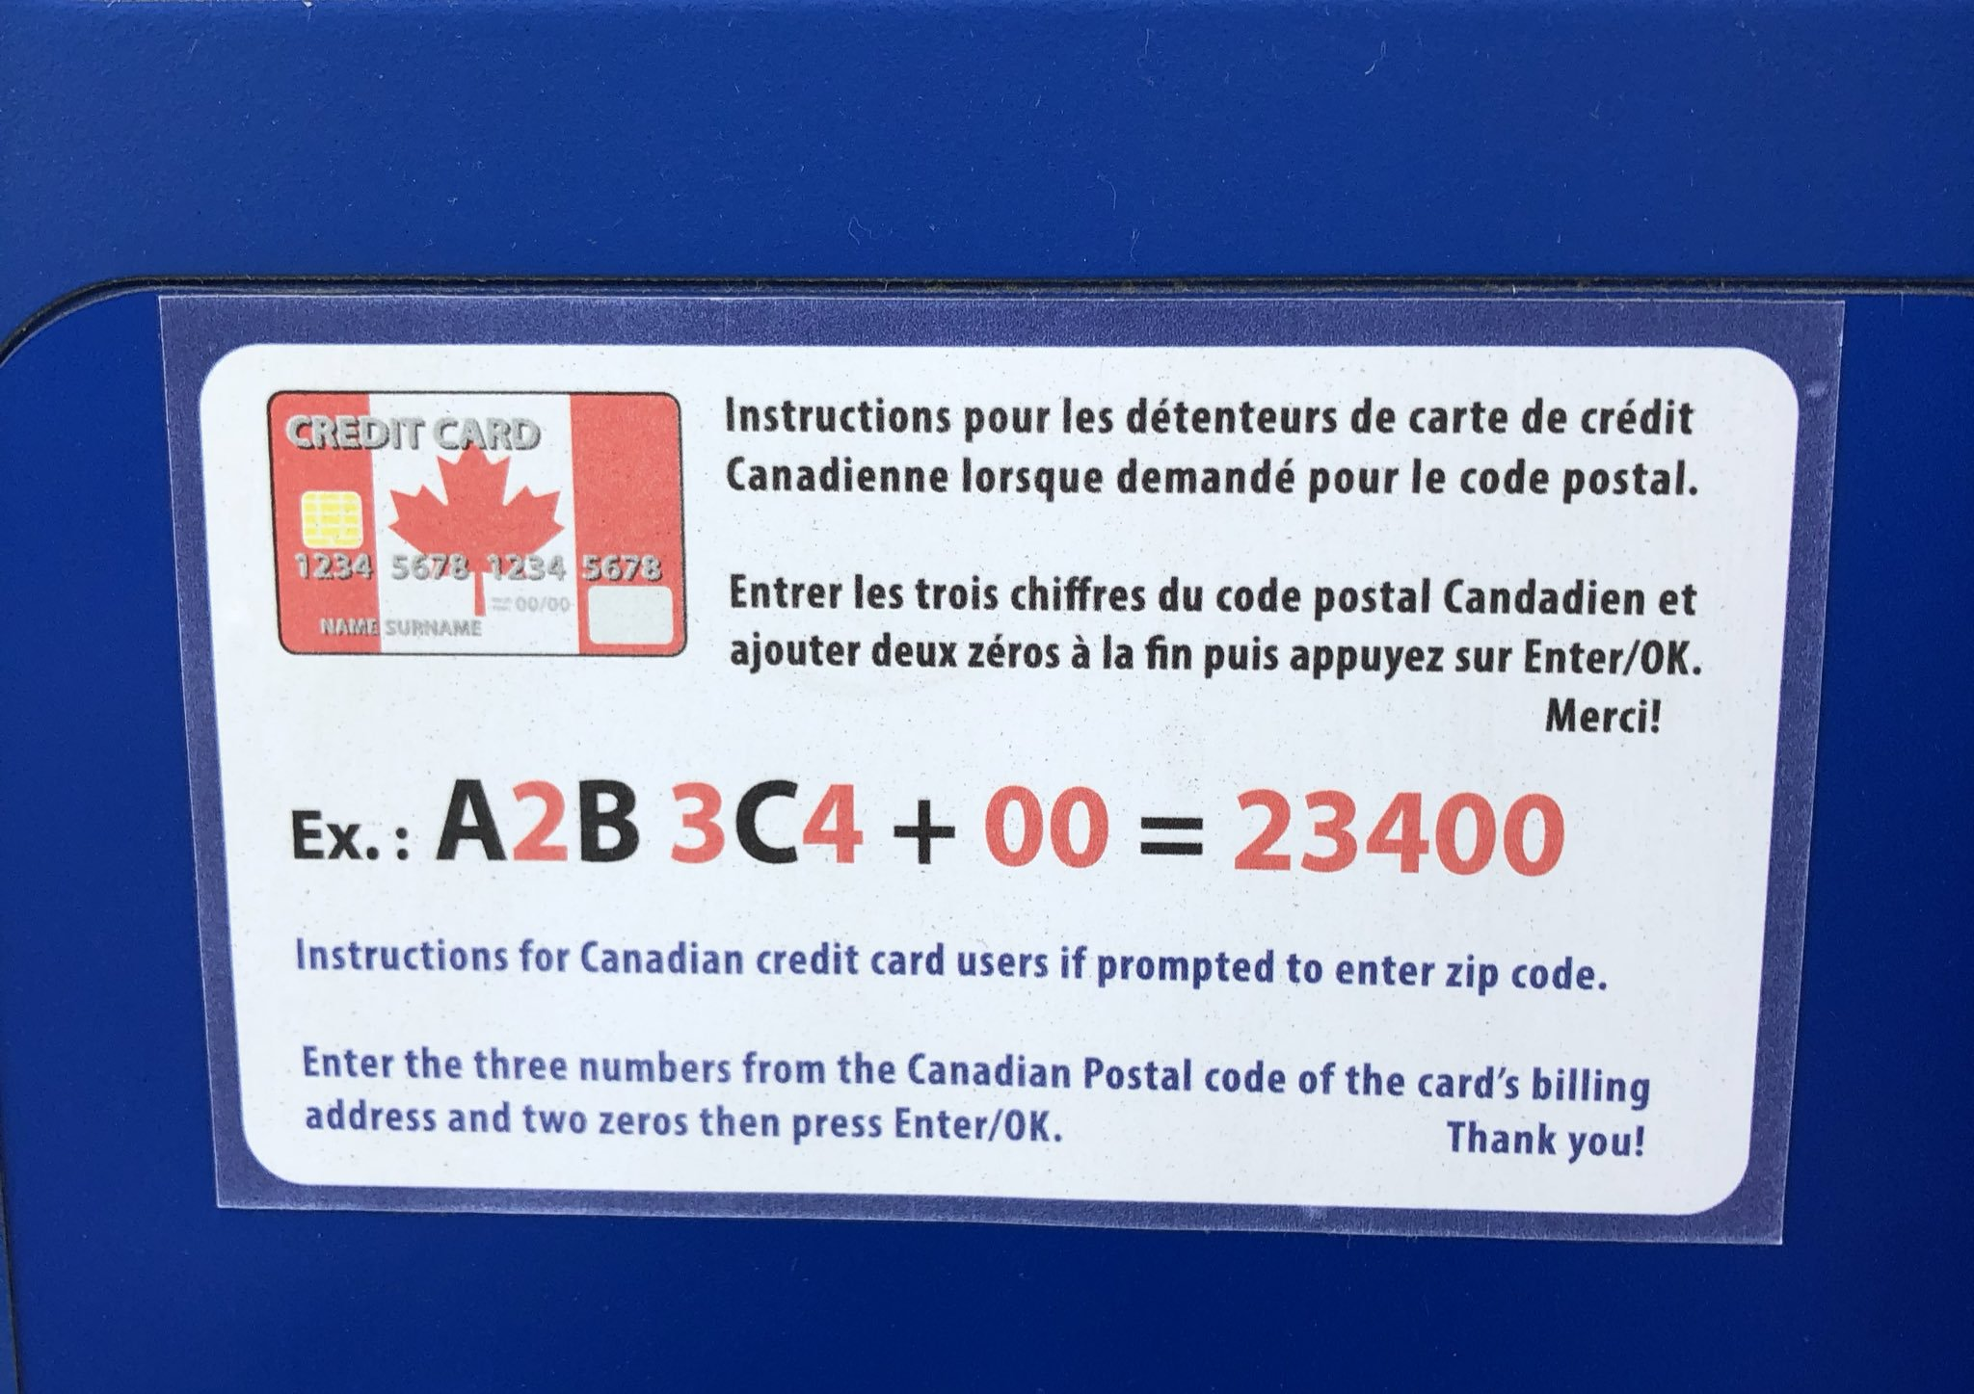
Person- Place Model of Need What is the barrier?! What is getting in the way in the place? Why can’t Shelley fill up with gas?
Fixing the Deficit vs. Removing the Barrier
Shelley Moore, 2021

Slide 55
Person-Place Perspective: Reduce barriers in place, respond to needs of individual Place: America Barrier: Gas tank needs a Zip code to pay with a credit card Shelley’s need: Shelley is Canadian and has a postal code Shelley’s IEP Goal: Shelley can fill up her car with gas by: Objective: turning her postal code into a zip code Universal Strategy: Sticker Individual Supports & Strategies: None
Shelley Moore, 2021

Slide 56
What are the barriers in a community? (What is getting in the way that is outside of a student control?) What are the needs of the individuals in a community? (Needs not disabilities) How do we anticipate supports & strategies needed for individuals in the community? (Planned for before, not after) How can we teach the supports & strategies so ALL students can access and choose? (Accessing supports & strategies do not affect evaluation or grades)
Shelley Moore, 2021

Slide 57
Practice: Popcorn
What is useful so far?

Slide 58
Creating Learning Statements
I used to think….
But now….
Shelley Moore, 2021

Slide 59
Creating Learning Statements - Examples
I uses to think that community could not be created in virtual learning spaces. But now I think that when we create opportunities for engagement and connection, community can be built anywhere!
I used to think that inclusion meant making a plan to include a student with a disability into a general education classroom. But now I think that inclusion means making a plan to respond to the diversity of all students but creating a safe place for students to identify and increase the places where they feel like they belong
Shelley Moore, 2021

Slide 60
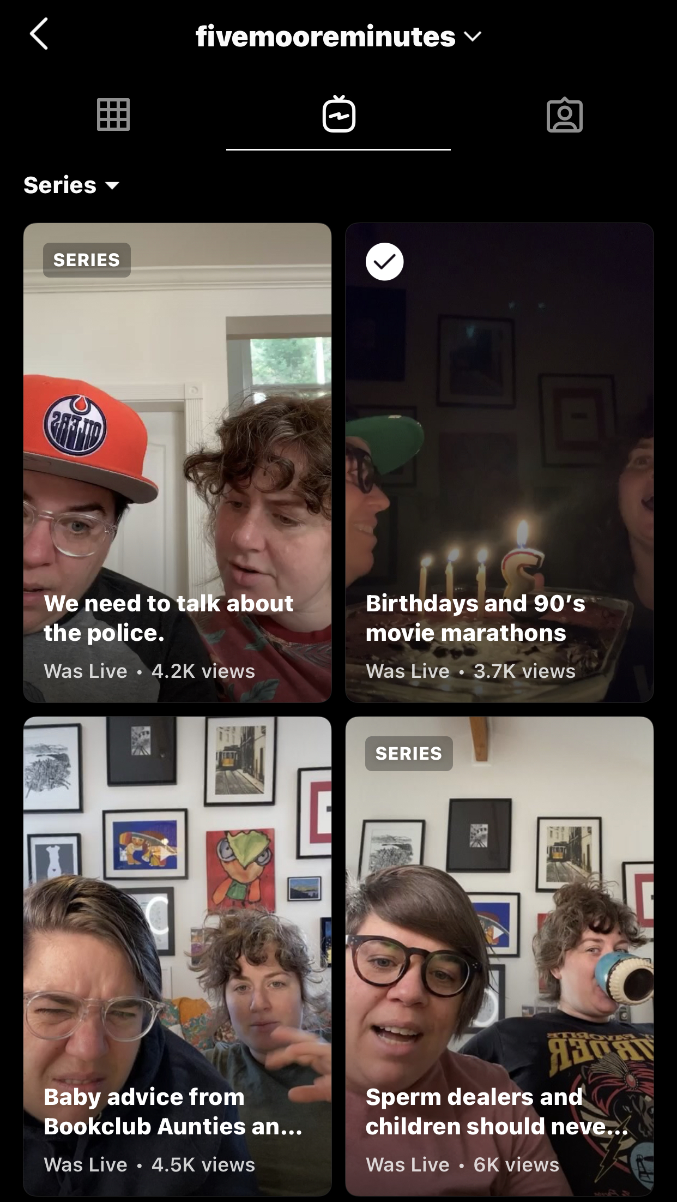

Evidence of learning: What artifact can represent your learning - Examples
I uses to think that community could not be created in virtual learning spaces. But now I think that when we create opportunities for engagement and connection, community can be built anywhere!
I used to think that inclusion meant making a plan to include a student with a disability into a general education classroom. But now I think that inclusion means making a plan to respond to the diversity of all students but creating a safe place for students to identify and increase the places where they feel like they belong.
Shelley Moore, 2021

Slide 61
Padlet – Sharing your learning
Padlet
Add team name
Share learning statement(s)
Add one piece of evidence
Image, photo, reflection, website, audio recording, video, etc.
Padlet is private to our group
Shelley Moore, 2021

Slide 62
https://padlet.com/fivemooreminutes/abn6w77y0fethhqp
Shelley Moore, 2021

Slide 63
Our plan for today
Sharing Out
Participation Protocols
Quick Review
P #2: The Importance of Place
Next Steps & Action Plans
Resources

Slide 64
Place Based Planning the ICBIEP
Who am I with?
Place
Where I am?
Who am I?
How do we increase the places where a student feels belonging?
I & CBIEPs Session 2 Shelley Moore, 2020

Slide 65
Strategy: Place Alignment Planner
For students who are not included in any places
For students who are partially included in some places
For students who are existing, but not belonging in an inclusive place (AND have some challenging behaviour)
NOT for students who are already included
NOT for students who are not having challenging behaviour
I & CBIEPs Session 2 Shelley Moore, 2020

Slide 66
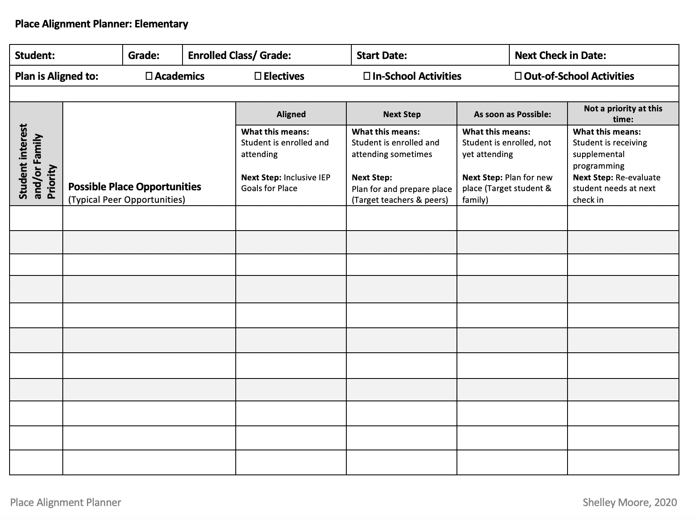
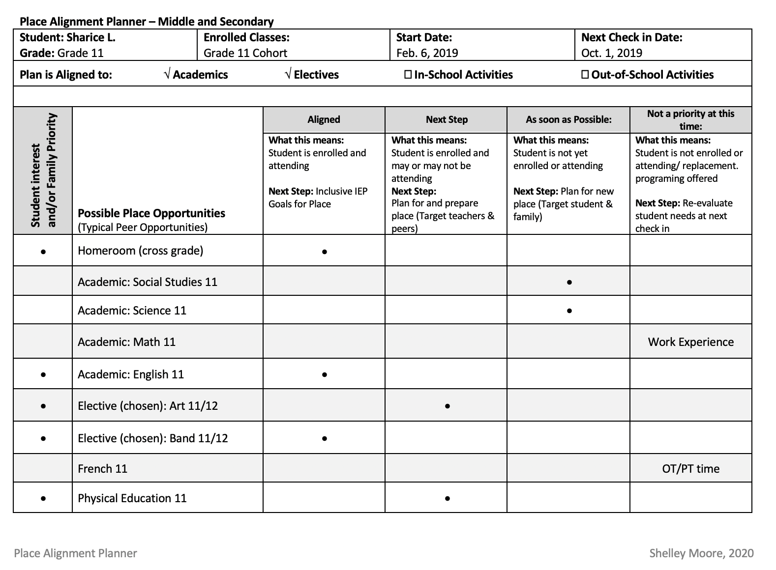

Slide 67
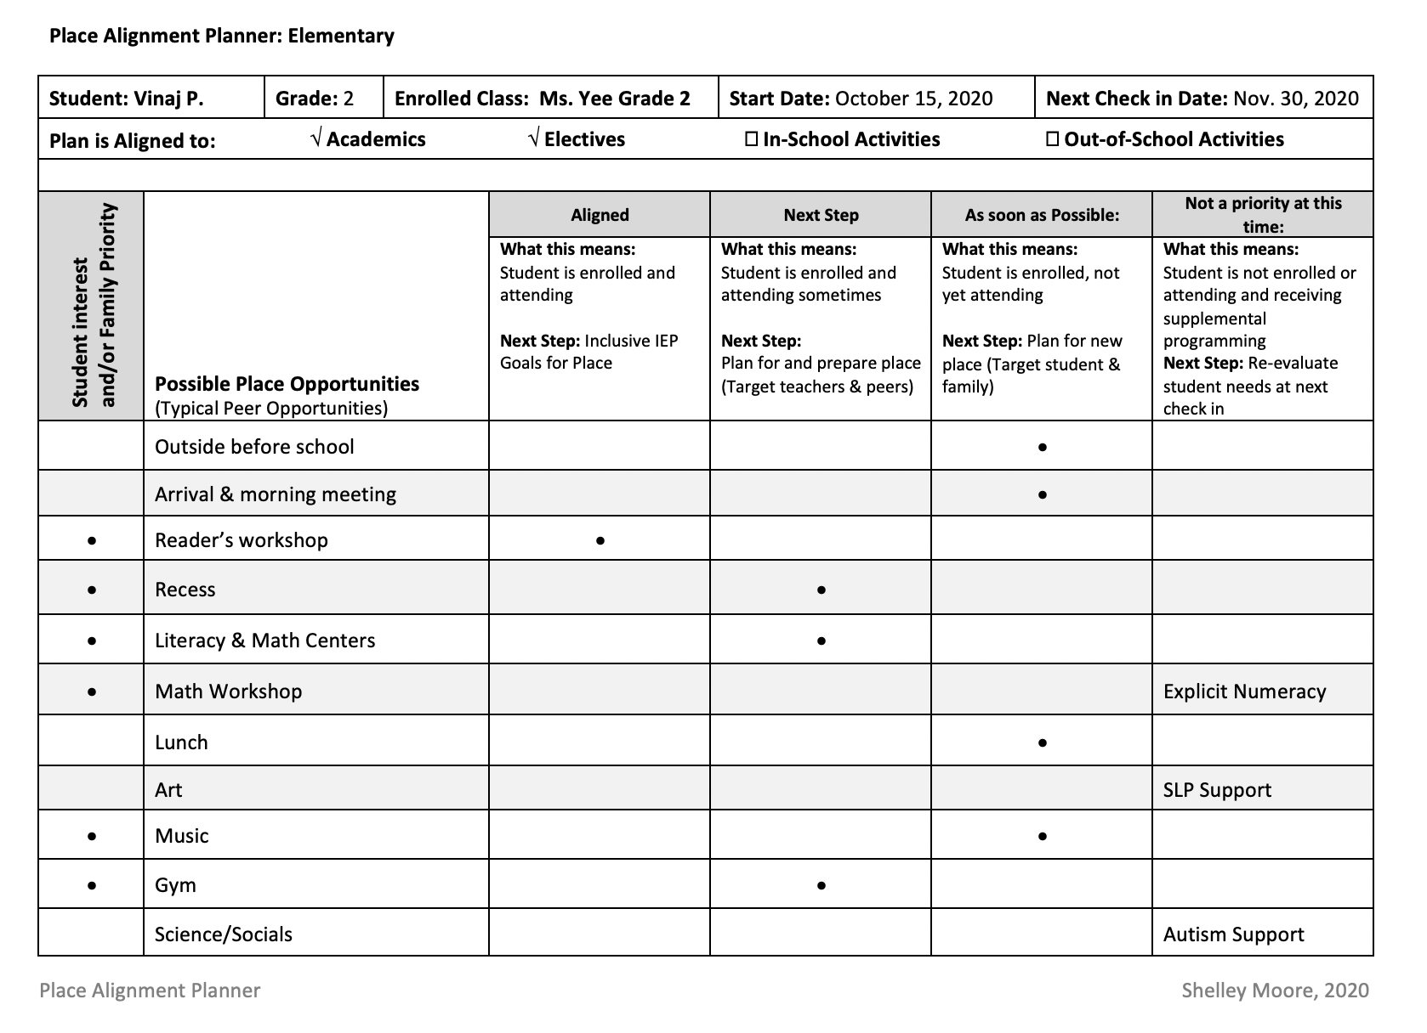

Slide 69
Taking Action: Some Ideas!
Your team:
watch the 5MM video (March 1!) and have a conversation with your team about your reflections
choose an article or a video from the resource list. As a team eat lunch together one day and have a discussion about what you are learning
construct a place-based strategy with a school team (i.e. Place Alignment planner
share a resource with someone not on your team, connected to what you are learning
to share a summary of what your team learned with your staff at a staff meeting or a professional development session
Have another idea? Let me know in your google form
Shelley Moore, 2021

Slide 70
Practice: Popcorn
How do you want to pull today’s information into your team’s action plans?

Slide 71
Inquiry Action Statements
How can we _______________ by ______________________,
(goal) (actions)
And we will try to capture our learning by ________________.
(evidence)

Slide 72
Example
How can we move forward in our inclusive journey by reviewing our current school structures and we will try to capture our learning by making a list of the strengths and stretches of our context?
Goal
Action
Evidence

Slide 73
Example
How can we build capacity in our school by sharing our learning with others and we will try to capture our learning by taking a picture of us meeting with a new teacher or group of teachers?
Goal
Action
Evidence

Slide 74
Example
How can we challenge our biases and assumptions by visiting a specialized classroom or program and noticing what students can do and reading an article about presuming competence and we will try to capture our learning by writing a reflection about what I noticed?
Goal
Action
Evidence

Slide 75
Session 2 Quad: https://forms.gle/SBrYFBMFcUHfTS4HA
Q1: What is one action that your team has taken since the series started?
Q2: What are you noticing?
Our Inquiry Team Name
__________________________
Q3: Create 1 -2 inquiry actions statements describing what your team will try between now and next session?
Shelley Moore, 2021

Slide 76
Our plan for today
Sharing Out
Participation Protocols
Quick Review
P #2: The Importance of Place
Next Steps & Action Plans
Resources

Slide 77


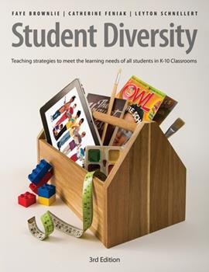
Resources
Interview with Jo Chrona
https://vimeo.com/user126497787/review/515910987/58365674fc
5MM Podcast with Mabel and Jo:
https://podcasts.apple.com/ca/podcast/the-five-moore-minutes-podcast/id1439038183?i=1000509241169
Place Based Inclusion Strategies
https://wordpress.com/page/blogsomemoore.com/4962

Slide 78
Research & Literature that Supports this Session:
Brownlie, F., & King, J. (2000). Learning in safe schools: Creating classrooms where all students belong. Markham, Ont: Pembroke.
Falvey, M. A. (2004). Toward Realizing the Influence of. Research and Practice for Persons with Severe Disabilities (RPSD), 29(1), 9-10.
Feldman, R., Carter, E., Asmus, J., & Brock, M. E. (2016). Presence, proximity, and peer interactions of adolescents with severe disabilities in general education classrooms. Exceptional Children, 82(2), 192-208.
Hunt, P., & Farron-Davis, F. (1992). A preliminary investigation of IEP quality and content associated with placement in general education versus special education classes. Journal of the Association for Persons with Severe Handicaps, 17(4), 247-253.
McDonnell, J., Mathot-Buckner, C., Thorson, N., & Fister, S. (2001). Supporting the inclusion of students with moderate and severe disabilities in junior high school general education classes: The effects of classwide peer tutoring, multi-element curriculum, and accommodations. Education and Treatment of children, 141-160.
National Center for Educational Restructuring and Inclusion. (1995). National study of inclusion. New York: Author
Wagner, M., Newman, L., Cameto, R., & Levine, P. (2006). The Academic Achievement and Functional Performance of Youth with Disabilities. A Report from the National Longitudinal Transition Study-2 (NLTS2). NCSER 2006-3000. Online Submission.
Yell, M. L. (1995). Least restrictive environment, inclusion, and students with disabilities: A legal analysis. The Journal of Special Education, 28(4), 389-404.

Slide 79
For Next Session
Bring the evidence of what you tried!

Slide 80
Next Session
1. Guiding conditions of inclusion describe that all students...
2. Teacher professional development that...
3. Systems frameworks that ...
supports collaboration and the changing roles of educators & support staff
are presumed competent
are enrolled in and attending curricular classes
are in proximity to and participating in learning with peers
have purposeful roles and responsibilities
is situated, ongoing and inquiry based
support Universal Design for Learning
move away from a medical & deficit-based model of special education (IEPS)
are planned for
School & District Infrastructure
Teacher & Staffing Infrastructure
Student Infrastructure

