Slide 1
SD 44: Eastview Elementary
Grade 6/7
Rachel: LST
Ali: CT
Christine: EA am
2 EA - pm
Chantry: Case Manager/ Counsellor
Rick Chan: Principal

Slide 2
Class 6/7
Strengths: community, compassionate, diverse
Stretches: wide range of need,
Needs: gifted, learning, attendance, social emotional,
Supports & strategies: Structure
Decisions: curricular design to respond to the range of need

Slide 3
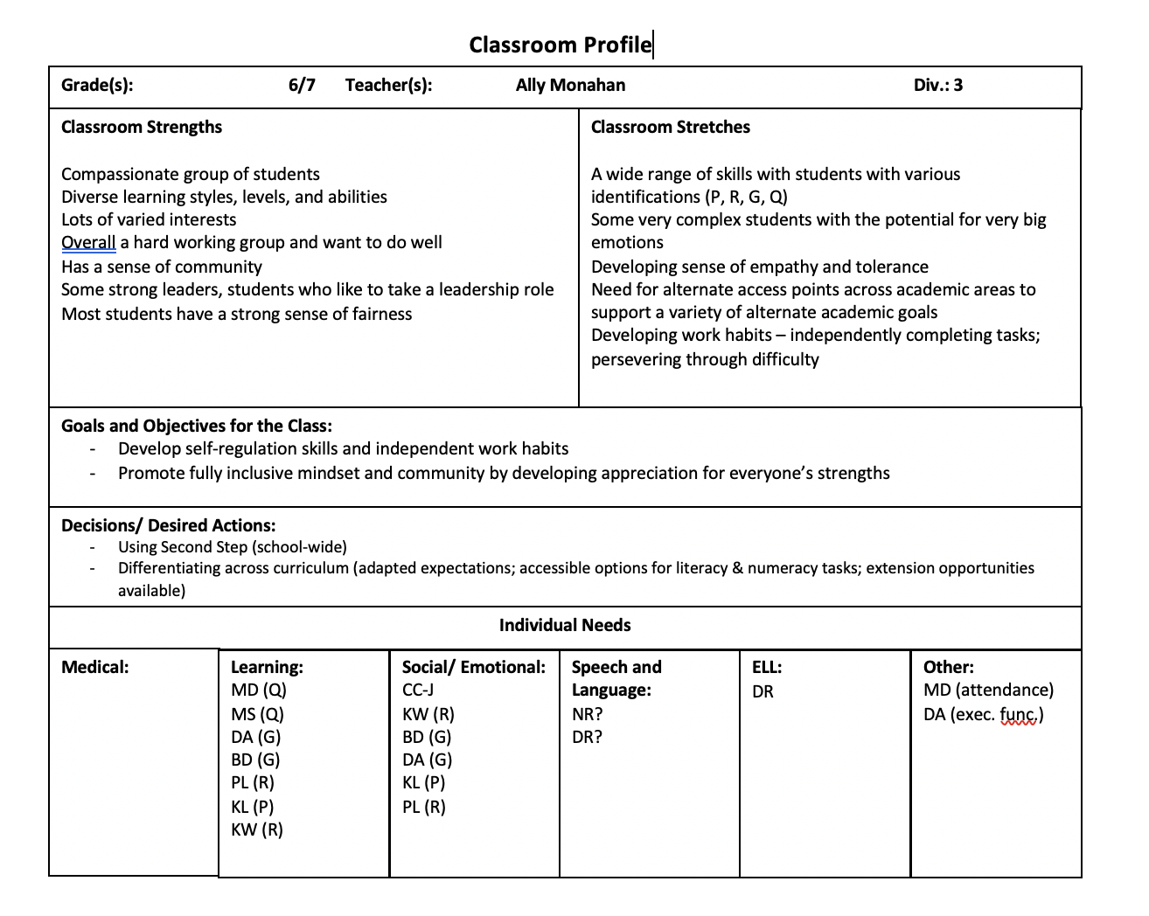

Slide 4
Target Student
BD (H/G)
  Interests: Science, math, animals, facts, going outside is motivating
  Strengths: getting better at flexibility, has grown immensely this year, more and more included in the class (100% in classes), wants to be with class for recess/lunch, self aware
  Stretches: Doesn’t like talking about himself, verbal/physical aggression, historically has not often been in class, difficulty with disability community
  Needs: Self regulation, social skills, independence, safety, medical needs, family needs, aggression, very black and white thinking
  Goals: admit and be okay when wrong, empathy,
  Supports & Strategies: team cohesion, behaviour consultant working with the family, alternate schedule (increasing)

Slide 5
Target Student
KW (R/D/Q)
  Interests: fashion, trendy, pop culture, gaming,
  Strengths: sweet, lovely, proud, social, connected, lots of friends, wants to do well, sense of humour, self and socially aware
  Stretches: difficulty asking for support, self esteem, academic (reading/writing/math)
  Needs: anxiety, family/sibling needs, learning needs
  Goals: self advocacy, independence
  Supports & strategies: connection, check ins

Slide 6
Target Students
MD (Q)
  Interests: gaming, connections (one-on-one) with peers and adults, cars, fast and shiny things, food, restaurants
  Strengths:
  Stretches: attendance, staying up late (gaming), hard time connections with peers because of attendance
  Needs: learning (late identification), anxiety, family needs, trauma
  Goals: attendance, readiness for secondary
  Supports & strategies: Food, pick ups, connecting family with community support and family workers, knowing he has a friend, strategic pairing with peers

Slide 7
Target Students
DA (G)
  Interests: body image, muscle building, sports, cars, being clean and organized, sports, kicking the ball
  Strengths: athletic, smart, strong memory, great at math, spelling, engaged when he is motivated, polite, sweet, coachable, very verbal
  Stretches: unpredictable, only works with particular people, doesn’t want to stand out, defensive and reactive reflexes, can have difficulty being socially appropriate
  Needs: movement, family needs-does not want him to know that he has Autism, attention
  Goals: increase expectations slowly over time, building stamina, sustaining engagement
  Supports & Strategies: needs connection, movement breaks, routine, one task at a time, task/break/task/break, task breakdowns, praise, practice, repetition, modelling, social skills teaching, scaffolding, practice

