Slide 1
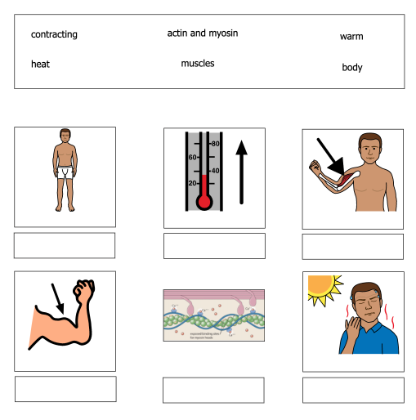
Bio 20-1 Unit Test: Muscles
Name: __________________________
Date: ___________________________
1. Use the words in the box to label the pictures
This question is evidence of learning goals:
20-D4.2K (R)
20-4KS (R)
20-4.4S (R)
20-1 Muscles Unit Test (Replacement) Shelley Moore, 2022

Slide 2
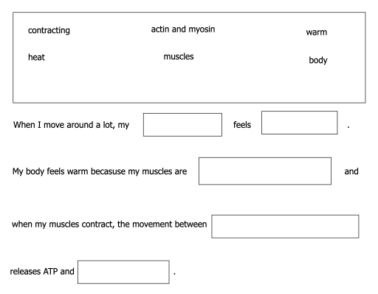
Bio 20-1 Unit Test: Muscles
2. Use the words in the box to complete the paragraph:
This question is evidence of learning goals:
20-D4.2K (R, E)
20-4KS (R)
20-4.4S (R)
20-1 Muscles Unit Test (Replacement) Shelley Moore, 2022

Slide 3
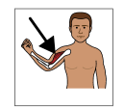
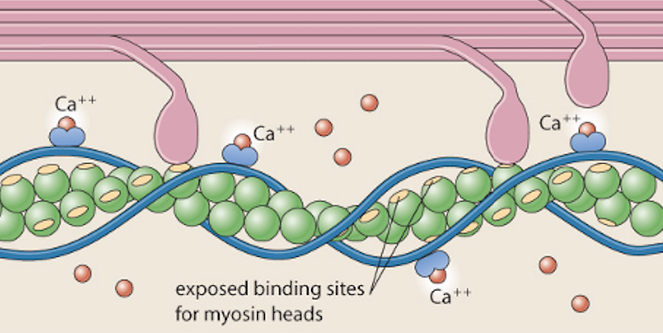
Bio 20-1 Unit Test: Muscles
3. Label the diagram of the muscle below.
Which part of the muscle is pointing to MYOSIN?
Which part of the muscle is pointing to ACTIN?
This question is evidence of learning goals:
20-D4.2K (R, E)
20-4KS (R)
20-4.4S (R)
20-1 Muscles Unit Test (Replacement) Shelley Moore, 2022

Slide 4
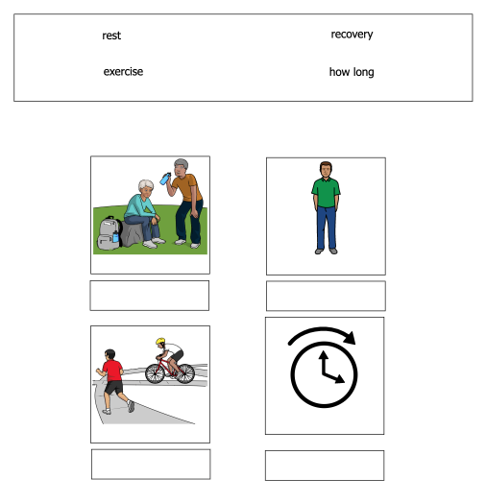
Bio 20-1 Unit Test: Muscles
Name: __________________________
Date: ___________________________
4. Use the words in the box to label the pictures. Use these words to help you in the next question
This question is evidence of learning goals:
20-D4.2K (R)
20-4KS (R)
20-4.4S (R)
20-1 Muscles Unit Test (Replacement) Shelley Moore, 2022

Slide 5
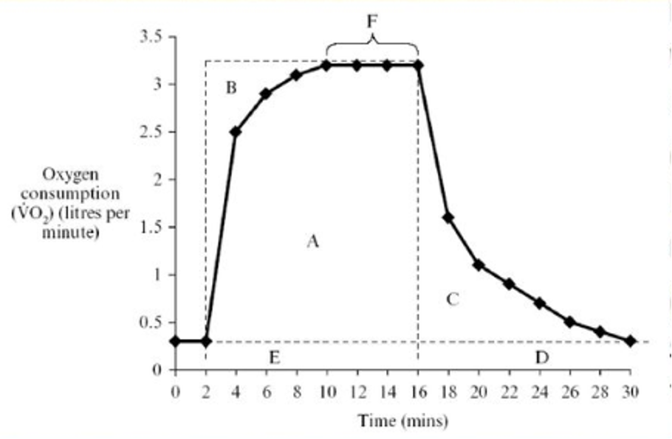
Bio 20-1 Unit Test: Muscles
4. This graph shows how a person’s body moves during exercise. Can you figure out when they:
Took a rest
Exercised really hard
How long they exercised for
Recovered
This question is evidence of learning goals:
20-4KS (R, E)
20-4.4S (R)
20-1 Muscles Unit Test (Replacement) Shelley Moore, 2022

