Slide 1
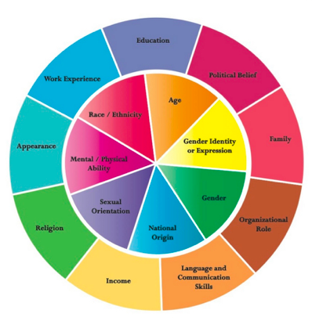
What are my Identities?
What communities do I belong to?
What colours are bright for me?
What colours are important to me?
What colours are areas of strength or passion?
What colours are bright at school?
What colours are bright outside of school?
How have my communities changed over time?
I & CBIEPs Session 3 Shelley Moore, 2021

Slide 2
What are my interests?
What are some things that I like? or I am interested in?
What are some things that I am passionate about?
What do I want to learn more about?
What do I spend a lot of time thinking about?
What do I wish I could do more of?
I & CBIEPs Session 3 Shelley Moore, 2021

Slide 3
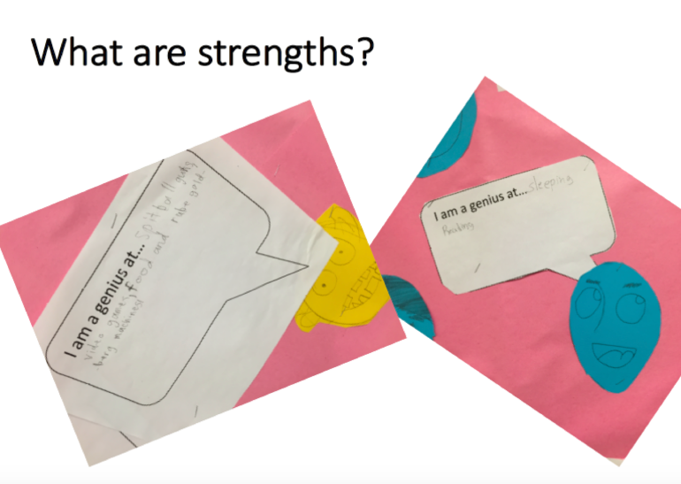
What are my strengths??
What are some things that I am really good at?
What are things I can do on my own?
What are some things that I can help others with or teach to others?
I & CBIEPs Session 3 Shelley Moore, 2021

Slide 4
What are my stretches??
What do I need to get better at?
Things that I can control
Things that are hard, but am getting better at?
Things I need some support with?
I & CBIEPs Session 3 Shelley Moore, 2021

Slide 5
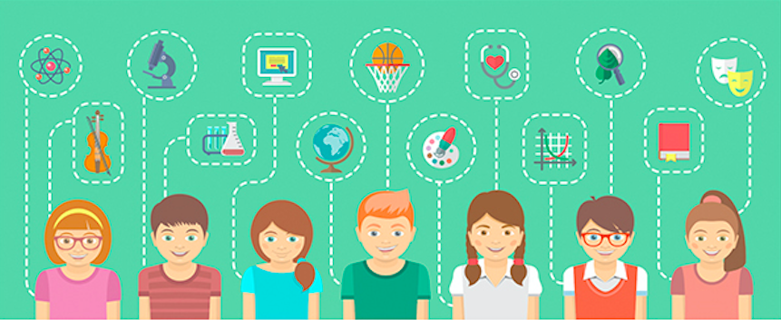
What are my needs??
What effects my learning that is out of my control?
What effects me at school and at in life?
What will I need support for for a long time?
I & CBIEPs Session 3 Shelley Moore, 2021

Slide 6
What are supports that can help me?
What are some tools that I can use to help me learn?
What tools help me to pay attention and keeps me interested?
What are strategies that can help me?
What are some actions that I can do to help me learn?
What are some actions of others that help me learn?
These actions help me to pay attention and keeps me interested?
I & CBIEPs Session 3 Shelley Moore, 2021

Slide 7

What are my goals??
How can I make a plan to target my stretches?
What do I want to get better at this year at school? At home? In life
What do I want to learn more about this year?
Where do I see myself in 25 year?
What goals do I have for my future?
What competencies (or sub competencies) do I want to target?
I & CBIEPs Session 3 Shelley Moore, 2021

