Slide 1
School: |  | Student Profile
Who am I as a person?
 | Name |  |  | Age
 | Grade |  |  | Year
 | A little about me…
 | Words that I or others might use to describe me and/or who I am as a person |  | My identities are:
 | Things I spend a lot of time doing, and/or things I want to learn about |  | My interests are:
 | Things I want my teachers to know about me/ things that will help others understand me better |  | My needs are:
I & CBIEPs Session 3 Shelley Moore, 2021

Slide 2
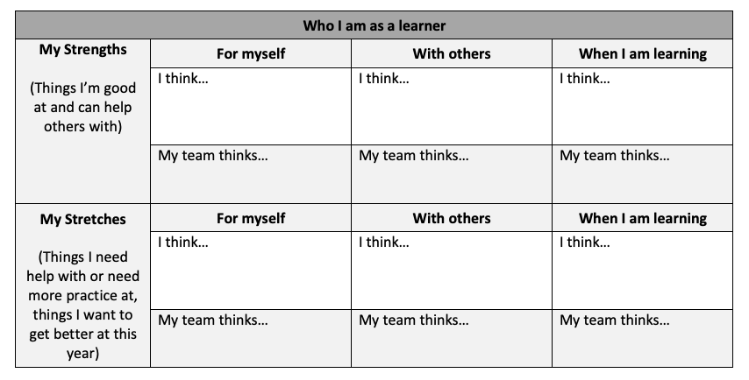
I & CBIEPs Session 3 Shelley Moore, 2021

