Slide 1
Science Templates

Slide 2

Backwards Design Planning
Grade: | Subject Area: Science | Strand/Topic:
Learning Standard: |  | Unit Guiding Question(s):
Key Vocabulary:
Learning Goals | Curricular Language What do Students need to Know and Do? | Student Friendly Language | Student Friendly Language
Science and Engineering Practices |  | I can make and use models to help me understand
Disciplinary Core Ideas |  | I know how to identify and describe matter using their structures and properties
Crosscutting Concepts |  | I know that I can use scale, proportion and quantity to describe matter that is too small to see
Next Generation Science Standards (NGSS)
Backwards Design Planning Template
S ,Moore, 2023

Slide 3
Backwards Design Planning
Grade: | Subject Area: Science |  |  | Strand/Topic:
Learning Standard: |  |  |  | Unit Guiding Question(s):
Key Vocabulary:
Learning Goals | Curricular Language What do Students need to Know and Do? | Curricular Language What do Students need to Know and Do? |  | Student Friendly Language |  | Student Friendly Language
Science and Engineering Practices | Developing and Using Models: I can make and use models to help me understand |  |  | I can make and use models to help me understand |  | I can make and use models to help me understand
Access (1) | Essential (2) | Essential (2) | Developing (3) |  | Challenge (4) | Challenge (4)
 | I can make a plan to create a model
Next Generation Science Standards (NGSS)
Backwards Design Planning Template
S ,Moore, 2023

Slide 4
Backwards Design Planning
Grade: | Subject Area: Science |  | Strand/Topic:
Learning Standard: |  |  | Unit Guiding Question(s):
Key Vocabulary:
Learning Goals | Curricular Language What do Students need to Know and Do? |  | Student Friendly Language | Student Friendly Language
Disciplinary Core Ideas |  |  | I can make and use models to help me understand | I can make and use models to help me understand
Access (1) | Essential (2) | Developing (3) |  | Confident (4)
Next Generation Science Standards (NGSS)
Backwards Design Planning Template
S ,Moore, 2023

Slide 5
Backwards Design Planning
Grade: | Subject Area: Science |  |  | Strand/Topic:
Learning Standard: |  |  |  | Unit Guiding Question(s):
Key Vocabulary:
Learning Goals | Curricular Language What do Students need to Know and Do? | Curricular Language What do Students need to Know and Do? |  | Student Friendly Language | Student Friendly Language
Crosscutting Concepts | Scale, Proportion, and Quantity I know that I can use scale, proportion and quantity to describe matter that is too small to see |  |  | I can make and use models to help me understand | I can make and use models to help me understand
Access (1) | Essential (2) | Essential (2) | Developing (3) |  | Challenge (4) | Challenge (4)
Next Generation Science Standards (NGSS)
Backwards Design Planning Template
S ,Moore, 2023

Slide 6
Science Example

Slide 7
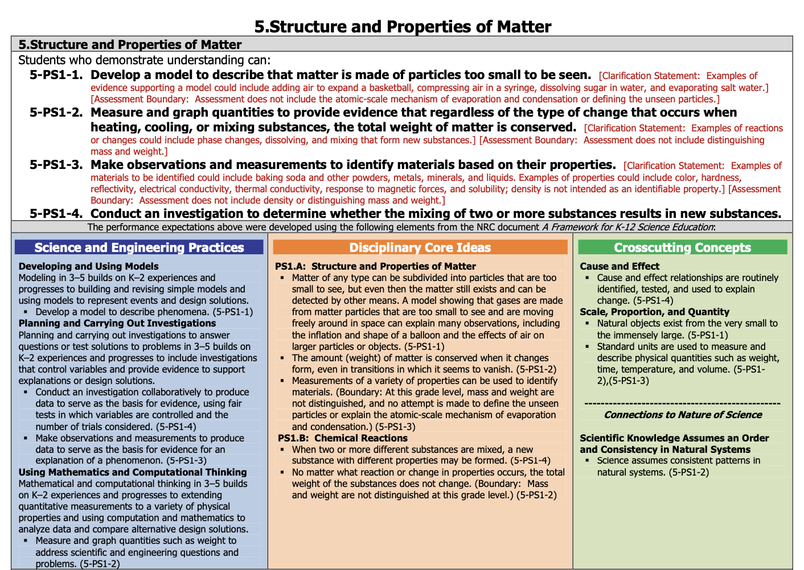

Slide 8
Backwards Design Planning
Grade: 5 | Subject Area: Science | Strand/Topic: Structures & Properties of Matter
Learning Standard: 5-PS1-1 Students can develop a model to describe that matter is made of particles too small to be seen |  | Unit Guiding Question(s): How can I make a model to show that matter can be made up of particles that are too small to see?
Key Vocabulary: matter, properties, structures, scale, proportion, quantity, models particles
Learning Goals | Curricular Language What do Students need to Know and Do? | Student Friendly Language | Student Friendly Language
Science and Engineering Practices | Developing and Using Models | I can make and use models to help me understand | I can make and use models to help me understand
Disciplinary Core Ideas | Structure and Properties of Matter | I know how to identify and describe matter using their structures and properties | I know how to identify and describe matter using their structures and properties
Crosscutting Concepts | Scale, Proportion, and Quantity | I know that I can use scale, proportion and quantity to describe matter that is too small to see | I know that I can use scale, proportion and quantity to describe matter that is too small to see
Next Generation Science Standards (NGSS)
Backwards Design Planning Template
S ,Moore, 2023

Slide 9
Backwards Design Planning
Grade: 5 | Subject Area: Science |  |  | Strand/Topic: Structures & Properties of Matter
Learning Standard: 5-PS1-1 Students can develop a model to describe that matter is made of particles too small to be seen |  |  |  | Unit Guiding Question(s): How can I make a model to show that matter can be made up of particles that are too small to see?
Key Vocabulary: matter, properties, structures, scale, proportion, quantity, models particles
Learning Goals | Curricular Language What do Students need to Know and Do? | Curricular Language What do Students need to Know and Do? |  | Student Friendly Language |  | Student Friendly Language
Science and Engineering Practices | Developing and Using Models: I can make and use models to help me understand | Developing and Using Models: I can make and use models to help me understand |  | I can make and use models to help me understand |  | I can make and use models to help me understand
Access (1) | Essential (2) | Essential (2) | Developing (3) |  | Challenge (4) | Challenge (4)
I can follow/participate in creating a model | I can make a plan to create a model | I can make a plan to create a model | I can build and test a model |  | I can adjust and improve a model
Next Generation Science Standards (NGSS)
Backwards Design Planning Template
S ,Moore, 2023

Slide 10
Backwards Design Planning
Grade: 5 | Subject Area: Science |  | Strand/Topic: Structures & Properties of Matter
Learning Standard: 5-PS1-1 Students can develop a model to describe that matter is made of particles too small to be seen |  |  | Unit Guiding Question(s): How can I make a model to show that matter can be made up of particles that are too small to see?
Key Vocabulary: matter, properties, structures, scale, proportion, quantity, models particles
Learning Goals | Curricular Language What do Students need to Know and Do? |  | Student Friendly Language | Student Friendly Language
Disciplinary Core Ideas | PS1.A: Structure and Properties of Matter I know how to identify and describe matter using their structures and properties |  | I can make and use models to help me understand | I can make and use models to help me understand
Access (1) | Essential (2) | Developing (3) |  | Confident (4)
I know that matter can be divided up into tiny parts | I know that matter can be divided up into particles that are too small to see | I know that even though there are particles that are too small to see, they still exist and can be seen using models |  | I know why a model can help us to see tiny particles because of how they move together in space
Next Generation Science Standards (NGSS)
Backwards Design Planning Template
S ,Moore, 2023

Slide 11
Backwards Design Planning
Grade: 5 | Subject Area: Science |  |  | Strand/Topic: Structures & Properties of Matter
Learning Standard: 5-PS1-1 Students can develop a model to describe that matter is made of particles too small to be seen |  |  |  | Unit Guiding Question(s): How can I make a model to show that matter can be made up of particles that are too small to see?
Key Vocabulary: matter, properties, structures, scale, proportion, quantity, models particles
Learning Goals | Curricular Language What do Students need to Know and Do? | Curricular Language What do Students need to Know and Do? |  | Student Friendly Language | Student Friendly Language
Crosscutting Concepts | Scale, Proportion, and Quantity I know that I can use scale, proportion and quantity to describe matter that is too small to see | Scale, Proportion, and Quantity I know that I can use scale, proportion and quantity to describe matter that is too small to see |  | I can make and use models to help me understand | I can make and use models to help me understand
Access (1) | Essential (2) | Essential (2) | Developing (3) |  | Challenge (4) | Challenge (4)
I know what big and small is I know what more is I know what less is |  | I know what scale, proportion and quantity are | I know how scale and proportions can help describe the size of tiny particles that are too small to see |  |  | I know how to use scale and proportion to describe and compare different kinds of matter
Next Generation Science Standards (NGSS)
Backwards Design Planning Template
S ,Moore, 2023

Slide 12
Backwards Design Planning
Grade: 5 | Subject Area: Science | Strand/Topic: Structures & Properties of Matter
Learning Standard: 5-PS1-3 Students can make observations and measurements to identify materials and matter based on their properties |  | Unit Guiding Question(s): How can I make observations and measurements to identify and describe materials and matter based on their properties?
Key Vocabulary: observations, measurements, materials, matter, properties, structures, scale, proportion, quantity, make a plan, investigate
Learning Goals | Curricular Language What do Students need to Know and Do? | Student Friendly Language | Student Friendly Language
Science and Engineering Practices | Planning and Carrying Out Investigations | I can make a plan to investigate matter | I can make a plan to investigate matter
Disciplinary Core Ideas | Structure and Properties of Matter | I know how to identify and describe matter using their structures and properties | I know how to identify and describe matter using their structures and properties
Crosscutting Concepts | Scale, Proportion, and Quantity | I know that I can use scale, proportion and quantity to describe matter that I can see | I know that I can use scale, proportion and quantity to describe matter that I can see
Next Generation Science Standards (NGSS)
Backwards Design Planning Template
S ,Moore, 2023

Slide 13
Rubrics vs. Learning Progressions
 | deficit | deficit | Standard
goal

Slide 14
Reductive vs vs. Additive
 | Essential | More complex | More complex
Learning Outcome

Slide 15
The Planning Pyramid: Differentiated Curriculum
ALL
MOST
FEW
Even More Complexity
More Complexity
Essential Concept
Start from access, build on challenge

Slide 16
An Additive Continuum of Proficiency
Grade Level Learning Standard | Approaching Grade Level (1) | Grade Level Partial (2) | Grade Level Fully (3) | Extending Grade Level (4)
 | Creating Access | Essential Concept | More Complexity | Creating Challenge
www.fivemooreminutes.com
Shelley Moore, 2023

