Slide 1

Describe what you see.
What do you notice?
This is activity is connected to: 5-PS1-1 (NGSS) Dr. Shelley Moore, 2024

Slide 2

Describe what you see.
How does this image connect to the other image?
This is activity is connected to: 5-PS1-1 (NGSS) Dr. Shelley Moore, 2024

Slide 3
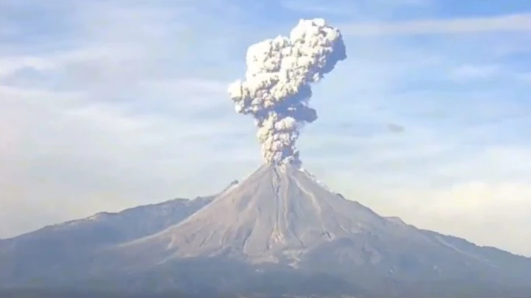
Describe what you see.
How is this image different or the same as the other images?
This is activity is connected to: 5-PS1-1 (NGSS) Dr. Shelley Moore, 2024

Slide 4

Describe what you see.
How is this image different or the same as the other images?
This is activity is connected to: 5-PS1-1 (NGSS) Dr. Shelley Moore, 2024

Slide 5

Describe what you see.
How is this image different or the same as the other images?
This is activity is connected to: 5-PS1-1 (NGSS) Dr. Shelley Moore, 2024

Slide 6

Describe what you see.
How is this image different or the same as the other images?
This is activity is connected to: 5-PS1-1 (NGSS) Dr. Shelley Moore, 2024

Slide 7

Describe what you see.
How is this image different or the same as the other images?
This is activity is connected to: 5-PS1-1 (NGSS) Dr. Shelley Moore, 2024

Slide 8

Describe what you see.
How is this image different or the same as the other images?
This is activity is connected to: 5-PS1-1 (NGSS) Dr. Shelley Moore, 2024

Slide 9

What do all these images have in common?
This is activity is connected to: 5-PS1-1 (NGSS) Dr. Shelley Moore, 2024

Slide 10
All the images are different states of matter
SOLID
LIQUID
GAS
This is activity is connected to: 5-PS1-1 (NGSS) Dr. Shelley Moore, 2024

Slide 11
Our Learning Goal: I know that matter can be broken apart into tiny particles that are too small to see
SOLID
LIQUID
GAS
This is activity is connected to: 5-PS1-1 (NGSS) Dr. Shelley Moore, 2024

