Slide 1
Student: ________________ Class: ________________
Priority Need Area | Universal Design for Learning Indicators that will reduce barriers (Teach to All; Useful to all) | Specific & Targeted Supports & Strategies that will increase agency (Teach to All; Useful to Some) | Individualized Supports & Strategies that will increase access (Teach to All; Useful for One)
What individual need are we targeting? | What 3-5 UDL indicators could we focus on that would reduce barriers for all students who have this need? | What specific supports (tools) and strategies (actions) could we teach to all students to increase their agency when managing this need? | What individualized supports (tools) and strategies (actions) would increase access for the student we are designing for?
Universalizing & Anchoring Individual Supports & Strategies
Dr. Shelley Moore, 2025

Slide 2
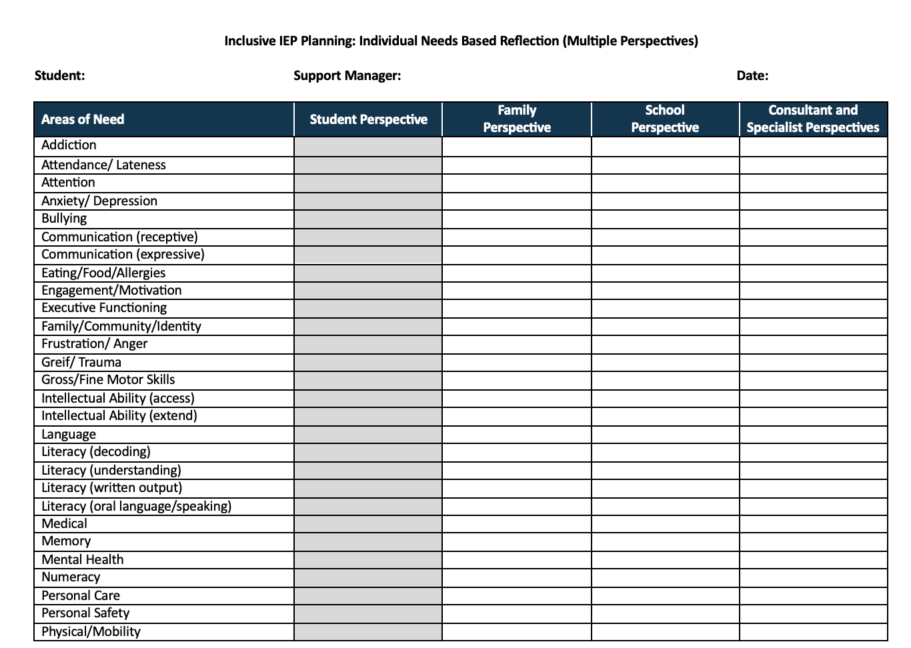

Slide 3
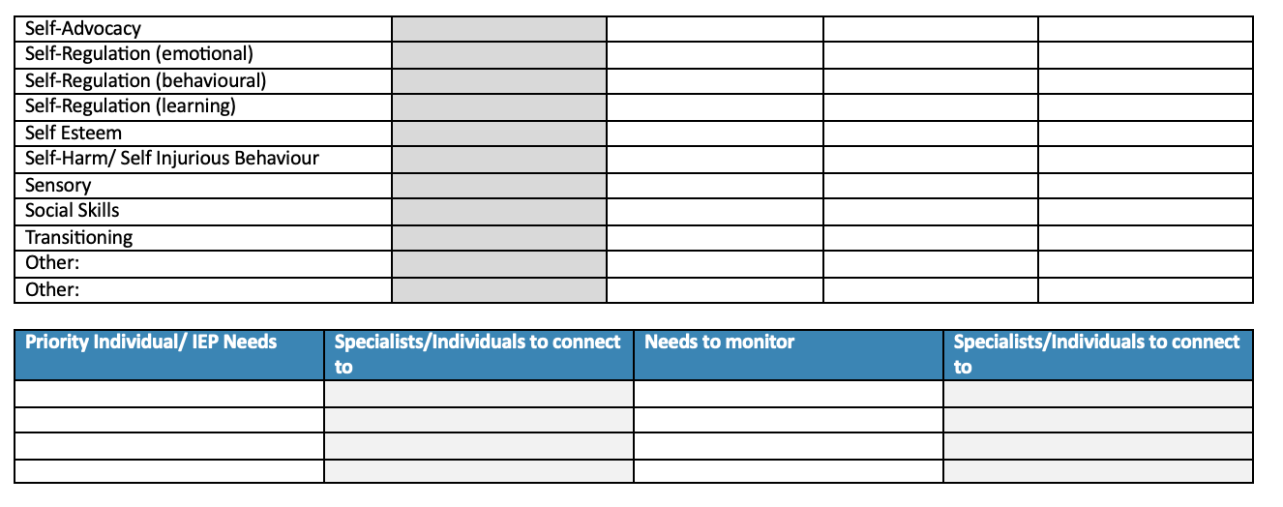

Slide 4
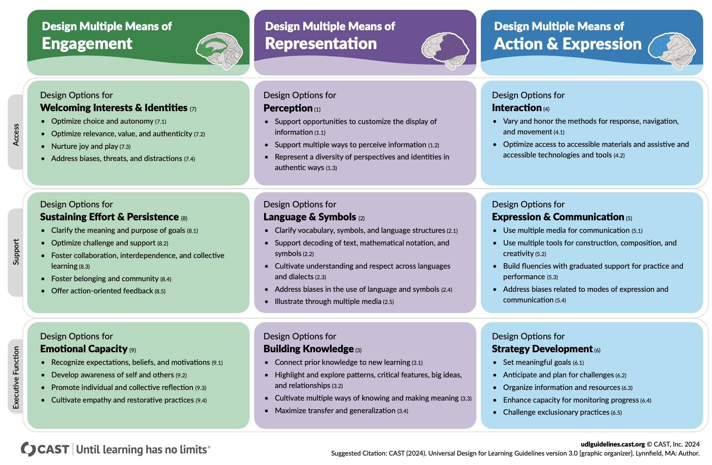
What universal supports & strategies can be taught to reduce barriers for everyone?

