Slide 1
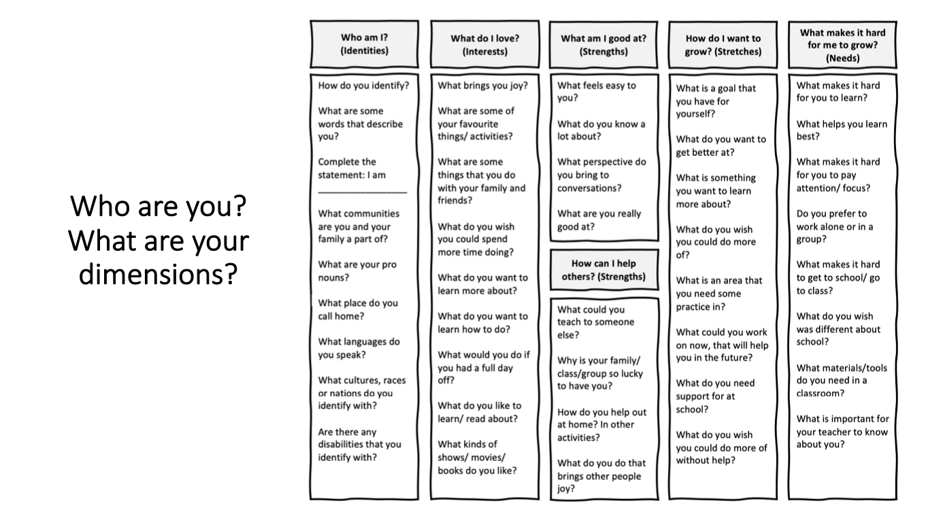

Slide 2
Getting to Know Children & Family Dimensions – Family Interviews
Child: | Child: | Child: | Child: | Child:
What are the identities of your child and your family? | What are the identities of your child and your family? | What are the identities of your child and your family? | What are the identities of your child and your family? | What are the identities of your child and your family?
What are the interests of your child and your family? | What are the interests of your child and your family? | What are the interests of your child and your family? | What are the interests of your child and your family? | What are the interests of your child and your family?
What are the strengths of your child? | What are the strengths of your child? | What are the strengths of your child? | What are the strengths of your child? | What are the strengths of your child?
What is hard for your child in this community? What do they need support with? | What is hard for your child in this community? What do they need support with? | What is hard for your child in this community? What do they need support with? | What is hard for your child in this community? What do they need support with? | What is hard for your child in this community? What do they need support with?
What is getting in the way for your child to feel a sense of belonging and success in this community? What is getting in the way for the family? | What is getting in the way for your child to feel a sense of belonging and success in this community? What is getting in the way for the family? | What is getting in the way for your child to feel a sense of belonging and success in this community? What is getting in the way for the family? | What is getting in the way for your child to feel a sense of belonging and success in this community? What is getting in the way for the family? | What is getting in the way for your child to feel a sense of belonging and success in this community? What is getting in the way for the family?
Children & Family Dimensions Interview
Dr. Shelley Moore, 2023

