Slide 1
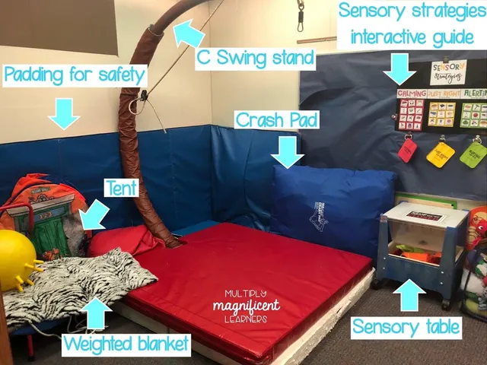
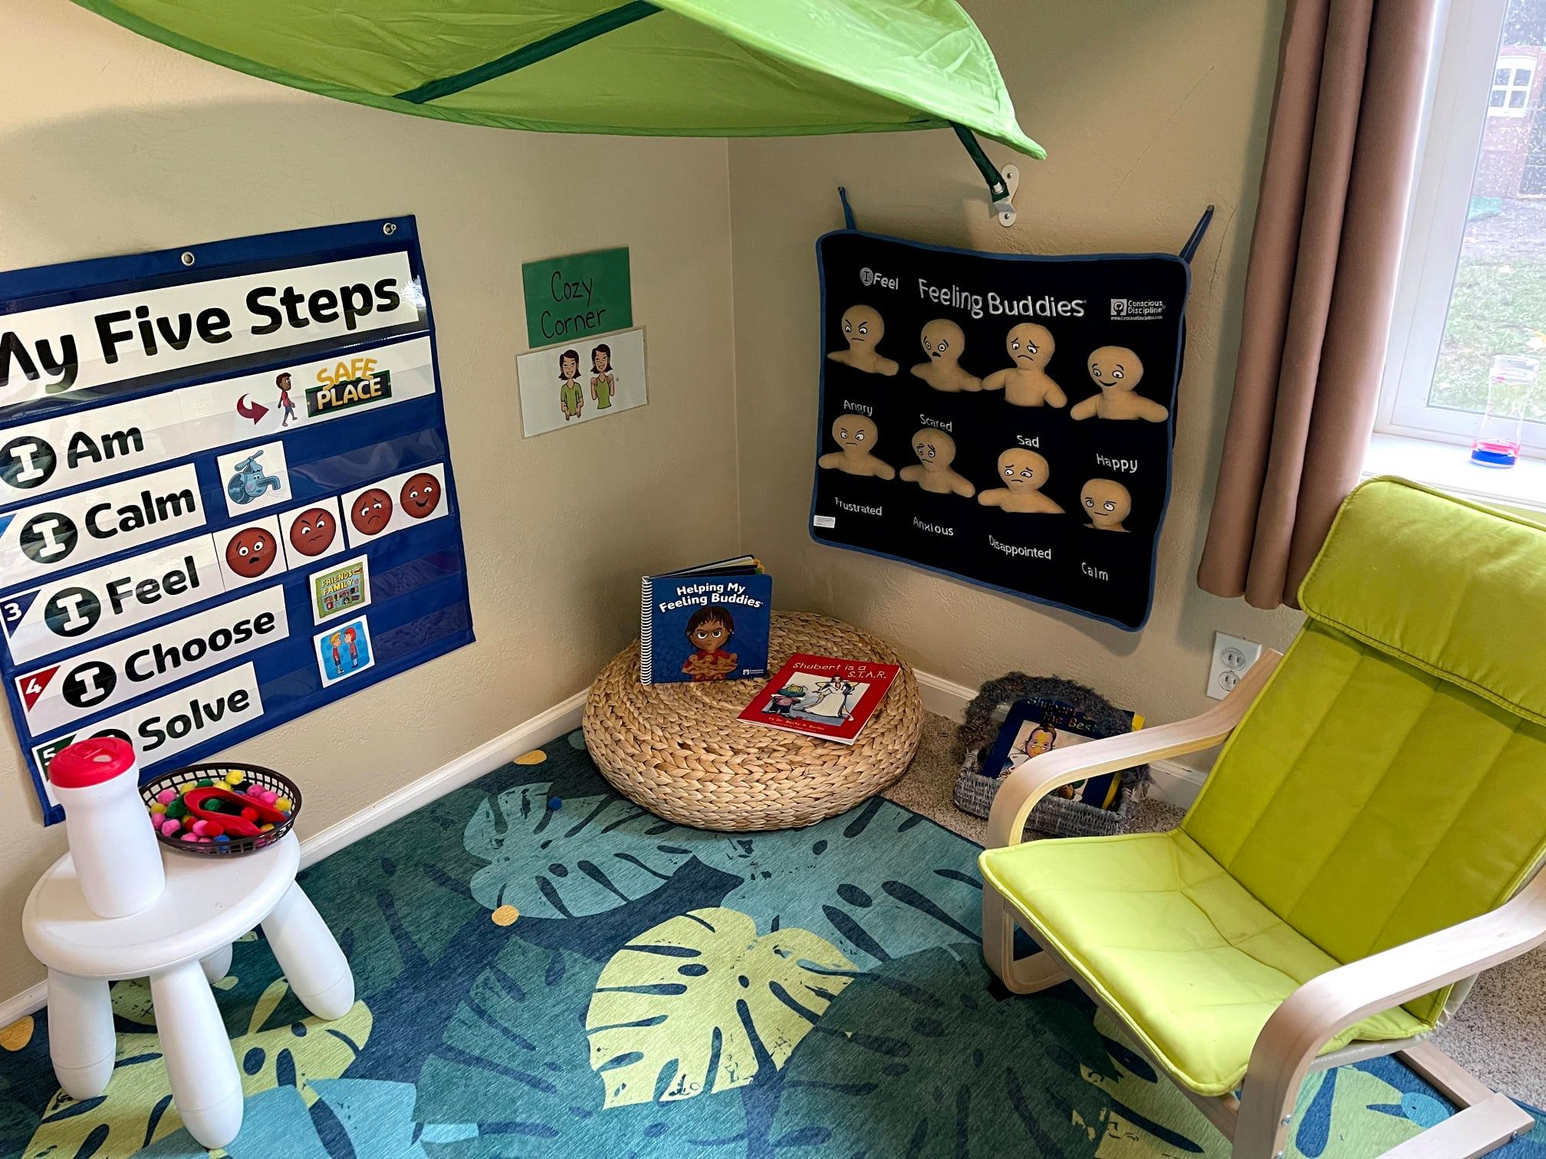
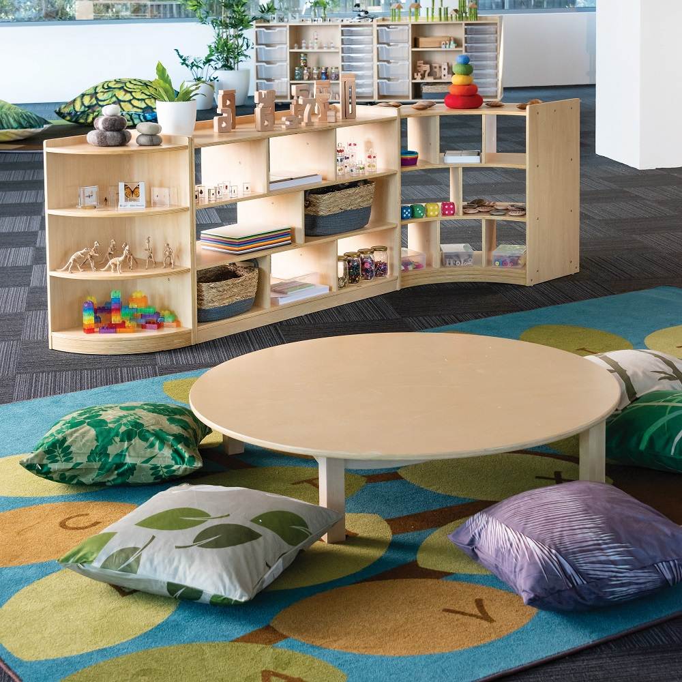
UDL 3.0 Indicator | What this means in teacher friendly language | What might look like in a grade 2 classroom? | What this might look like arriving to school
7.4 Address biases, threats, and distractions | Educators intentionally create safe, predictable, and inclusive environments where children experience emotional security, see their identities reflected, and have multiple ways to participate and succeed. | Reduce sensory threat: Multiple zones (active / social / quiet). Kids can opt out of noisy activities without losing belonging. Clear noise expectations and access to sensory tools | Emotional + relational safety: Staff assume kids may be tired, hungry, overstimulated; there’s a decompression routine (snack, quiet corners, low-demand entry) before expectations ramp up.
Making sense of UDL 3.0
Dr. Shelley Moore, 2026

Slide 2
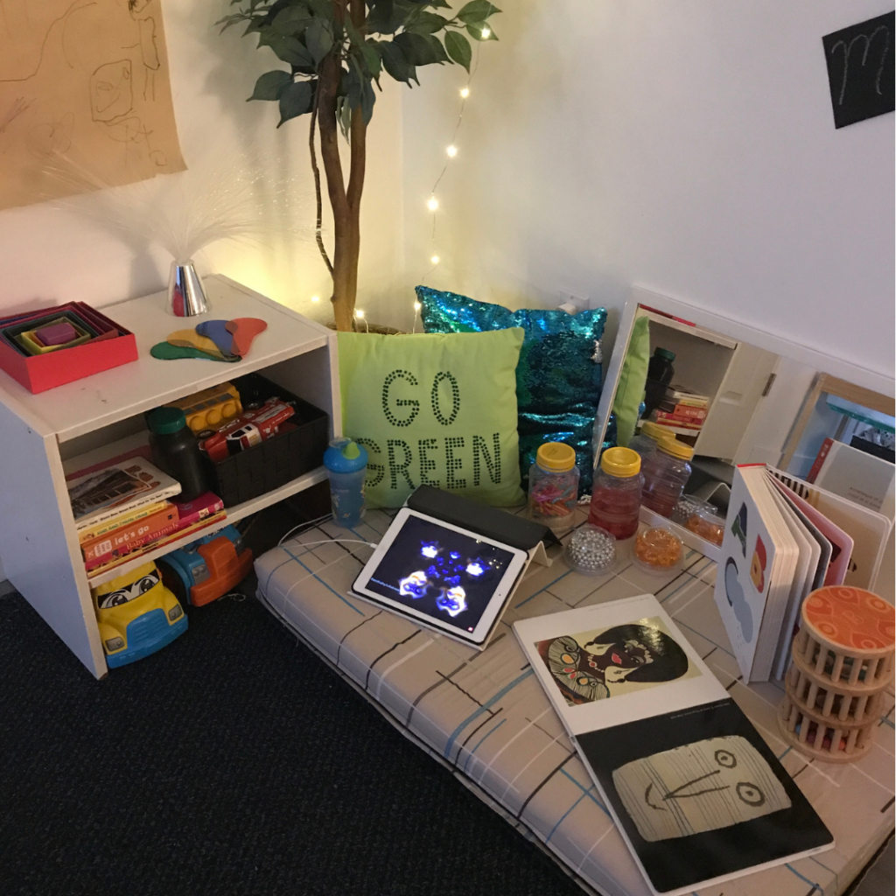
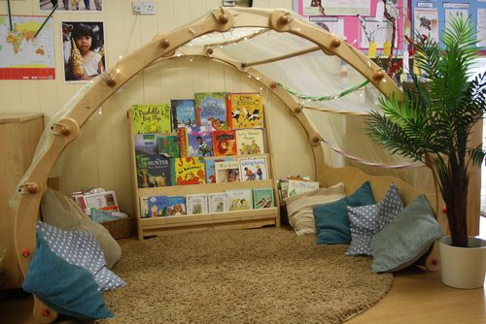
Examples of ramp 7.4 - Address biases, threats, and distractions: Reducing Sensory Threat
Multiple zones for different purposes
Quiet/cozy corners
Flexible seating options including low tables
A place to opt out of loud and large group activities
Uncluttered
Soft sounds/music
Headphones available

Slide 3
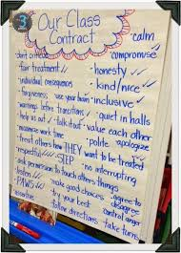
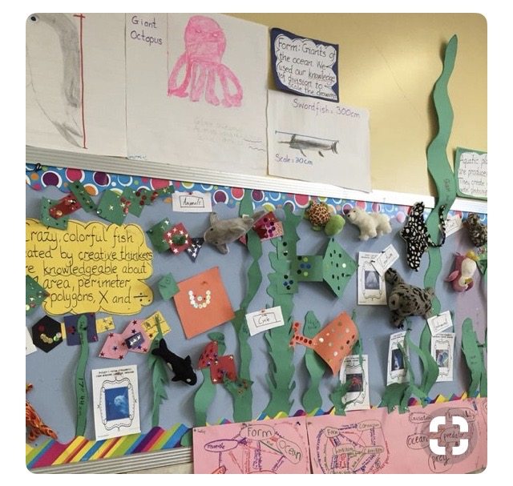
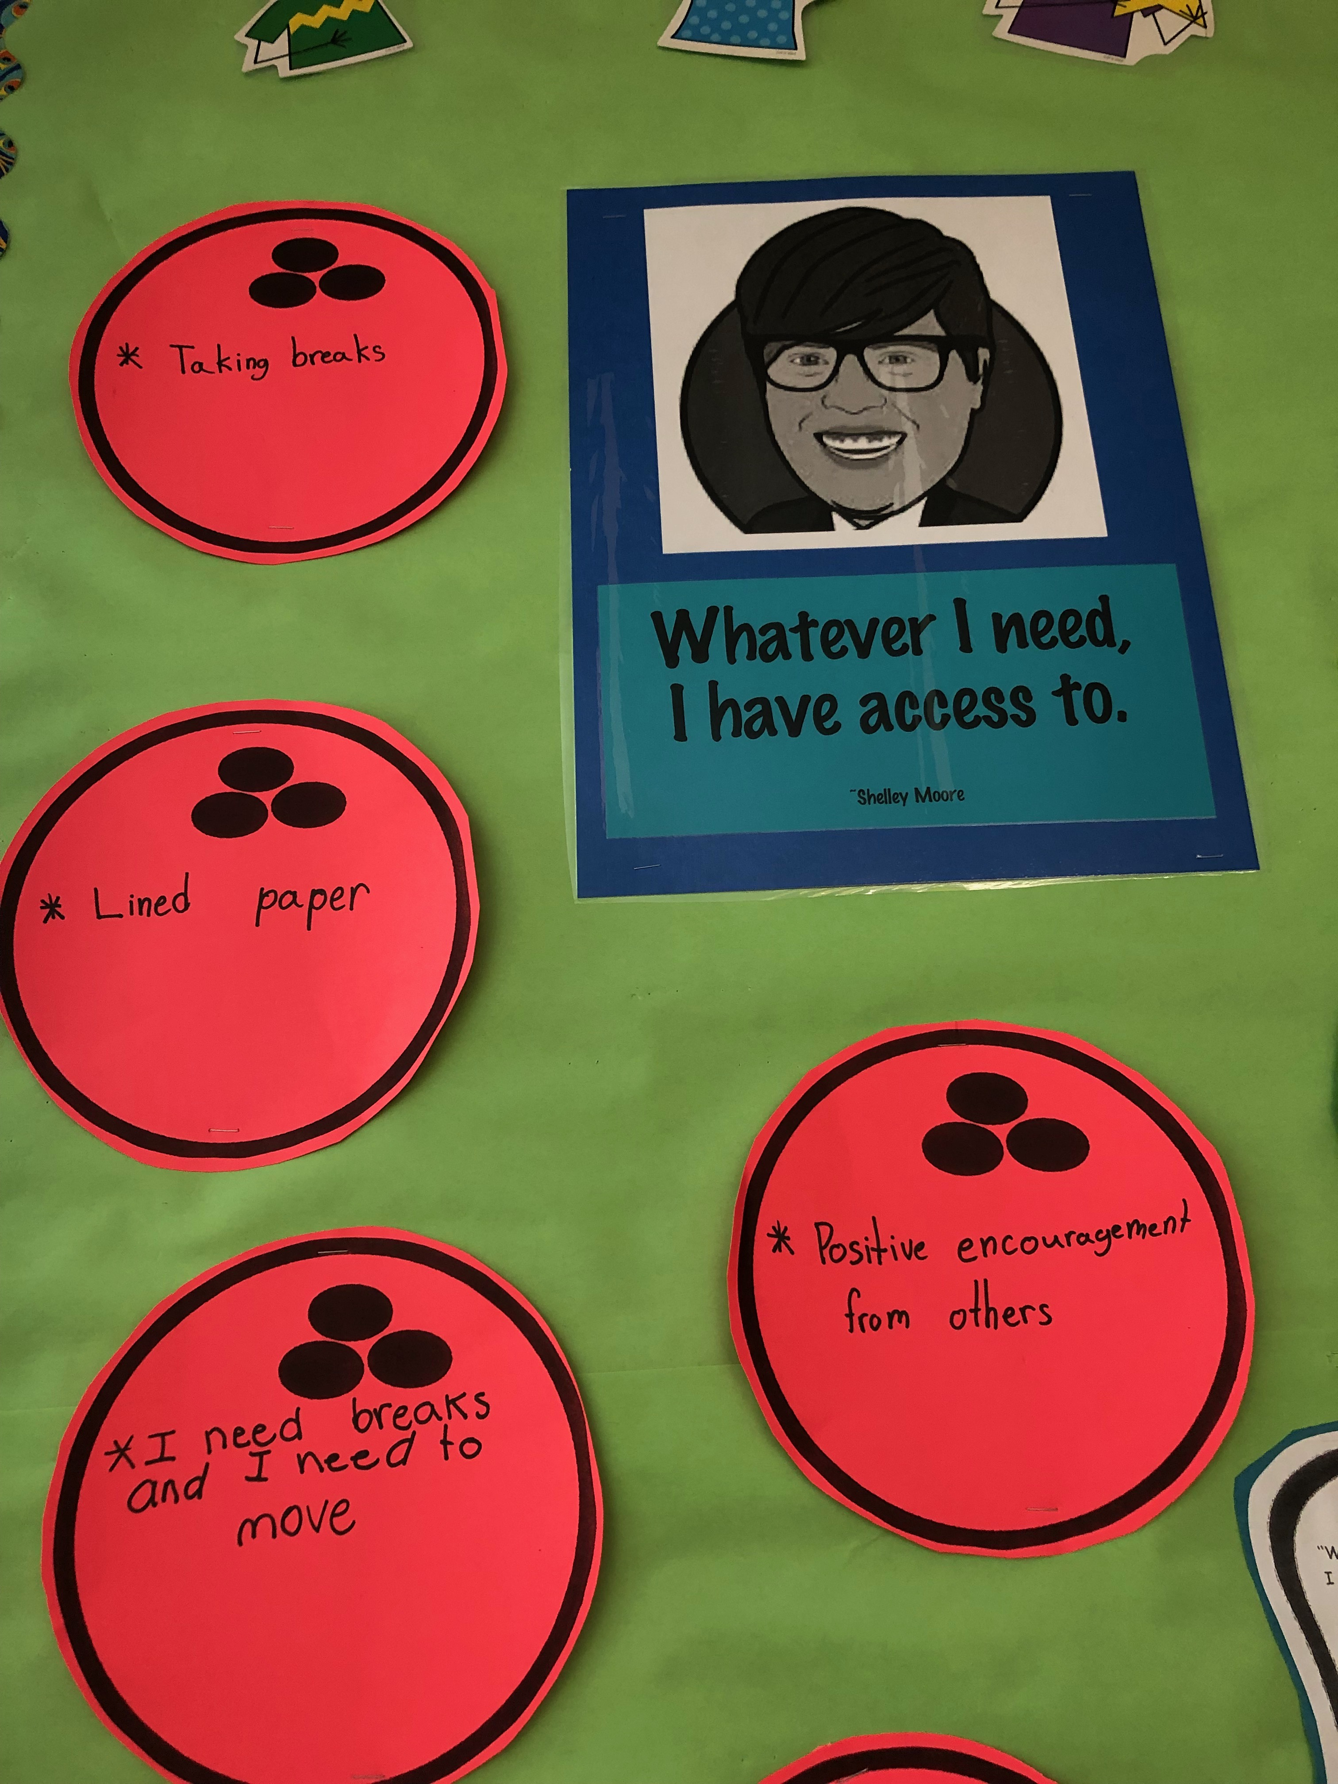
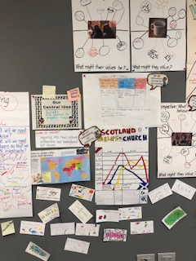
UDL 3.0 Indicator | What this means in teacher friendly language | What might look like in a grade 6 class? | What might look like as an assessment activity?
9.3 Promote individual and collective reflection | Educators intentionally create opportunities for children to think about their experiences, notice their feelings, recognize their growth, and share ideas with others. | Community reflection: Groups set norms, revisit them, and reflect on belonging and safety (“What helped us feel included today?”). | Choice-based reflection: Kids choose how to reflect—talk, sketch, photo captions, short audio/video, comic strip, or “show me” demonstration.
Making sense of UDL 3.0
Dr. Shelley Moore, 2026

Slide 4

Your Job
Think of a class/context and ask your self, what “kind of ramp” (UDL principle) would support them to “get into the coffee shop” (learning)?
the motivation ramp? (engagement)
the understanding ramp? (representation)
the showing their learning ramp? (action & expression)
2. Choose a specific ramp to translate and apply to your own context
3. Find resources that show you examples of what this could look like
2023

Slide 5
UDL 3.0 Indicator | What this means in teacher friendly language | What this might look like in _________________ | What this might look like in _________________
Making sense of UDL 3.0
Dr. Shelley Moore, 2026

Slide 6
UDL 3.0 Indicator | What this means in teacher friendly language | What this might look like in _________________ | What this might look like in _________________
Making sense of UDL 3.0
Dr. Shelley Moore, 2026

Slide 7
UDL 3.0 Indicator | What this means in teacher friendly language | What this might look like in _________________ | What this might look like in _________________
Making sense of UDL 3.0
Dr. Shelley Moore, 2026

