Slide 1
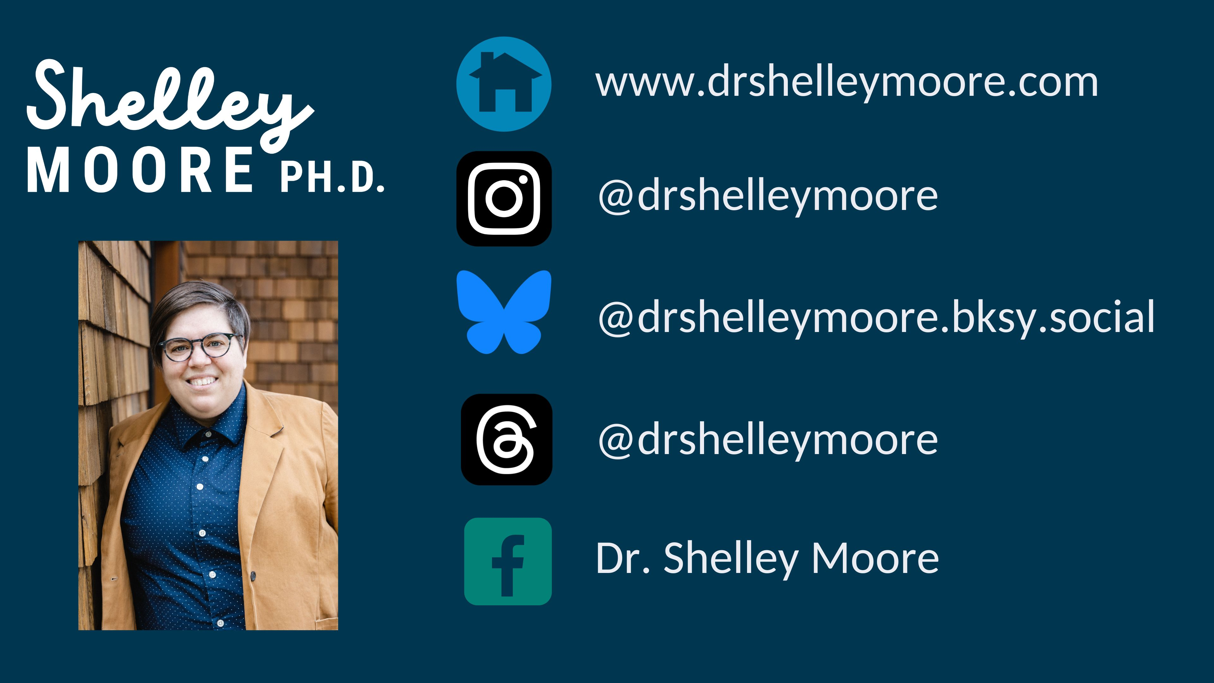

Slide 2

Our Plan Together
September 26 - Kick Off – Inclusion: How do we do it?
September 26 - Session 1 - Getting to Know Students from a strength-based perspective
January 23: Session 2 - Making decisions to reduce barriers for ALL
March 6: Session 3 -Designing needs-based classroom support plans
March 6: Session 4 - Curricular Design Strategies: Backwards Design
April 17 : Session 5 - Curricular Design Strategies: Lesson Design through a UDL lens
April 17: Session 6 - Inclusive Assessment
April 17: Celebration

Slide 3
Reflecting on learning
What did you try since last session?
What are you noticing about your thinking?
What are you noticing about your practice?
What questions are coming up for you?

Slide 4
What grade level curriculum are we using?
What are the learning standards?
CURRICULUM & ASSESSMENT DESIGN
Adjustable Assessment
INSTRUCTIONAL DESIGN
Adjustable Supports & Strategies
NEEDS BASED DESIGN
Adjustable Curriculum
Student choice of challenge
Students
Student choice of evidence
Who are the pilots?
What are their dimensions?
Where is their agency?
Student choice of tools and actions
What are the student needs?
What barriers are getting in the way?
What do student require to navigate needs & barriers?
How will students show growth within the learning standard?
How do we know?
2023

Slide 5
What grade level curriculum are we using?
What are the learning standards?
CURRICULUM & ASSESSMENT DESIGN
Adjustable Assessment
INSTRUCTIONAL DESIGN
Adjustable Supports & Strategies
NEEDS BASED DESIGN
Adjustable Curriculum
Student choice of challenge
Students
Student choice of evidence
Who are the pilots?
What are their dimensions?
Where is their agency?
Student choice of tools and actions
What are the student needs?
What barriers are getting in the way?
What do student require to navigate needs & barriers?
How will students show growth within the learning standard?
How do we know?
2023

Slide 6
Class Review: |  |  | School Team: |  |  |  |  | Date:
Class Dimensions
Class Identities Student Perspectives: Team Perspectives: |  | Class Interests Student Perspectives: Team Perspectives: | Classroom Strengths - memorization, sharing, speaking ideas, strong math/ math facts, chatty, social, German community, low German (oral), many shared experiences, get along (many are related), giving and generous, identity |  | Classroom Strengths creative, drawing, working together, supporting and helping each other, encourage each other, love learning, flexible, persuasive, a group that is very independent, persevere, kind, clean up after, work hard, coping-showing a lot growth | Classroom Strengths Student Perspectives: Team Perspectives: |  | Classroom Stretches All ELL learners, engagement, a lot needs, range of abilities, literacy level, resources are not accessible for them to understand, have limited experiences, sometimes have a hard time because they are together all the time, some individual struggle to fit, a lot of needs | Classroom Stretches Student Perspectives: Team Perspectives:
Class Needs
Need: | Need: |  |  | Need: |  |  | Need: |  |  | Need:
Team Goals
Some big questions and/or goals that we have for this class:
Team Reflections & Decisions
What works well for this class? |  |  |  |  | What else can we do to reduce barriers for this class?
The Class Review – Brownlie, F & King, J, 2011 adapted by Dr. Shelley Moore 2023

Slide 7
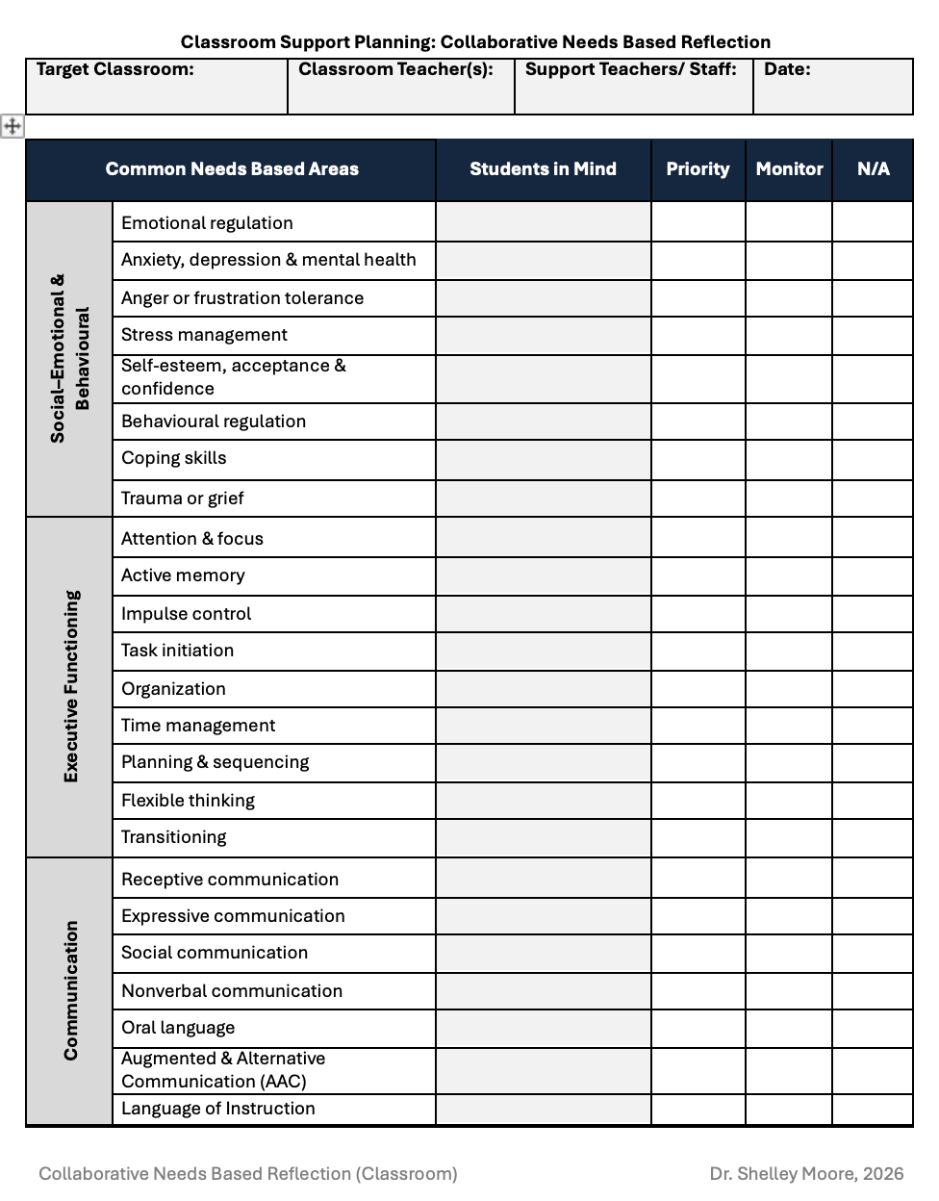
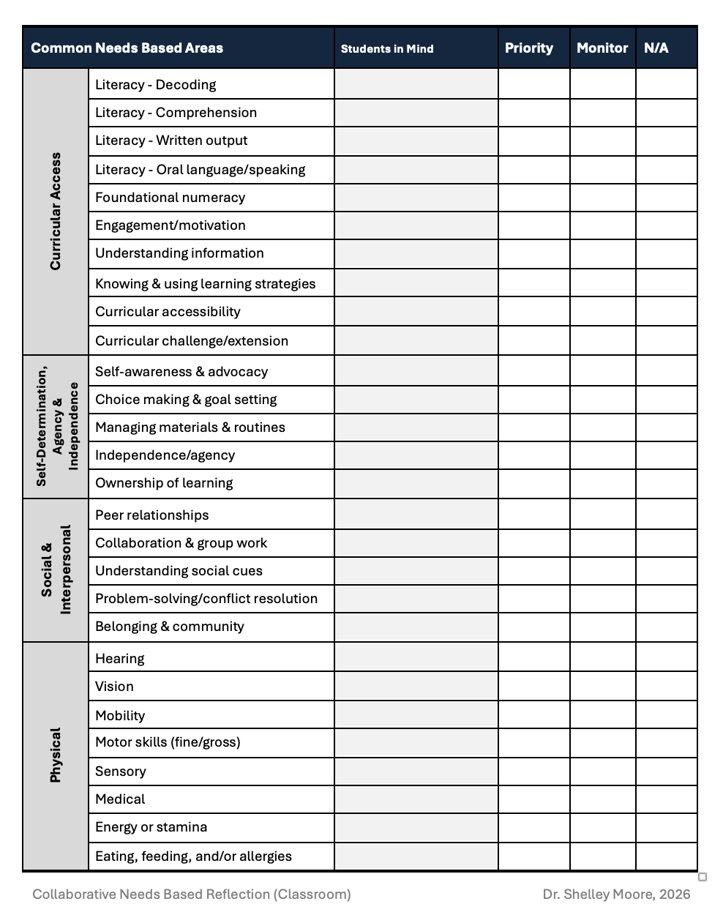

Slide 8
What grade level curriculum are we using?
What are the learning standards?
CURRICULUM & ASSESSMENT DESIGN
Adjustable Assessment
INSTRUCTIONAL DESIGN
Adjustable Supports & Strategies
NEEDS BASED DESIGN
Adjustable Curriculum
Student choice of challenge
Students
Student choice of evidence
Who are the pilots?
What are their dimensions?
Where is their agency?
Student choice of tools and actions
What are the student needs?
What barriers are getting in the way?
What do student require to navigate needs & barriers?
How will students show growth within the learning standard?
How do we know?
2023

Slide 9
Universal Needs-Based Support
Universal
(Good for ALL)
Reducing & Eliminating Barriers
to increase agency & independence
(reducing the stairs)
Building Skills & Competencies
to increase agency & independence
(confidence, perseverance, advocacy)

Slide 10
Classroom Needs-Based Support Plan
Clas: |  | Planning Team: | Year:
Step 1: Describe the conditions (e.g. class or student, subject area or task, location and curriculum etc.)
Step 2: Determine one priority needs area
Step 3: Choose 1-3 high impact competency-based goals that will build skills in this needs area and in these conditions
Step 4: Choose 1-3 high impact UDL 3.0 indicators that will reduce barriers for this needs area and in these conditions |  | Step 5: Determine some specific supports (tools) and strategies (actions) that reflect UDL 3.0 indicator (insert UDL indicator)? | Step 6: Individualize these supports and strategies for (describe target student)? | Step 6: Individualize these supports and strategies for (describe target student)?
UDL 3.0 # | What does this UDL 3.0 indicator mean in these conditions?
UDL 3.0 # | What does this UDL 3.0 indicator mean in these conditions? |  | seat student near the board where the step chart is visible, give them a private reference card

Slide 11
What grade level curriculum are we using?
What are the learning standards?
CURRICULUM & ASSESSMENT DESIGN
Adjustable Assessment
INSTRUCTIONAL DESIGN
Adjustable Supports & Strategies
NEEDS BASED DESIGN
Adjustable Curriculum
Student choice of challenge
Students
Student choice of evidence
Who are the pilots?
What are their dimensions?
Where is their agency?
Student choice of tools and actions
What are the student needs?
What barriers are getting in the way?
What do student require to navigate needs & barriers?
How will students show growth within the learning standard?
How do we know?
2023

Slide 12
Supporting the Unicorns…
Supports & Strategies are
useful for ONE
Taught to ALL
What one needs
Individualized
+
Supports & Strategies are
useful for SOME
taught to ALL
choice for ALL
What some need
Targeted
+
Supports & Strategies are useful for ALL
taught to ALL
What everyone/most
need
Universal

Slide 13
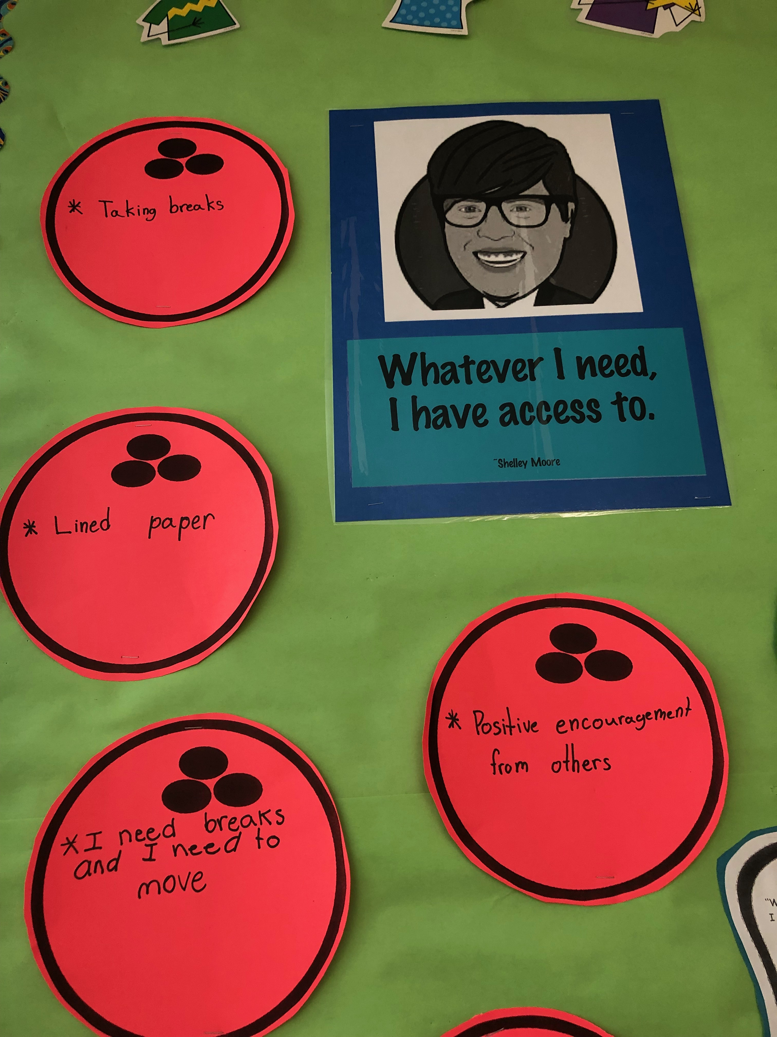
Strategy: taking a 2 min break
Instruct
What is a 2 min break?
Why is a 2 min break useful?
How do I use a 2 min break as a tool or an action?
  What does a 2 min break look like when I use it?
  What does a 2 min break sound like when I use it?
  What does a 2 min break feel like when I use it?
Practice (1 – 2 weeks)
Reflect
Was taking a 2 min break useful for me?
How will I know when I need a 2 min break?
How will I know when I don’t need a 2 min break?
Module 3

Slide 14
What grade level curriculum are we using?
What are the learning standards?
CURRICULUM & ASSESSMENT DESIGN
Adjustable Assessment
INSTRUCTIONAL DESIGN
Adjustable Supports & Strategies
NEEDS BASED DESIGN
Adjustable Curriculum
Student choice of challenge
Students
Student choice of evidence
Who are the pilots?
What are their dimensions?
Where is their agency?
Student choice of tools and actions
What are the student needs?
What barriers are getting in the way?
What do student require to navigate needs & barriers?
How will students show growth within the learning standard?
How do we know?
2023

Slide 15
High Impact Curricular UDL Strategies
Benefits all students
Reducing many barriers at the same time
Meets multiple needs at the same time
Small adjustments that make big differences to student learning
Does not compromise evaluation
What are you already doing?
What is one more thing you could try?

Slide 16
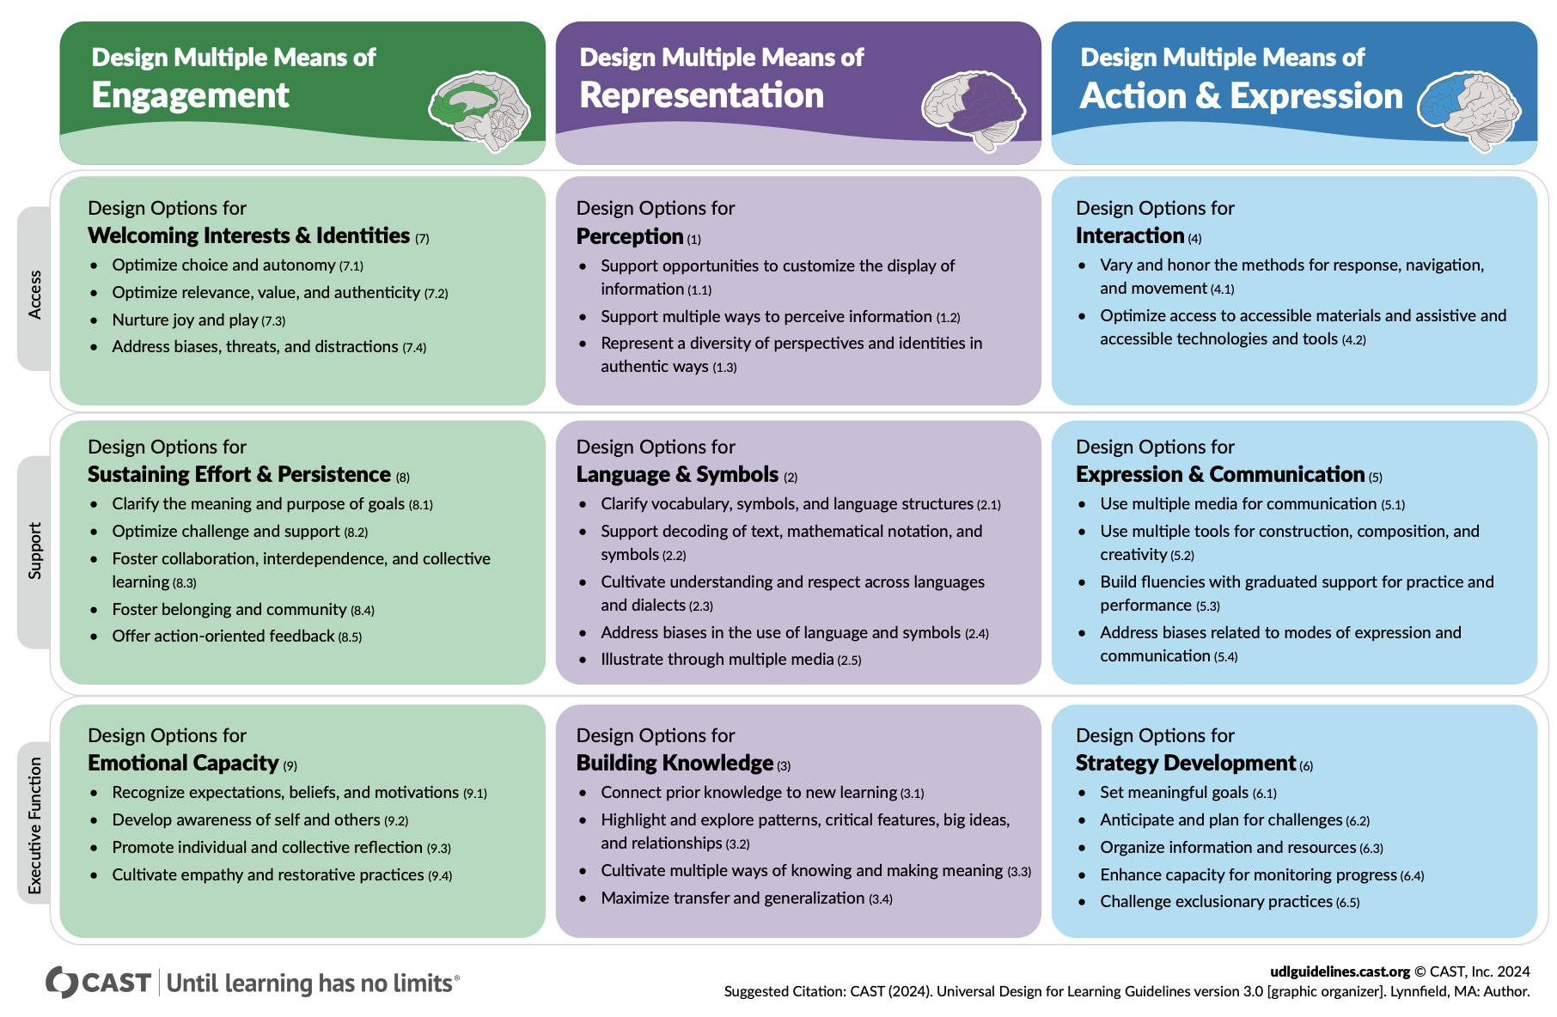
High Impact UDL Strategies in Curricular Design

Slide 17
Backwards Design:
Forward Design
Standardized
Differentiated
Same for Everyone
Grade Level Goals
Activity/Task
Compromises the integrity of
evaluation
Adapted Goals
Modified Goals
Backward Design
Differentiated
Same for Everyone
Activity 1
Grade Level Learning Goals
Does not compromise the integrity evaluation
Activity 2
Activity 3
McTigue, 2010
Standards Based

Slide 18
Inclusive Curricular Planning: Weaving Together UDL and Backwards Design
Step 1: Choose the grade level subject area/course and the topic/theme/strand that you want to design
Step 2: Identify the grade level learning standards that you want to assess
Step 3: Determine the Learning Goals that you will be teaching
Step 4: Fill in the learning goal gaps if needed
Step 5: Translate the learning goals into student friendly language
Step 6: Identify important vocabulary that you want students to know and use
Step 7: Create a provoking guiding question that create the context for learning

Slide 19
Inclusive Curricular Planning: Weaving Together UDL and Backwards Design
Step 1: Choose the grade level subject area/course and the topic/theme/strand that you want to design
Step 2: Identify the grade level learning standards that you want to assess
Step 3: Determine the Learning Goals that you will be teaching
Step 4: Fill in the learning goal gaps if needed
Step 5: Translate the learning goals into student friendly language
Step 6: Identify important vocabulary that you want students to know and use
Step 7: Create a provoking guiding question that create the context for learning

Slide 20

Grade: | Subject Area/ Course | Strand/Topic:
HS Science: Life Science - Inheritance of Genetic Variation (1-1)
Grade 5 PE: Standard 3 – Health Enhancing Activity & Fitness (Learning Priority 1)
Kindergarten Math: Counting & Cardinality

Slide 21
Inclusive Curricular Planning: Weaving Together UDL and Backwards Design
Step 1: Choose the grade level subject area/course and the topic/theme/strand that you want to design
Step 2: Identify the grade level learning standards that you want to assess
Step 3: Determine the Learning Goals that you will be teaching
Step 4: Fill in the learning goal gaps if needed
Step 5: Translate the learning goals into student friendly language
Step 6: Identify important vocabulary that you want students to know and use
Step 7: Create a provoking guiding question that create the context for learning

Slide 22
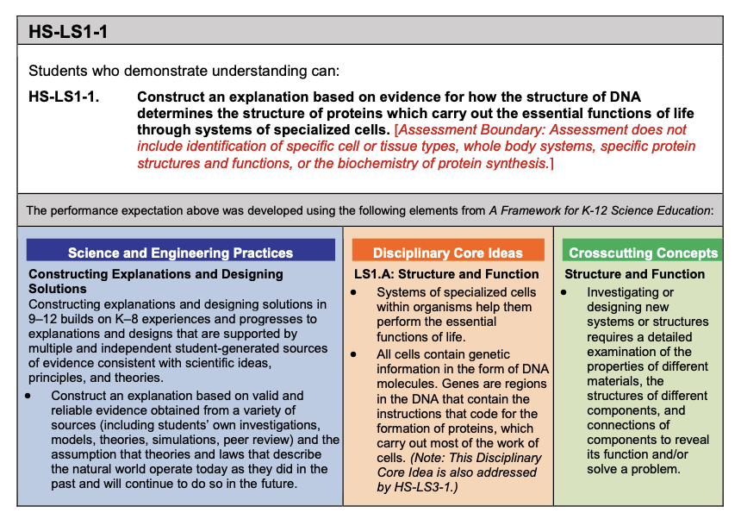
The grade level learning standard in Science is called the Performance Expectation

Slide 23
Grade: HS | Subject Area/ Course: Life Science |  | Strand/Topic: Inheritance of Genetic Variation
Performance Expectation: HS-LS1-1. Construct an explanation based on evidence for how the structure of DNA determines the structure of proteins which carry out the essential functions of life through systems of specialized cells

Slide 24
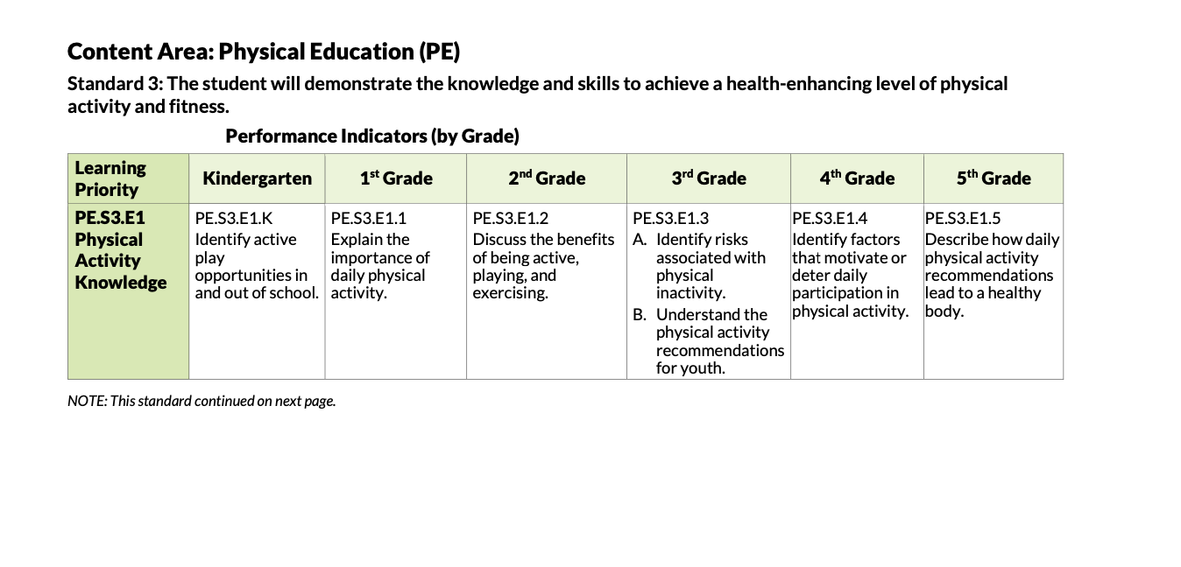
The grade level learning standard in PE is called the Standard
v

Slide 25
Grade: 5 | Subject Area/ Course: PE |  | Strand/Topic: Learning Priority 1
Standard: Student will demonstrate the knowledge and skills to achieve a health-enhancing level of activity and fitness

Slide 26
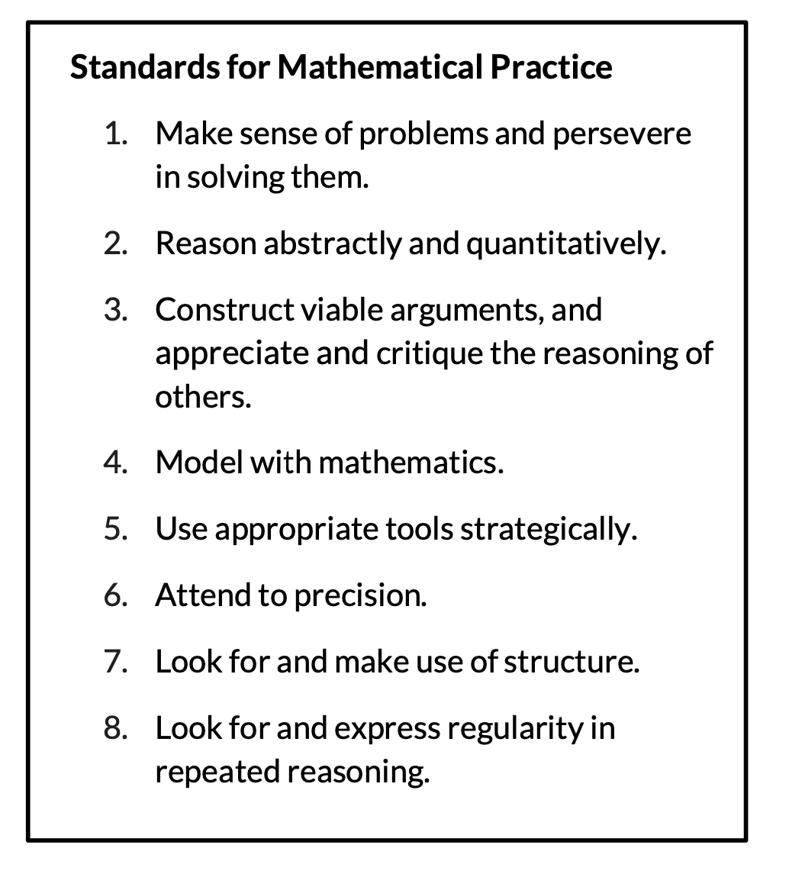
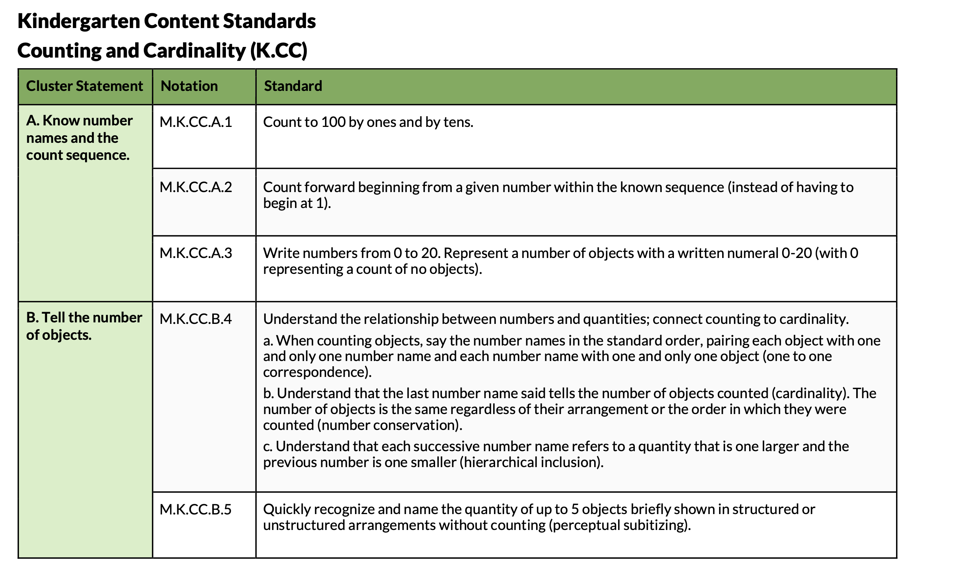
The grade level learning standard in Math is called the Cluster Statement

Slide 27
Grade: K | Subject Area/ Course: Math |  | Strand/Topic: Counting & Cardinality
Cluster Statement: Students will Know number names and the count sequence

Slide 28
Inclusive Curricular Planning: Weaving Together UDL and Backwards Design
Step 1: Choose the grade level subject area/course and the topic/theme/strand that you want to design
Step 2: Identify the grade level learning standards that you want to assess
Step 3: Determine the Learning Goals that you will be teaching
Step 4: Fill in the learning goal gaps if needed
Step 5: Translate the learning goals into student friendly language
Step 6: Identify important vocabulary that you want students to know and use
Step 7: Create a provoking guiding question that create the context for learning

Slide 29
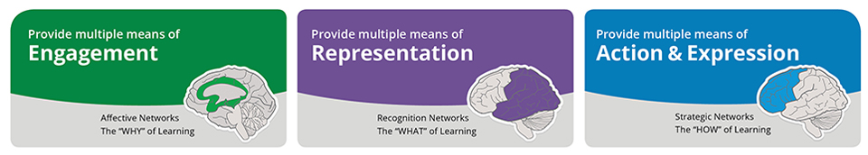
Universal Design for Learning relies on Backwards Design

Slide 30
High Impact UDL Strategies in Curricular Design

Slide 31
Backwards Design: Determining Learning Goals
The Grade Level Learning Standards are what we assess
The Learning Goals are what we teach to get there
There are different kinds of learning goals:
  What students need to know?
  What students need to do?
Some subject areas/courses include all of the learning goals
Some subject areas/courses some only focus on a couple learning goals

Slide 32
Backwards Design: Determining Learning Goals
The Grade Level Learning Standards are what we assess
The Learning Goals are what we teach to get there
There are different kinds of learning goals:
  What students need to understand?
  What students need to know?
  What students need to do?
  What competencies do students need to develop?
Some subject areas/courses include all of the learning goals
Some subject areas/courses some only focus on a couple learning goals

Slide 33
NGSS: The grade level learning standard in Science is called the Performance Expectation
  What students need to understand
  What students need to do
  What students
  need to know

Slide 34
Grade: HS |  | Subject Area/ Course: Life Science | Strand/Topic: Inheritance of Genetic Variation
Performance Expectation: HS-LS1-1. Construct an explanation based on evidence for how the structure of DNA determines the structure of proteins which carry out the essential functions of life through systems of specialized cells
 | Curricular Language
What do students need to do? | Construct an explanation based on valid and reliable evidence obtained from a variety of sources (including students’ own investigations, models, theories, simulations, peer review) and the assumption that theories and laws that describe the natural world operate today as they did in the past , present, future.
What do students need to know? | LS1.A: Structure and Function Systems of specialized cells within organisms help them perform the essential functions of life. All cells contain genetic information in the form of DNA molecules. Genes are regions in the DNA that contain the instructions that code for the formation of proteins, which carry out most of the work of cells
What do students need to understand? | Structure and Function Investigating or designing new systems or structures requires a detailed examination of the properties of different materials, the structures of different components, and connections of components to reveal its function and/or solve a problem.
What competencies do students need to develop? | Disciplinary Literacy Valuing Evidence Comprehend as well as critique Build strong content knowledge

Slide 35
The grade level learning standard in PE is called the Standard
v
  What students need to do
  What students
  need to know

Slide 36
Grade: 5 | Subject Area/ Course: PE | Strand/Topic: Learning Priority 1
Standard: Student will demonstrate the knowledge and skills to achieve a health-enhancing level of activity and fitness
 | Curricular Language
What do students need to know? | PE.S3.E1 Physical Activity Knowledge
What do students need to do? | PE.S3.E1.5: Describe how daily physical activity recommendation lead to a healthy body
What do students need to understand?
Who do students need to be?

Slide 37
The grade level learning standard in Math is called the Cluster Statement
  What competencies do students need to develop?
KNOW
DO
UNDERSTAND

Slide 38
Grade: K | Subject Area/ Course: Math | Strand/Topic: Counting & Cardinality
Cluster Statement: Students will Know number names and the count sequence
 | Curricular Language
What do students need to know? | Know number names Know the count sequence
What do students need to do? | M.K.CC.A.1 Count to 100 by ones and by tens. M.K.CC.A.2 Count forward beginning from a given number within the known sequence (instead of having to begin at 1). M.K.CC.A.3 Write numbers from 0 to 20. Represent a number of objects with a written numeral 0-20 (with 0 representing a count of no objects).
What do students need to understand?
Who do students need to be? | Make sense of problems and persevere in solving them

Slide 39
Inclusive Curricular Planning: Weaving Together UDL and Backwards Design
Step 1: Choose the grade level subject area/course and the topic/theme/strand that you want to design
Step 2: Identify the grade level learning standards that you want to assess
Step 3: Determine the Learning Goals that you will be teaching
Step 4: Fill in the learning goal gaps if needed
Step 5: Translate the learning goals into student friendly language
Step 6: Identify important vocabulary that you want students to know and use
Step 7: Create a provoking guiding question that create the context for learning

Slide 40
Grade: HS |  | Subject Area/ Course: Life Science | Strand/Topic: Inheritance of Genetic Variation
Performance Expectation: HS-LS1-1. Construct an explanation based on evidence for how the structure of DNA determines the structure of proteins which carry out the essential functions of life through systems of specialized cells
 | Curricular Language
What do students need to do? | Construct an explanation based on valid and reliable evidence obtained from a variety of sources (including students’ own investigations, models, theories, simulations, peer review) and the assumption that theories and laws that describe the natural world operate today as they did in the past , present, future.
What do students need to know? | LS1.A: Structure and Function Systems of specialized cells within organisms help them perform the essential functions of life. All cells contain genetic information in the form of DNA molecules. Genes are regions in the DNA that contain the instructions that code for the formation of proteins, which carry out most of the work of cells
What do students need to understand? | Structure and Function Investigating or designing new systems or structures requires a detailed examination of the properties of different materials, the structures of different components, and connections of components to reveal its function and/or solve a problem.
What competencies do students need to develop? | Disciplinary Literacy Valuing Evidence Comprehend as well as critique Build strong content knowledge

Slide 41
Grade: 5 | Subject Area/ Course: PE | Strand/Topic: Learning Priority 1
Standard: Student will demonstrate the knowledge and skills to achieve a health-enhancing level of activity and fitness
 | Curricular Language
What do students need to know? | PE.S3.E1 Physical Activity Knowledge
What do students need to do? | PE.S3.E1.5: Describe how daily physical activity recommendation lead to a healthy body
What do students need to understand? | Regular physical activity is essential for a healthy body, and understanding daily activity recommendations helps individuals make choices that improve their fitness and overall well-being
Who do students need to be? | Physically active

Slide 42
Grade: K | Subject Area/ Course: Math | Strand/Topic: Counting & Cardinality
Cluster Statement: Students will Know number names and the count sequence
 | Curricular Language
What do students need to know? | Know number names Know the count sequence
What do students need to do? | M.K.CC.A.1 Count to 100 by ones and by tens. M.K.CC.A.2 Count forward beginning from a given number within the known sequence (instead of having to begin at 1). M.K.CC.A.3 Write numbers from 0 to 20. Represent a number of objects with a written numeral 0-20 (with 0 representing a count of no objects).
What do students need to understand? | Numbers help us count, describe, and represent how many things there are
Who do students need to be? | Make sense of problems and persevere in solving them

Slide 43
Inclusive Curricular Planning: Weaving Together UDL and Backwards Design
Step 1: Choose the grade level subject area/course and the topic/theme/strand that you want to design
Step 2: Identify the grade level learning standards that you want to assess
Step 3: Determine the Learning Goals that you will be teaching
Step 4: Fill in the learning goal gaps if needed
Step 5: Translate the learning goals into student friendly language
Step 6: Identify important vocabulary that you want students to know and use
Step 7: Create a provoking guiding question that create the context for learning

Slide 44
High Impact UDL Strategies in Curricular Design

Slide 45
Grade: HS |  | Subject Area/ Course: Life Science | Strand/Topic: Inheritance of Genetic Variation
Performance Expectation: HS-LS1-1. Construct an explanation based on evidence for how the structure of DNA determines the structure of proteins which carry out the essential functions of life through systems of specialized cells
 | Curricular Language |  | Student Friendly Language
What do students need to do? | Construct an explanation based on valid and reliable evidence obtained from a variety of sources (including students’ own investigations, models, theories, simulations, peer review) and the assumption that theories and laws that describe the natural world operate today as they did in the past , present, future. |  | I can explain using evidence that there are theories and laws that describe the natural world I know what evidence is I know what science and theories and laws* are I know what the natural world is
What do students need to know? | LS1.A: Structure and Function Systems of specialized cells within organisms help them perform the essential functions of life. All cells contain genetic information in the form of DNA molecules. Genes are regions in the DNA that contain the instructions that code for the formation of proteins, which carry out most of the work of cells |  | I know that the systems of specialized cells inside organisms perform essential functions of life I know what systems of specialized cells are I know what organisms are I know what the essential* functions of life are I know that cells have genetic information in DNA molecules I know that genes are parts of DNA that are instructions for how proteins are formed I know how cells work
What do students need to understand? | Structure and Function Investigating or designing new systems or structures requires a detailed examination of the properties of different materials, the structures of different components, and connections of components to reveal its function and/or solve a problem. |  | I understand that structures are made of many different components that are connected and have specific functions.
What competencies do students need to develop? (self-assess) | Disciplinary Literacy Valuing Evidence Comprehend as well as critique Build strong content knowledge |  | I can use evidence to support my ideas I can understand information and explain what I think about it with evidence I can learn and understand important ideas about what we are learning about

Slide 46
Grade: 5 | Subject Area/ Course: PE | Strand/Topic: Learning Priority 1
Standard: Student will demonstrate the knowledge and skills to achieve a health-enhancing level of activity and fitness
 | Curricular Language | Student Friendly Language
What do students need to know? | PE.S3.E1 Physical Activity Knowledge | I know what physical activity is. I know how being active affects my body
What do students need to do? | PE.S3.E1.5: Describe how daily physical activity recommendation lead to a healthy body | I can explain how meeting daily physical activity recommendations helps my body stay healthy and fit
What do students need to understand? | Regular physical activity is essential for a healthy body, and understanding daily activity recommendations helps individuals make choices that improve their fitness and overall well-being | I understand that regular physical activity is important for a healthy body and that knowing daily activity recommendations helps me make healthy choices
Who do students need to be? | Physically active | I can be physically active

Slide 47
Grade: K | Subject Area/ Course: Math | Strand/Topic: Counting & Cardinality
Cluster Statement: Students will Know number names and the count sequence
 | Curricular Language |  | Student Friendly Language
What do students need to know? | Know number names Know the count sequence |  | I know the names of numbers I know how to count in order
What do students need to do? | M.K.CC.A.1 Count to 100 by ones and by tens. M.K.CC.A.2 Count forward beginning from a given number within the known sequence (instead of having to begin at 1). M.K.CC.A.3 Write numbers from 0 to 20. Represent a number of objects with a written numeral 0-20 (with 0 representing a count of no objects). |  | I can count to 100 by ones and by tens I can count on from any number I can write numbers to 20 I can show how many things there are with a number
What do students need to understand? | Numbers help us count, describe, and represent how many things there are |  | I understand that numbers help me count and show how many things there are
Who do students need to be? (self assess) | Make sense of problems and persevere in solving them |  | I can keep trying when something feels hard

Slide 48
Inclusive Curricular Planning: Weaving Together UDL and Backwards Design
Step 1: Choose the grade level subject area/course and the topic/theme/strand that you want to design
Step 2: Identify the grade level learning standards that you want to assess
Step 3: Determine the Learning Goals that you will be teaching
Step 4: Fill in the learning goal gaps if needed
Step 5: Translate the learning goals into student friendly language
Step 6: Identify important vocabulary that you want students to know and use
Step 7: Create a provoking guiding question that create the context for learning

Slide 49
High Impact UDL Strategies in Curricular Design

Slide 50
Grade: HS |  | Subject Area/ Course: Life Science | Strand/Topic: Inheritance of Genetic Variation
Performance Expectation: HS-LS1-1. Construct an explanation based on evidence for how the structure of DNA determines the structure of proteins which carry out the essential functions of life through systems of specialized cells
 | Curricular Language |  | Student Friendly Language
What do students need to do? | Construct an explanation based on valid and reliable evidence obtained from a variety of sources (including students’ own investigations, models, theories, simulations, peer review) and the assumption that theories and laws that describe the natural world operate today as they did in the past , present, future. | I can make and use models to help me understand | I can explain using evidence that there are theories and laws that describe the natural world I know what evidence is I know what science and theories and laws are I know what the natural world is
What do students need to know? | LS1.A: Structure and Function Systems of specialized cells within organisms help them perform the essential functions of life. All cells contain genetic information in the form of DNA molecules. Genes are regions in the DNA that contain the instructions that code for the formation of proteins, which carry out most of the work of cells. | I know how to identify and describe matter using their structures and properties | I know that the systems of specialized cells inside organisms perform essential functions of life I know what systems of specialized cells are I know what organisms are I know what the essential functions of life are I know that cells have genetic information in DNA molecules I know that genes are parts of DNA that are instructions for how proteins are formed I know how cells work
What do students need to understand? | Structure and Function Investigating or designing new systems or structures requires a detailed examination of the properties of different materials, the structures of different components, and connections of components to reveal its function and/or solve a problem. | I know that I can use scale, proportion and quantity to describe matter that is too small to see | I understand that structures are made of many different components that are connected and have specific functions.
What competencies do students need to develop? (self-assess) | Disciplinary Literacy Valuing Evidence Comprehend as well as critique Build strong content knowledge |  | I can use evidence to support my ideas I can understand information and explain what I think about it with evidence I can build my understanding about important ideas about in Science

Slide 51
Grade: 5 | Subject Area/ Course: PE | Strand/Topic: Learning Priority 1
Standard: Student will demonstrate the knowledge and skills to achieve a health-enhancing level of activity and fitness
 | Curricular Language | Student Friendly Language
What do students need to know? | PE.S3.E1 Physical Activity Knowledge | I know what physical activity is I know how being active affects my body
What do students need to do? | PE.S3.E1.5: Describe how daily physical activity recommendation lead to a healthy body | I can explain how meeting daily physical activity recommendations helps my body stay healthy
What do students need to understand? | Regular physical activity is essential for a healthy body, and understanding daily activity recommendations helps individuals make choices that improve their fitness and overall well-being | I understand that regular physical activity is important for a healthy body and that knowing daily activity recommendations helps me make healthy choices
Who do students need to be? | Physically active | I can be physically active

Slide 52
Grade: K | Subject Area/ Course: Math | Strand/Topic: Counting & Cardinality
Cluster Statement: Students will Know number names and the count sequence
 | Curricular Language |  | Student Friendly Language
What do students need to know? | Know number names Know the count sequence |  | I know the names of numbers I know how to count in order
What do students need to do? | M.K.CC.A.1 Count to 100 by ones and by tens. M.K.CC.A.2 Count forward beginning from a given number within the known sequence (instead of having to begin at 1). M.K.CC.A.3 Write numbers from 0 to 20. Represent a number of objects with a written numeral 0-20 (with 0 representing a count of no objects). |  | I can count to 100 by ones and by tens I can count on from any number I can write numbers to 20 I can show how many things there are with a number
What do students need to understand? | Numbers help us count, describe, and represent how many things there are |  | I understand that numbers help me count and show how many things there are
Who do students need to be? (self assess) | Make sense of problems and persevere in solving them |  | I can keep trying when something feels hard

Slide 53
Inclusive Curricular Planning: Weaving Together UDL and Backwards Design
Step 1: Choose the grade level subject area/course and the topic/theme/strand that you want to design
Step 2: Identify the grade level learning standards that you want to assess
Step 3: Determine the Learning Goals that you will be teaching
Step 4: Fill in the learning goal gaps if needed
Step 5: Translate the learning goals into student friendly language
Step 6: Identify important vocabulary that you want students to know and use
Step 7: Create a provoking guiding question that create the context for learning

Slide 54
High Impact UDL Strategies in Curricular Design

Slide 55
Grade: HS |  | Subject Area/ Course: Life Science | Strand/Topic: Inheritance of Genetic Variation
Performance Expectation: HS-LS1-1. Construct an explanation based on evidence for how the structure of DNA determines the structure of proteins which carry out the essential functions of life through systems of specialized cells |  |  | Provoking and Guiding Question: How can individuals of the same species have different characteristics?
 | Curricular Language |  | Student Friendly Language
What do students need to do? | Construct an explanation based on valid and reliable evidence obtained from a variety of sources (including students’ own investigations, models, theories, simulations, peer review) and the assumption that theories and laws that describe the natural world operate today as they did in the past , present, future. | I can make and use models to help me understand | I can explain using evidence that there are theories and laws that describe the natural world I know what evidence is I know what science and theories and laws are I know what the natural world is
What do students need to know? | LS1.A: Structure and Function Systems of specialized cells within organisms help them perform the essential functions of life. All cells contain genetic information in the form of DNA molecules. Genes are regions in the DNA that contain the instructions that code for the formation of proteins, which carry out most of the work of cells. | I know how to identify and describe matter using their structures and properties | I know that the systems of specialized cells inside organisms perform essential functions of life I know what systems of specialized cells are I know what organisms are I know what the essential functions of life are I know that cells have genetic information in DNA molecules I know that genes are parts of DNA that are instructions for how proteins are formed I know how cells work
What do students need to understand? | Structure and Function Investigating or designing new systems or structures requires a detailed examination of the properties of different materials, the structures of different components, and connections of components to reveal its function and/or solve a problem. | I know that I can use scale, proportion and quantity to describe matter that is too small to see | I understand that structures are made of many different components that are connected and have specific functions.
What competencies do students need to develop? (self-assess) | Disciplinary Literacy Valuing Evidence Comprehend as well as critique Build strong content knowledge |  | I can use evidence to support my ideas I can understand information and explain what I think about it with evidence I can build my understanding about important ideas about in Science

Slide 56
Grade: 5 | Subject Area/ Course: PE | Strand/Topic: Learning Priority 1
Standard: Student will demonstrate the knowledge and skills to achieve a health-enhancing level of activity and fitness |  | Provoking and Guiding Question: How much physical activity do I need each day to stay healthy?
 | Curricular Language | Student Friendly Language
What do students need to know? | PE.S3.E1 Physical Activity Knowledge | I know what physical activity is I know how being active affects my body
What do students need to do? | PE.S3.E1.5: Describe how daily physical activity recommendation lead to a healthy body | I can explain how meeting daily physical activity recommendations helps my body stay healthy
What do students need to understand? | Regular physical activity is essential for a healthy body, and understanding daily activity recommendations helps individuals make choices that improve their fitness and overall well-being | I understand that regular physical activity is important for a healthy body and that knowing daily activity recommendations helps me make healthy choices
Who do students need to be? | Physically active | I can be physically active

Slide 57
Grade: K | Subject Area/ Course: Math | Strand/Topic: Counting & Cardinality
Cluster Statement: Students will Know number names and the count sequence |  |  | Provoking and Guiding Question: How can counting help us figure out “how many”?
 | Curricular Language |  | Student Friendly Language
What do students need to know? | Know number names Know the count sequence |  | I know the names of numbers I know how to count in order
What do students need to do? | M.K.CC.A.1 Count to 100 by ones and by tens. M.K.CC.A.2 Count forward beginning from a given number within the known sequence (instead of having to begin at 1). M.K.CC.A.3 Write numbers from 0 to 20. Represent a number of objects with a written numeral 0-20 (with 0 representing a count of no objects). |  | I can count to 100 by ones and by tens I can count on from any number I can write numbers to 20 I can show how many things there are with a number
What do students need to understand? | Numbers help us count, describe, and represent how many things there are |  | I understand that numbers help me count and show how many things there are
Who do students need to be? (self assess) | Make sense of problems and persevere in solving them |  | I can keep trying when something feels hard

Slide 58
Activity
I Must: Choose a standard
Pick a grade level subject area or course
Zoom in on one grade level learning standard
I Can: Practice using the Backwards Design Framework
Determine the learning goals for the standard
  What students need to understand, know, do, develop
I Could: Weave in UDL strategies
Translate goals into student friendly language Highlight key vocabulary
Create a guiding question
Notes:
WORD Cloud – in person version

Slide 59
Grade: |  | Subject Area/ Course: | Strand/Topic:
Grade Level Learning Standard: |  |  | Provoking and Guiding Question:
 | Curricular Language |  | Student Friendly Language
What do students need to do? |  | I can make and use models to help me understand | I can
What do students need to know? |  | I know how to identify and describe matter using their structures and properties | I know
What do students need to understand? |  | I know that I can use scale, proportion and quantity to describe matter that is too small to see | I understand
What competencies do students need to develop? (self-assess) |  |  | I can

