Slide 1
Inclusive & Competency Based IEPS
Purposeful & Responsive Planning
Competency
Goals
Universal Support
Student Agency
Authentic Assessment
Place Based

Slide 2


The Five Dimensions
strengths
identities
me!
stretches
interests
needs
We cannot design for who a student isn't.
Moore, 2020

Slide 3













Identity
@mrsmacskinders

Slide 4




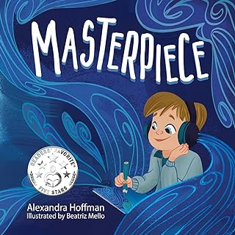

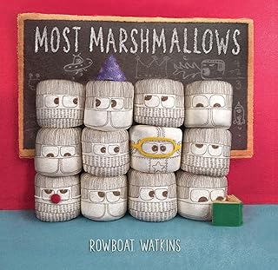
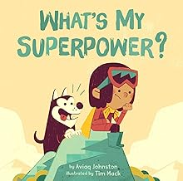
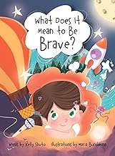

Strengths
Interests
@mrsmacskinders

Slide 5

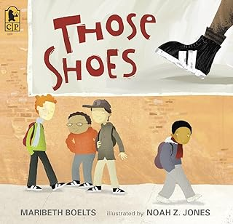

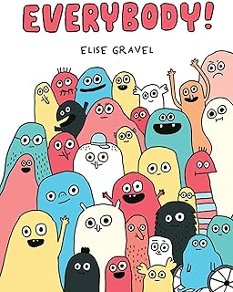

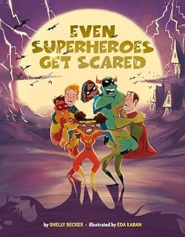
Needs
@mrsmacskinders

Slide 6







Stretches
@mrsmacskinders

Slide 7
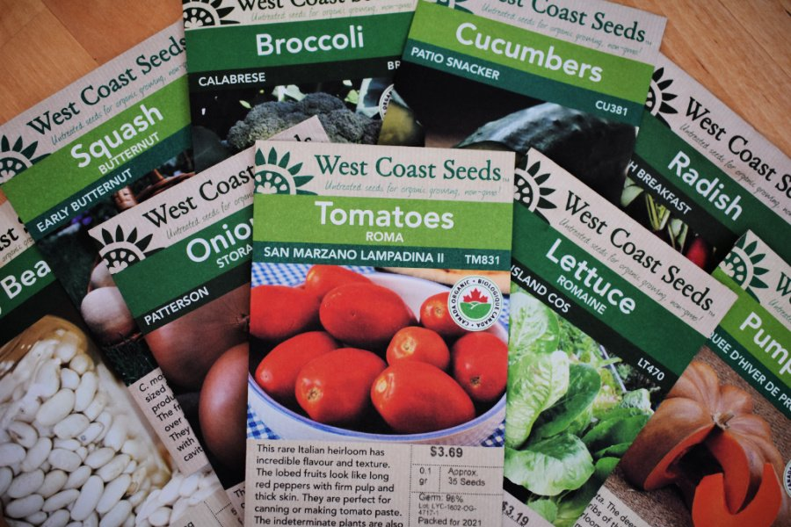
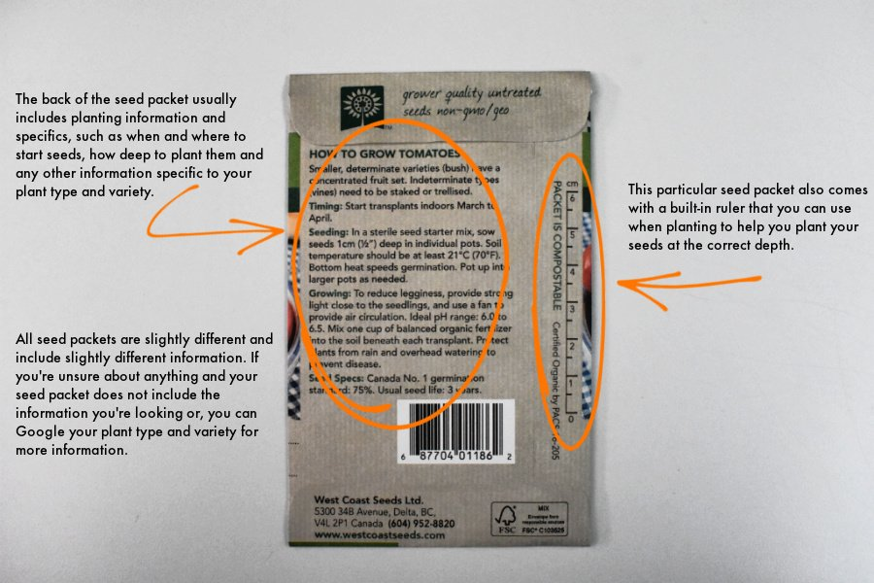
The SEED PACKET
Module 2

Slide 8

Strategy 1:
My I.E.Pea Seed Packet
Growth Year: ______________
Name: __________________ Grade: _______
Goals: I want to grow in these areas:
_____________________________________
_____________________________________
_____________________________________
Identities: I am…
_________________________
_________________________
_________________________
_________________________
_________________________
Needs: I need this support in these areas to grow:
____________________
____________________
_____________________
____________________
____________________
_____________________
Supports: I need this in my garden to grow:
Interests: I really like and/or what to learn more about:
__________________________________________________
__________________________________________________
__________________________________________________
__________________________________________________
__________________________________________________
Strengths: I am really good at and/or could teach others:
Barriers: This is what makes it hard for me to grow:
__________________________________________________
__________________________________________________
__________________________________________________
__________________________________________________
__________________________________________________
__________________________________________________
__________________________________________________
Thank You For helping me GROW
Module 2

Slide 9
Help us get to know: ________________________________ Date: _____________
Person connected to ___________ | Identities | Interests | Strengths | Stretches | Needs
Who are you and how do you know ________? | What words would you use to describe ________? What groups is _______ connected to in their community? | What is _______ interested in? What do they like to do on their own? With their friends? Family? Community? | What is _______ good at? What can they teach others? | What is hard for ________? What do you think _______ wants to get better at? | What does _________ need support with? What is important for people to know about _____________?
Person 1:
Person 2:
Person 3:
Person 4:
Module 2

