Slide 1
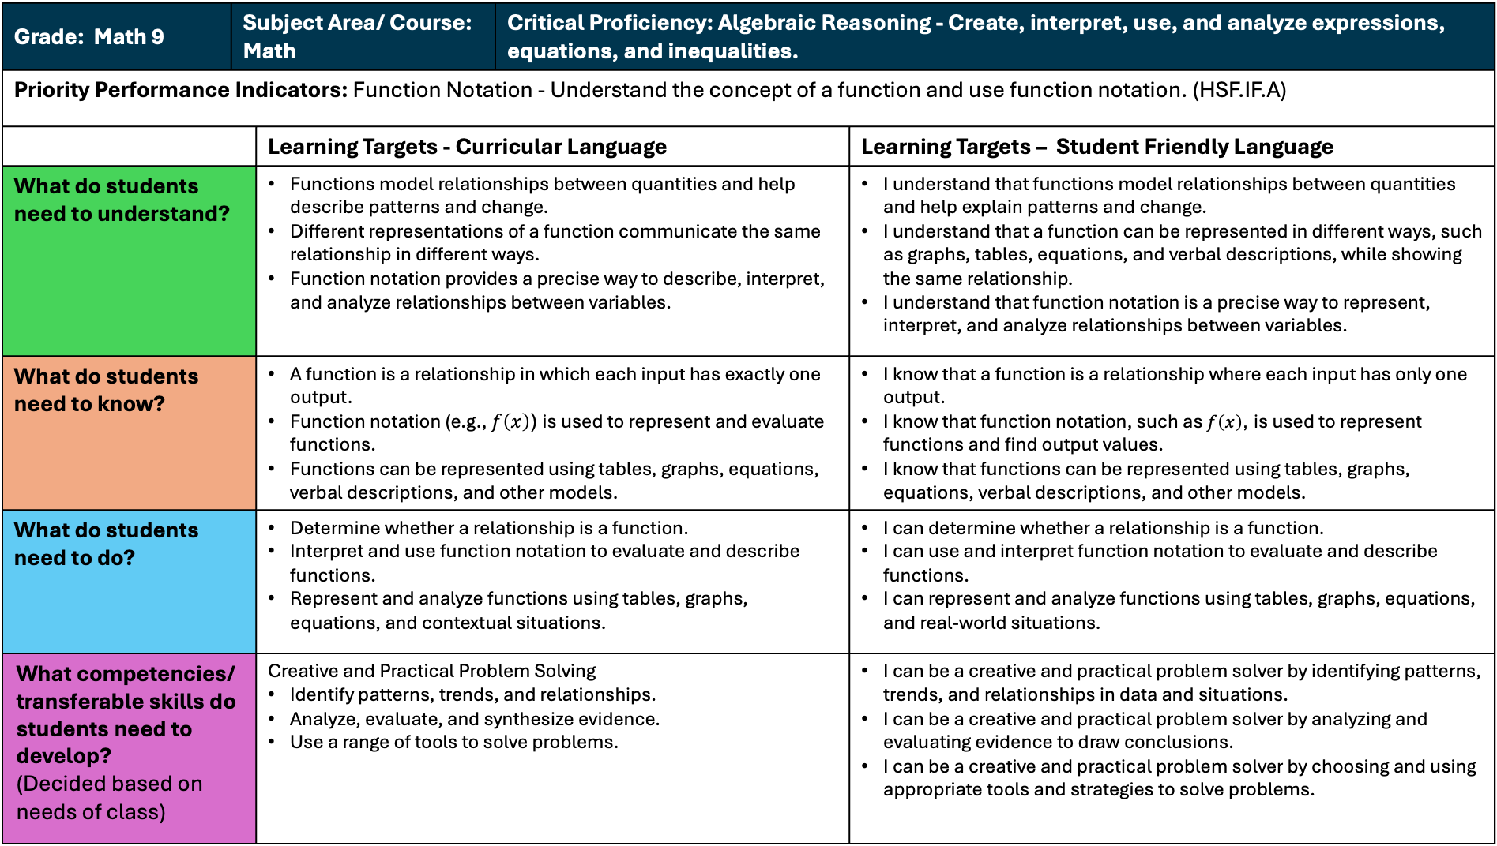
Grade: Math 9 | Subject Area/ Course: Math |  | Critical Proficiency: Algebraic Reasoning - Create, interpret, use, and analyze expressions, equations, and inequalities.
Priority Performance Indicators: Function Notation - Understand the concept of a function and use function notation. (HSF.IF.A)
 | Learning Targets - Curricular Language | Learning Targets - Curricular Language |  | Learning Targets – Student Friendly Language
What do students need to understand? | Cause-and-effect relationships help explain why some organisms survive better than others in a particular environment. The characteristics of a habitat influence which organisms can live there successfully. When environmental conditions change, the populations of plants and animals in a habitat may change as well. | Functions model relationships between quantities and help describe patterns and change. Different representations of a function communicate the same relationship in different ways. Function notation provides a precise way to describe, interpret, and analyze relationships between variables. |  | I understand that functions model relationships between quantities and help explain patterns and change. I understand that a function can be represented in different ways, such as graphs, tables, equations, and verbal descriptions, while showing the same relationship. I understand that function notation is a precise way to represent, interpret, and analyze relationships between variables.
What do students need to know? | Habitats provide the resources organisms need to survive. Different organisms have different traits that affect their ability to survive in a habitat. Environmental changes can affect which plants and animals can survive in a habitat. | A function is a relationship in which each input has exactly one output. Function notation (e.g., $f\left(x\right)$) is used to represent and evaluate functions. Functions can be represented using tables, graphs, equations, verbal descriptions, and other models. |  | I know that a function is a relationship where each input has only one output. I know that function notation, such as $f\left(x\right)$, is used to represent functions and find output values. I know that functions can be represented using tables, graphs, equations, verbal descriptions, and other models.
What do students need to do? | Use evidence from observations, texts, data, or models to explain organism survival in a habitat. Construct arguments supported by evidence about why some organisms survive better than others. Make and support claims about how environmental changes may affect plants and animals in a habitat. | Determine whether a relationship is a function. Interpret and use function notation to evaluate and describe functions. Represent and analyze functions using tables, graphs, equations, and contextual situations. |  | I can determine whether a relationship is a function. I can use and interpret function notation to evaluate and describe functions. I can represent and analyze functions using tables, graphs, equations, and real-world situations.
What competencies/ transferable skills do students need to develop? (Decided based on needs of class) | Informed and Integrative Thinking Analyze, evaluate, and synthesize information from multiple sources. Use evidence and reasoning to justify claims | Creative and Practical Problem Solving Identify patterns, trends, and relationships. Analyze, evaluate, and synthesize evidence. Use a range of tools to solve problems. |  | I can be a creative and practical problem solver by identifying patterns, trends, and relationships in data and situations. I can be a creative and practical problem solver by analyzing and evaluating evidence to draw conclusions. I can be a creative and practical problem solver by choosing and using appropriate tools and strategies to solve problems.

Slide 2
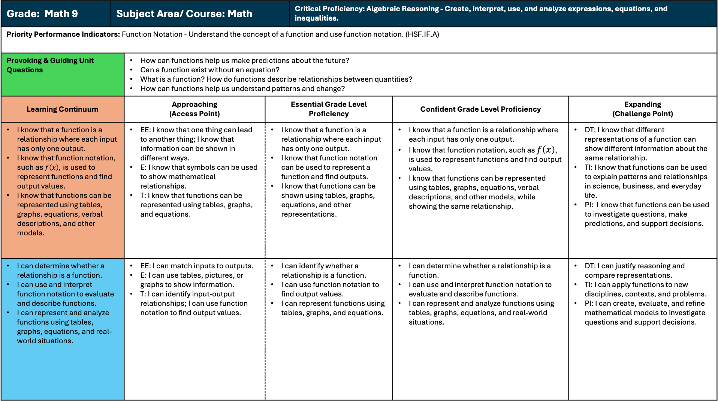
Grade: Math 9 | Subject Area/ Course: Math |  |  | Critical Proficiency: Algebraic Reasoning - Create, interpret, use, and analyze expressions, equations, and inequalities.
Priority Performance Indicators: Function Notation - Understand the concept of a function and use function notation. (HSF.IF.A)
Provoking & Guiding Unit Questions | I understand that reading words correctly helps me understand what I am reading. I understand that word parts can give clues about how a word sounds and what it means. I understand that fluent readers can spend more time thinking about the meaning of a text. | How can functions help us make predictions about the future? Can a function exist without an equation? What is a function? How do functions describe relationships between quantities? How can functions help us understand patterns and change?
Learning Continuum | Approaching (Access Point) | Approaching (Access Point) | Essential Grade Level Proficiency |  | Confident Grade Level Proficiency | Expanding (Challenge Point)
I know that a function is a relationship where each input has only one output. I know that function notation, such as $f\left(x\right)$, is used to represent functions and find output values. I know that functions can be represented using tables, graphs, equations, verbal descriptions, and other models. |  | EE: I know that one thing can lead to another thing; I know that information can be shown in different ways. E: I know that symbols can be used to show mathematical relationships. T: I know that functions can be represented using tables, graphs, and equations. | I know that a function is a relationship where each input has only one output. I know that function notation can be used to represent a function and find outputs. I know that functions can be shown using tables, graphs, equations, and other representations. | I know that letter patterns help me read unfamiliar words. I know that syllables can help me break apart longer words. I know that word parts can help me figure out unfamiliar words. I know that fluent readers read words correctly. I know that reading words accurately helps me understand what I read. | I know that a function is a relationship where each input has only one output. I know that function notation, such as $f\left(x\right)$, is used to represent functions and find output values. I know that functions can be represented using tables, graphs, equations, verbal descriptions, and other models, while showing the same relationship. | DT: I know that different representations of a function can show different information about the same relationship. TI: I know that functions can be used to explain patterns and relationships in science, business, and everyday life. PI: I know that functions can be used to investigate questions, make predictions, and support decisions.
I can determine whether a relationship is a function. I can use and interpret function notation to evaluate and describe functions. I can represent and analyze functions using tables, graphs, equations, and real-world situations. |  | EE: I can match inputs to outputs. E: I can use tables, pictures, or graphs to show information. T: I can identify input-output relationships; I can use function notation to find output values. | I can identify whether a relationship is a function. I can use function notation to find output values. I can represent functions using tables, graphs, and equations. | I can use letter-sound patterns to read unfamiliar words. I can break longer words into syllables to help me read them. I can read grade-level text I can use common word parts to help me read unfamiliar words. I can use simple context clues to help me understand unfamiliar words. | I can determine whether a relationship is a function. I can use and interpret function notation to evaluate and describe functions. I can represent and analyze functions using tables, graphs, equations, and real-world situations. | DT: I can justify reasoning and compare representations. TI: I can apply functions to new disciplines, contexts, and problems. PI: I can create, evaluate, and refine mathematical models to investigate questions and support decisions.

